Slide 1
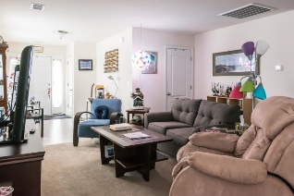
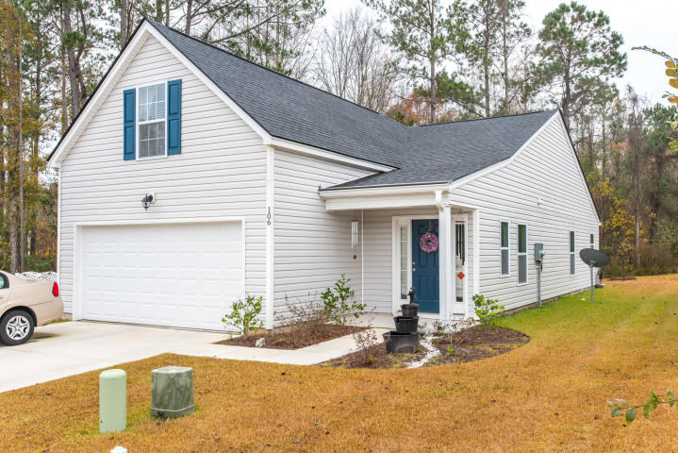
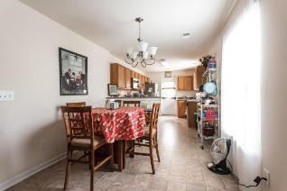
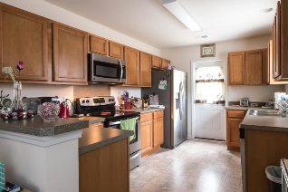
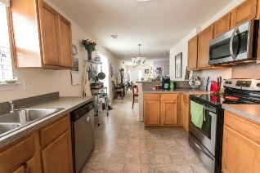
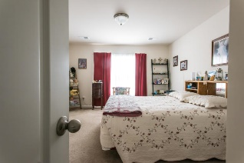
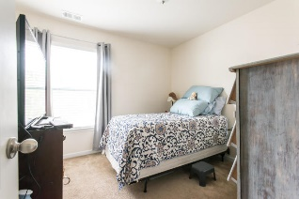
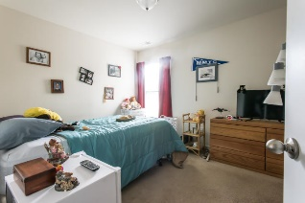
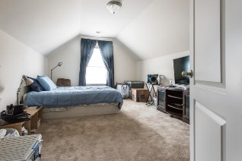
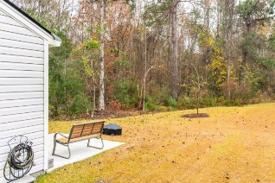


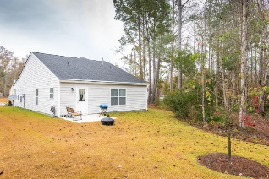
106 Runnels Cove Lakes of Summerville MLS# 18033119 ~ $228,000
$500 Agent Bonus!
This is the Ashton Floor Plan that boasts a spacious one story home. However, this home also includes a large frog which adds an extra bedroom or an office or another living room or man cave. The floor plan is very open and has a nice sized laundry room, a lovely kitchen with tons of counter space and also a breakfast area which is located just off of the family room. The master bedroom is located in the back of the home for extra privacy and has a large en suite bathroom and walk in closet. There are two other bedrooms on the first floor and then the frog; which is located down the hall and up the stairs from the two extra bedrooms. This home is just a little over a year old and includes blinds throughout the home and comes complete with all appliances including the washer and dryer and the fridge. There is a large two car garage just off of the laundry room as well. The best part of this particular home is the lot. It sits next to a protected wooded area so there are no neighbors on the left side of the home. It also backs up to a nice green space so you are not looking directly out at your neighbors. Its also on a large cul-de-sac that has a community volleyball court. Sellers are motivated and ready to sell!
Carey Nikonchuk
(843) 276-1701 M
cnikonchuk@gmail.com
www.palmettoproperty.net

