Slide 1
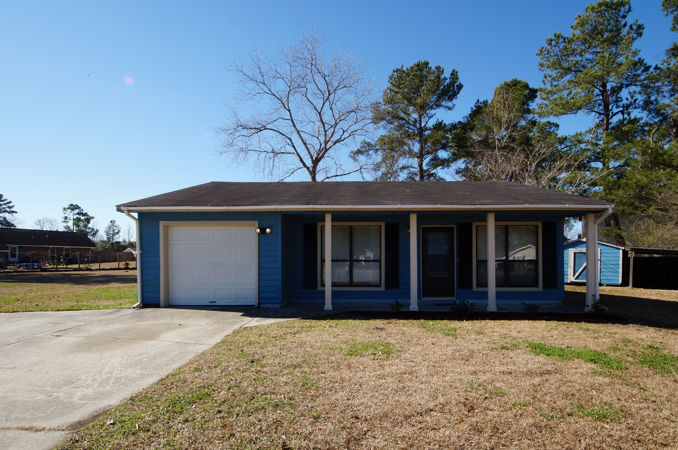
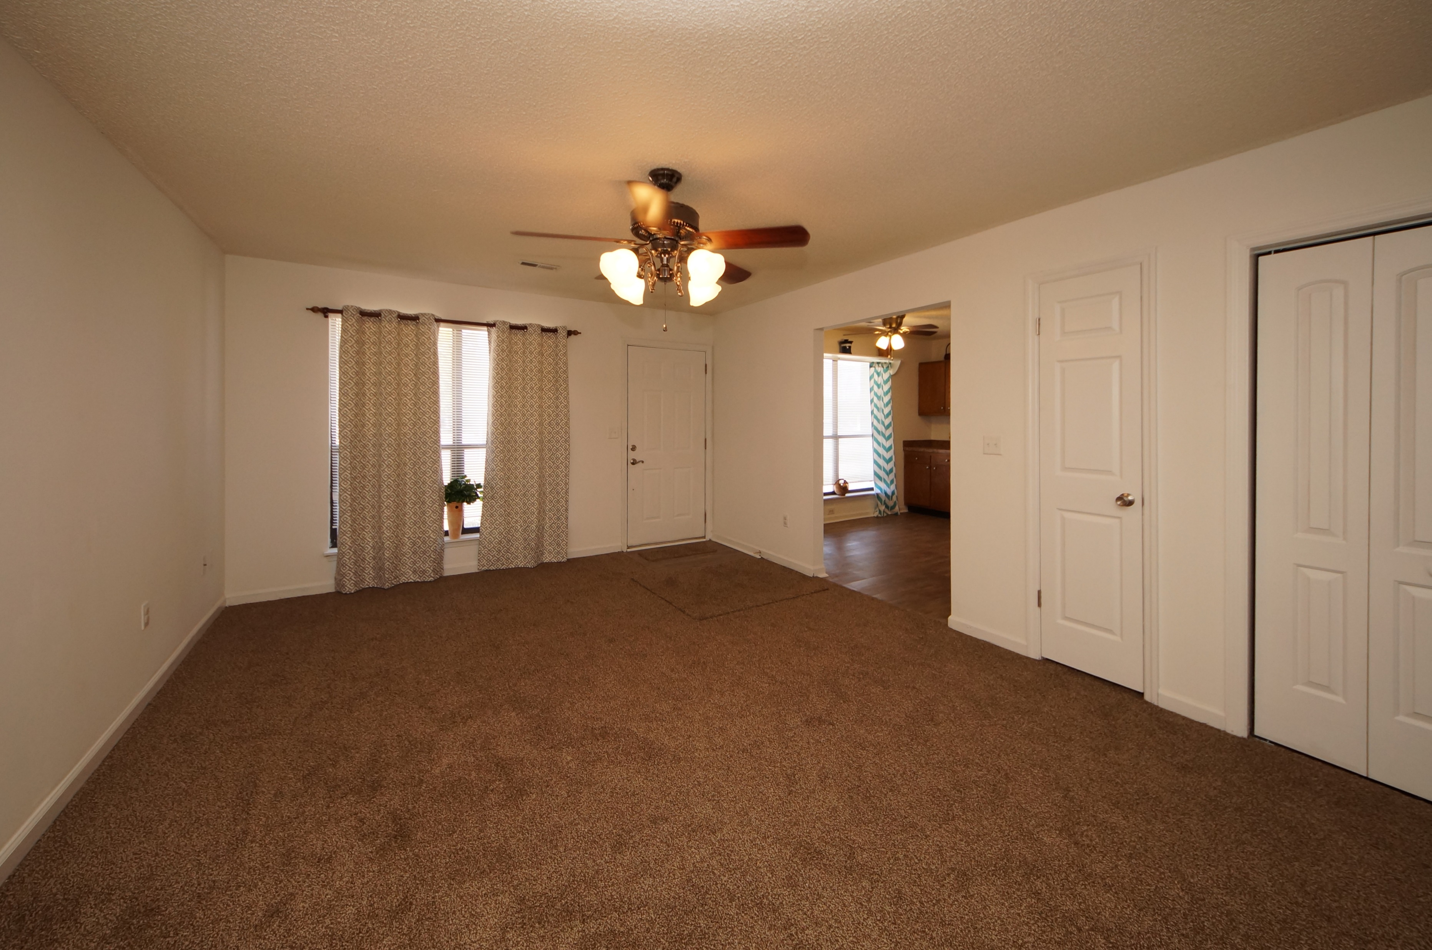
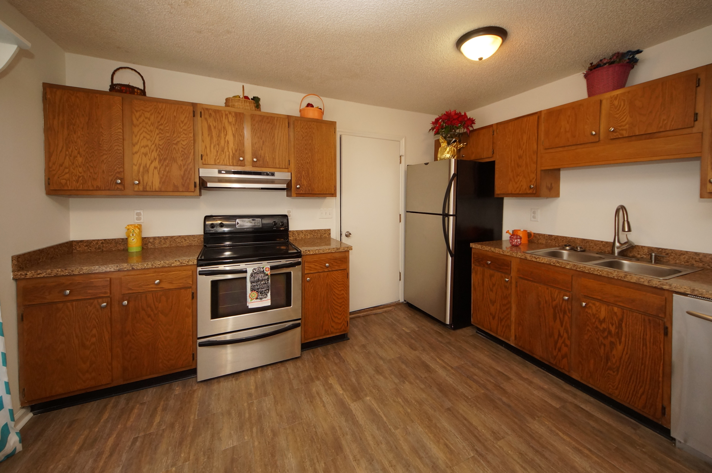
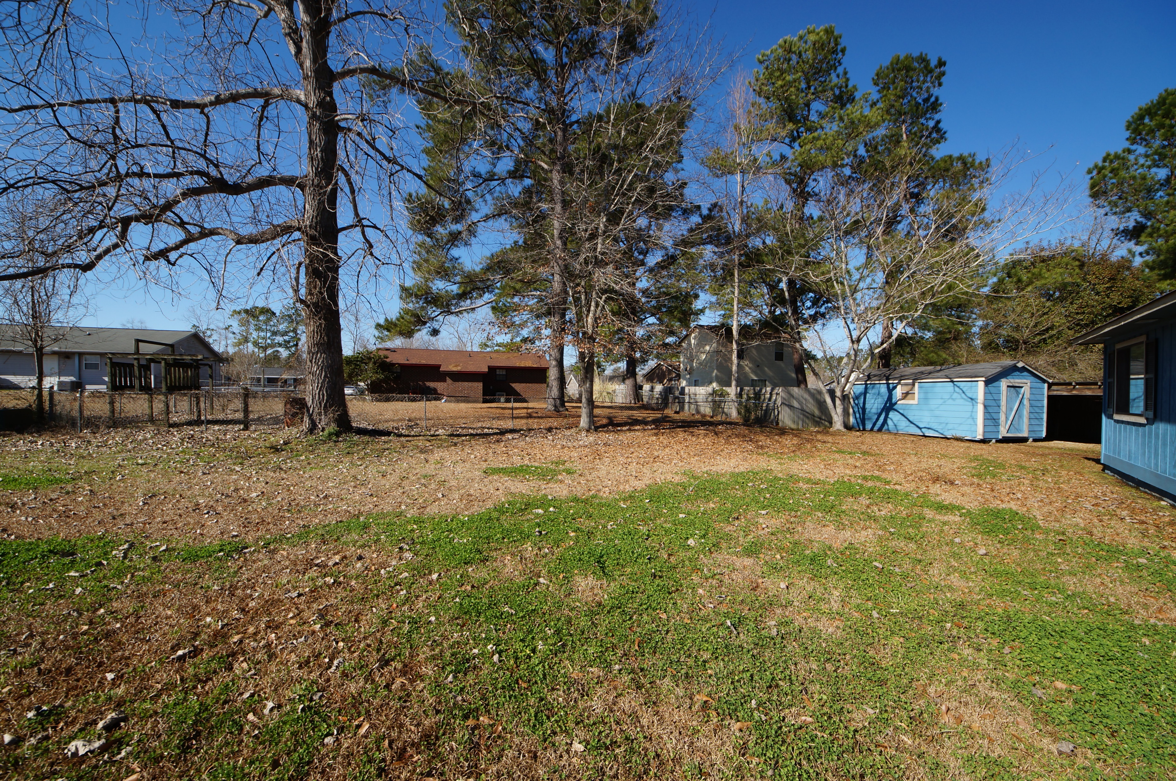


106 Sapling Court
Conifer Hall :: Moncks Corner, SC 29461
MLS# 18002533 :: $149,900
3 Bed / 1 Bath
Loaded With Updates! No HOA!
Just Reduced
New, Clean, and Modern is the theme of this move in ready home!
New list of items include AC Unit, Kitchen Tile, Interior Paint, Screen Door, Ceiling Fans, Interior Doors, WiFi Thermostat, Fixtures, Garbage Disposal and Blinds. Hot water heater is one year old, stainless appliances are less than 3 years old and the roof was installed in 2001.
We are ready for a new owner for this 3 bedroom home and no HOA!
Connie White, Broker
843-532-3356
conniesyouragent@gmail.com
Charleston Homes · 597 Old Mt. Holly Road · Suite 301 · Goose Creek, SC 29445

