Slide 1
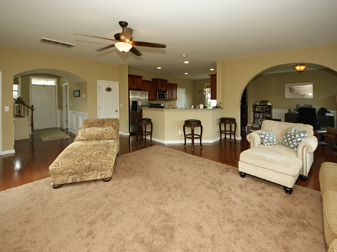
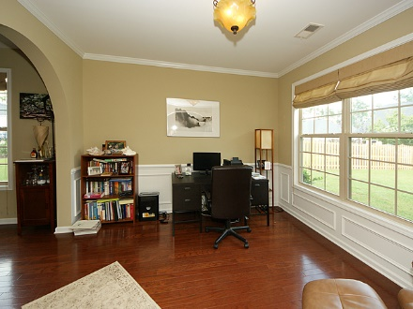
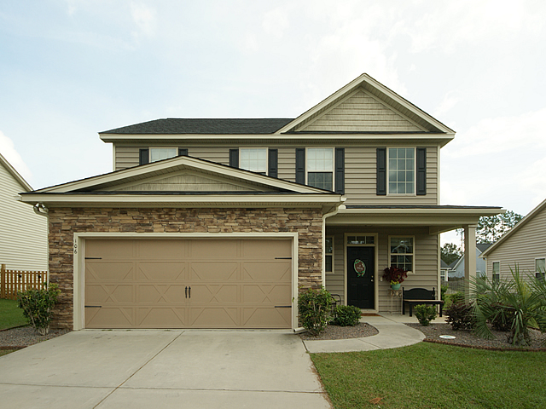
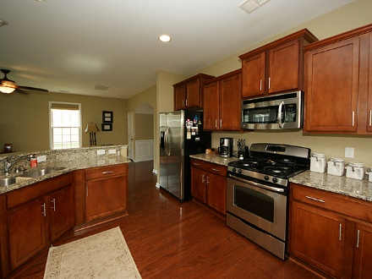
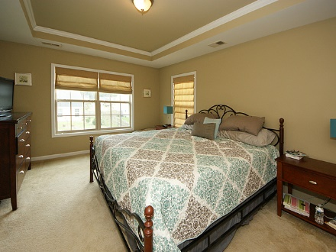
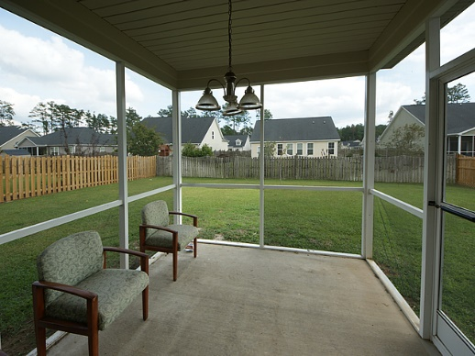
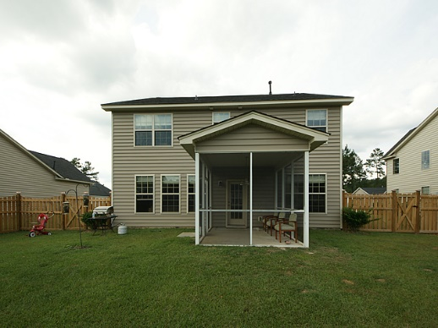
Like-New Home in Desirable Neighborhood
106 Torrey Pines Dr
Pine Forest Country Club
Summerville
MLS# 16026869
$264,900
4 Bedroom ~ 2½ Baths
2,178 Square Feet
Welcome to 106 Torrey Pines Drive located in the very desirable Pine Forest Country Club. It will be hard not to fall in love with this immaculate home. Enter this home to stunning hardwood floors throughout the first floor. Open floor plan offers great space for entertaining. Custom kitchen cabinets, granite countertops and stainless steel GE appliances make this kitchen really pop. Tons of cabinet space and large pantry. Enter the dining room thru a beautiful archway bringing lots of character to the home. Large living room offers tons of natural light. Master bedroom has beautiful tray ceilings with crown molding and large walk in closet. Master bathroom offers stand up shower and separate garden tub. Three secondary bedrooms are also found upstairs and offer plenty of room. You will find beautiful roman shades throughout. Admire the beautiful solar lights surrounding the newly installed fence. Enjoy the beautiful brisk fall air, sipping your coffee on this amazing screened in porch. Low maintenance flowerbeds offer grey stone and easily maintained shrubs. Pine Forest Country Club offers low HOA fees but still gives you the ability to join the country club which offer a clubhouse, swimming pool, tennis courts and golf. Best of both worlds!
Jennifer Laffey-Foster, MRP
Real Estate Agent
Miler Properties
Office: 843-821-1111
Cell: 843-708-1582
jlfoster86@gmail.com
www.milerproperties.com

