Slide 1
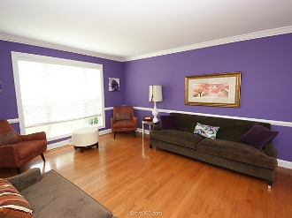
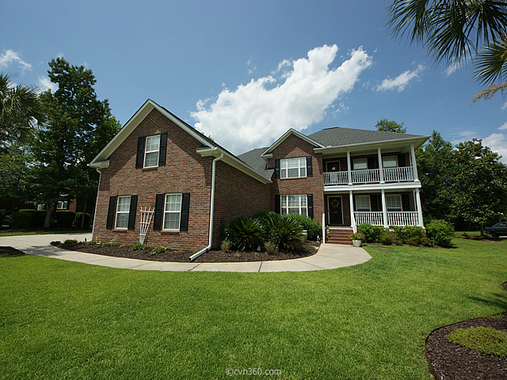
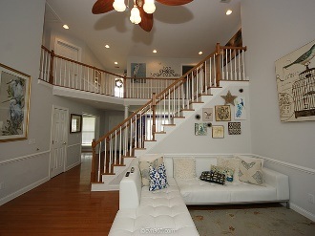
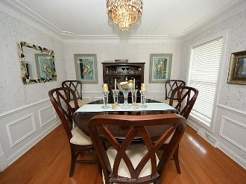
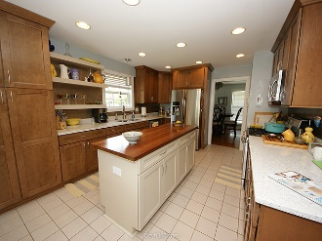
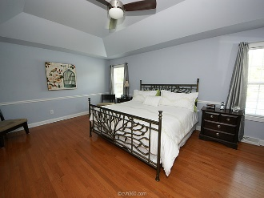
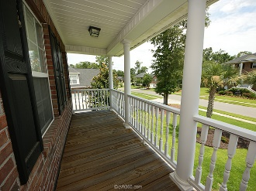
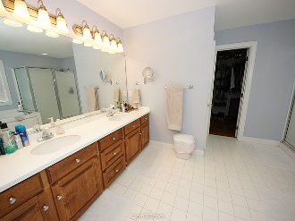
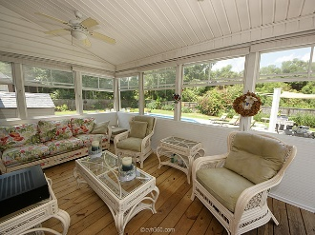
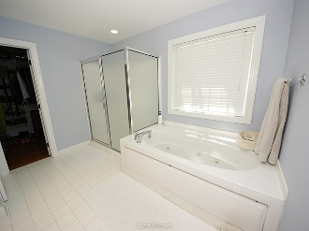
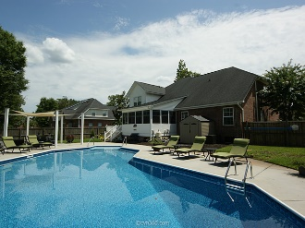


$1,000 Agent Bonus For Ratified Contract in September!
106 Welchman Avenue
Crowfield Plantation · Goose Creek MLS# 15019047 · $450,000
Take a look at this immaculately maintained brick home with double piazzas and a three car garage in the gated section of The Hamlets at Crowfield Plantation! This beautiful 5 bedroom home boasts an exceptional open floor plan with high ceilings, master on the main level, and a HUGE bonus room with a pool table that conveys! The kitchen has been tastefully updated with soft-close cabinets/drawers, John Boos & Co walnut butcher block island, and eco-friendly counters made from recycled glass and bottles! Hardwood floors can also be found throughout the entire home, aside from the upstairs bedrooms. A gorgeous 4-season porch overlooks your backyard oasis, which includes a deck, six foot privacy fence, 35,000 gallon in-ground saltwater pool, and covered patio area to protect you from the sun!
Arek Manakyan
Cell (843) 640-9395
kamanakyan@kw.com
Keller Williams Realty Charleston | 496 Bramson Ct, Suite 200 | Mt Pleasant, SC 29464

