Slide 1
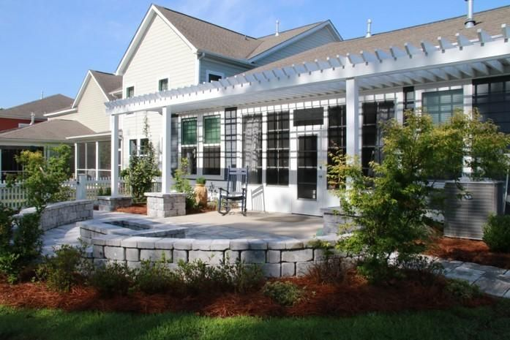
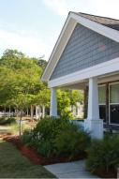
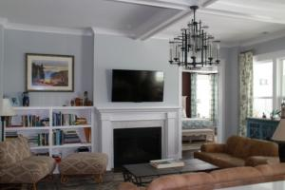
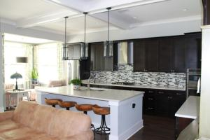
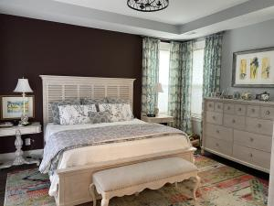
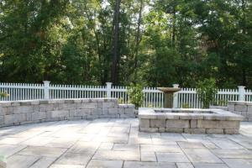
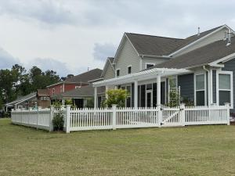
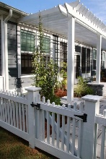
106 Headwaters Drive The Ponds | Summerville, SC 29483 MLS# 21012518 | $438,000
Beautifully
Landscaped
The seller is an artist and master gardener. Her talents are creatively displayed though out the landscaping, fencing, stonework, and special touches. All of these enhancements set this property apart from the others. Upon entering the home, the eye is drawn through the gracious entry to the garden. Enjoy the surrounding ambiance of the pond and fountain. This property is conveniently located.
Please call Judy for a showing at 843-708-1781.
Edy Mimms 843-224-9507
mimms@sanddollarsc.com
Judy Ash 843-708-1781 | judy@judyash.com
Carolina Life Real Estate & Auctions LLC | 314 E Main St | Monks corner, SC 29461

