Slide 1
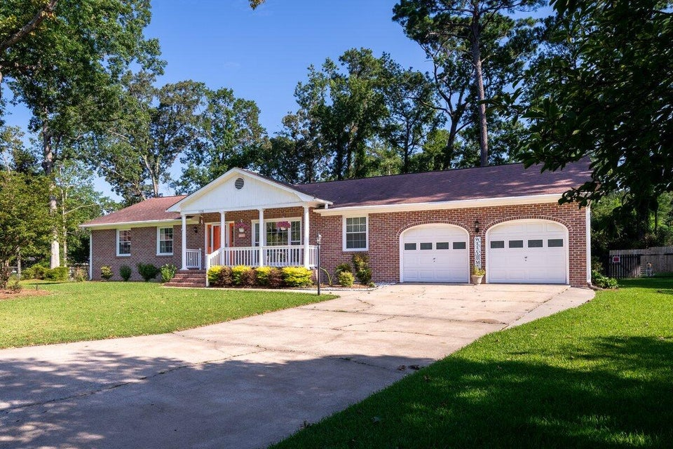
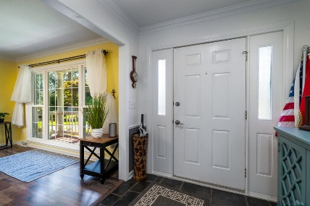
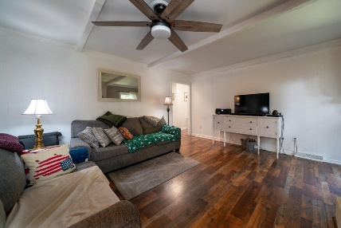
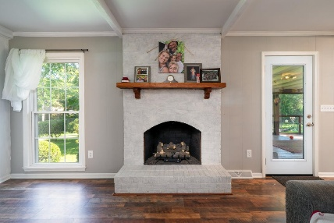
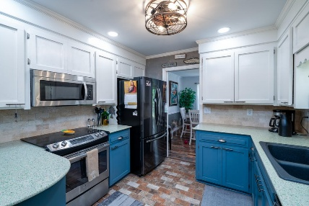
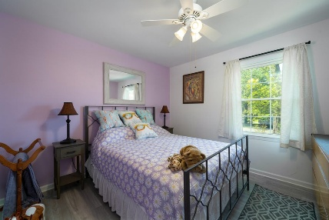
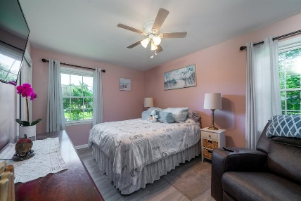
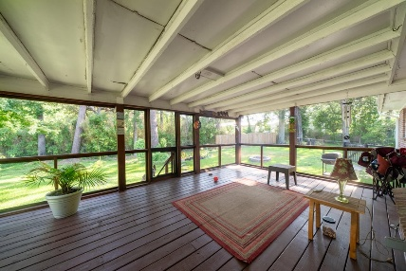


OPEN HOUSE THIS SATURDAY 12-3 PM
106 Labrador Court
Quail Arbor | Summerville, SC 29485 | MLS# 25017472 | $399,000
Wonderful brick ranch home on large lot at end of cul-de-sac! Great condition!
Back porch had new covering installed on July 7! Huge backyard with new storage shed, fountain, and fire pit. No carpet. All wood flooring and laminate. Interior painted within last 3 years. Kitchen was remodeled and painted 3 years ago. Primary bathroom has been updated and painted. Ceiling fans in every room! Conveniently located just a few minutes from downtown Summerville and just minutes from shopping and restaurants.
Erik Fender
843-830-7346
erik.fender@cbrealty.com
www.coldwellbankerhomes.com
Coldwell Banker Residential Brokerage
1127 Queensborough Blvd. 103
Mt Pleasant, SC 29464

