Slide 1
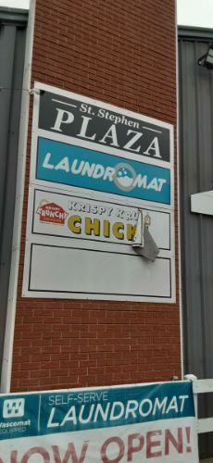
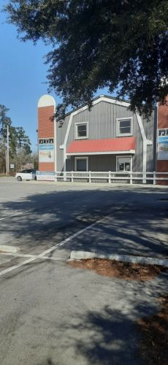
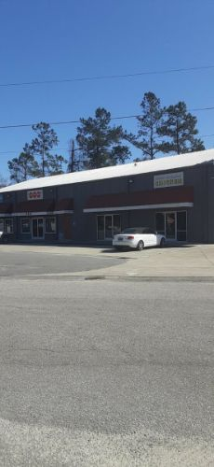
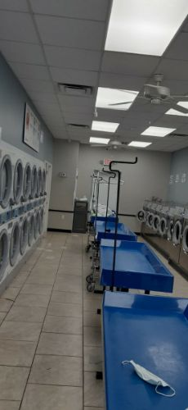
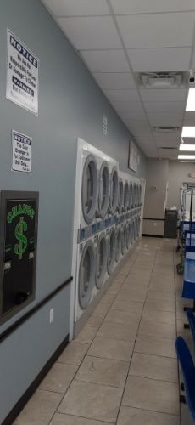
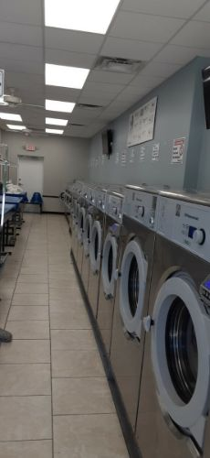
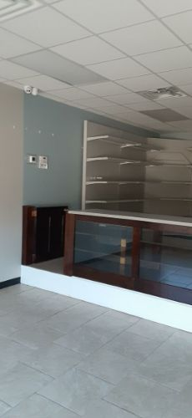
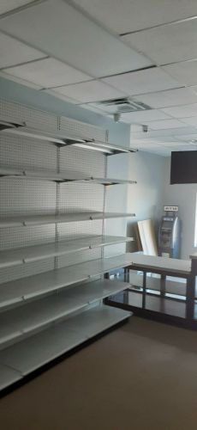
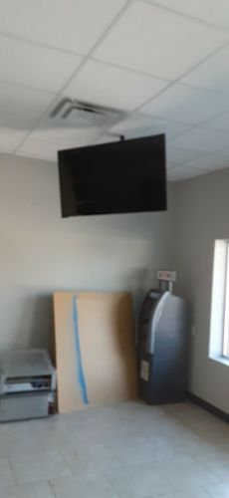
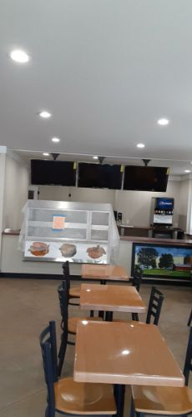
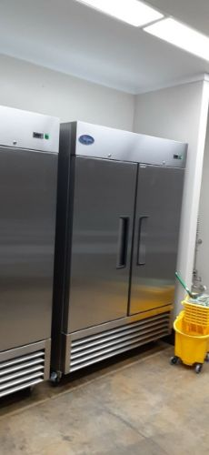
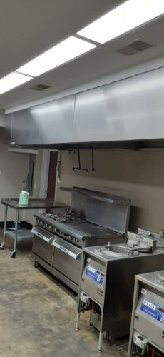
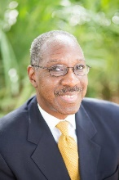
106 Martin Luther King Jr Blvd
Saint Stephen, SC, 29479
MLS# 30743596 · $1,100,000
Shopping Center/Strip Mall · 1.490 Acres
Great Investment Opportunity
This is a great investment opportunity or owner operator opportunity. There are three commercial units and one residential unit. The apartment has recently been rented along with the restaurant and the coin laundry is in full operation. The entire building has been completely renovated to be a coin laundry, liquor store, restaurant with a drive through window and a completely furnished two bedroom apartment. The coin laundry is a 1500 sf space, the liquor store is 1500 sf and the restaurant is 2000 sf all are ready for take over.
Lamar Holt
843-345-8374
lamar.holt@chscre.com
Commercial Specialty Group
3896 Leeds Ave Ste 100
N Charleston, SC 29405

