Slide 1
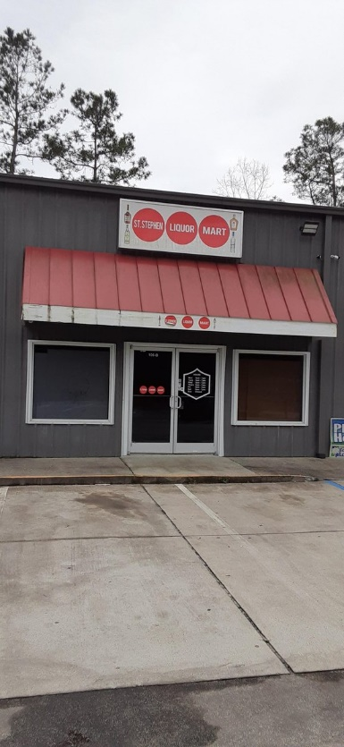
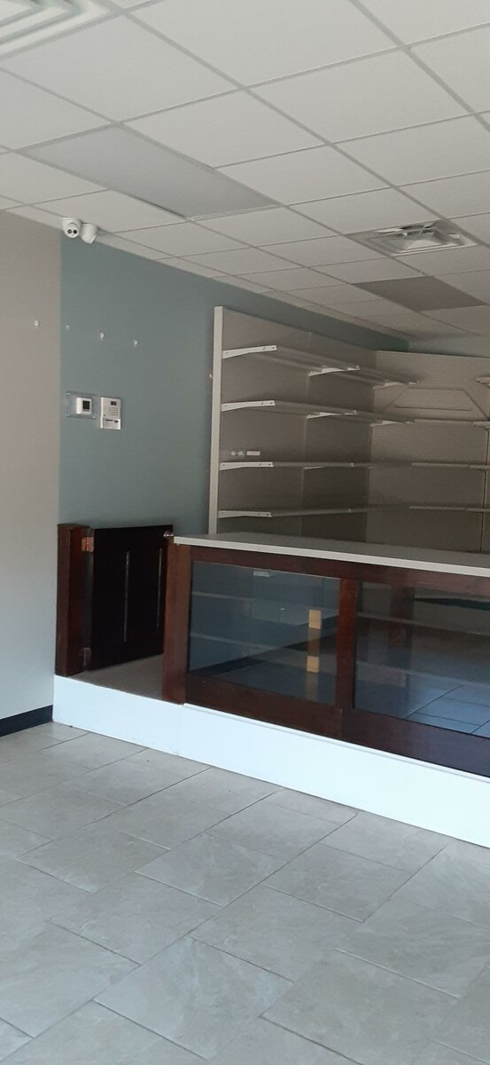
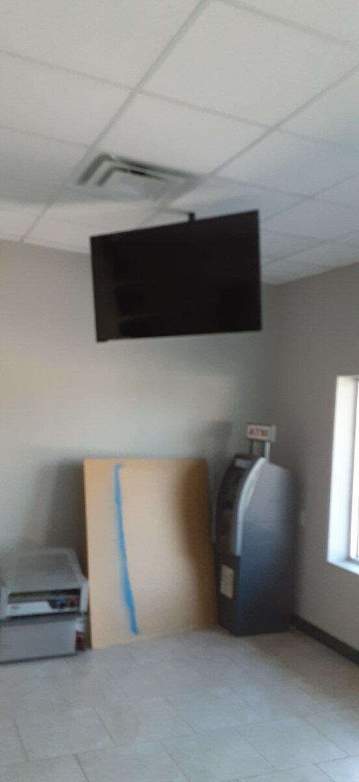
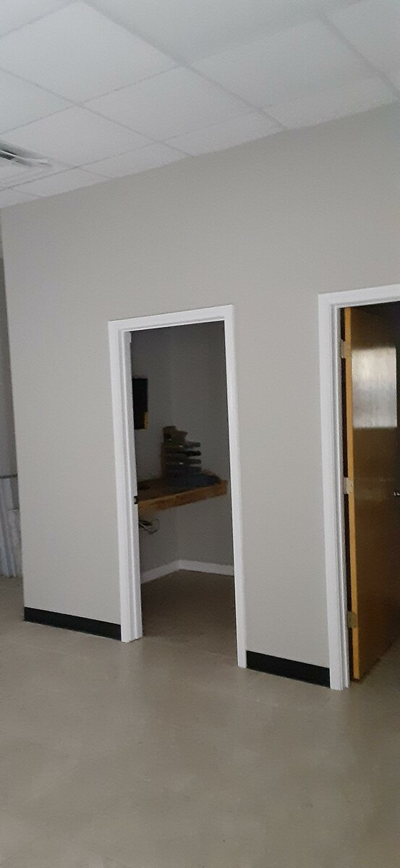
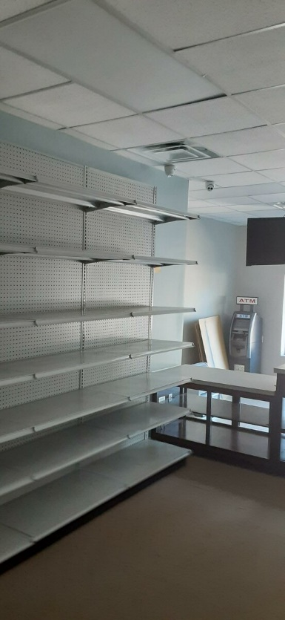

106 Martin Luther King Jr Blvd
Saint Stephen, SC, 29479
MLS# 30712268 · $1,400 (Monthly)
Saint Stephen Plaza · 1,500 SF
Great Store Front Opportunity
Saint Stephen Plaza located on the corner of M LK Blvd and Hwy 52 has a great opportunity for a serious investor looking to start a business or expand his franchise due to the low startup cost. Available is a 1500 sf space that was developed to be a liquor store. Everything in the store is new and ready for move in (Turn key ready), from the counters to the security cameras. All a tenant will need to start is their stock, licenses and insurances. The interior walls are not load bearing which gives this unit flexibility to be turned into something other than a liquor store. Owner is also offering two months tenant improvement allowance . An ATM machine will be left for tenants use.
Lamar Holt
843-345-8374
lamar.holt@chscre.com
Commercial Specialty Group
3896 Leeds Ave Ste 100
N Charleston, SC 29405

