Slide 1
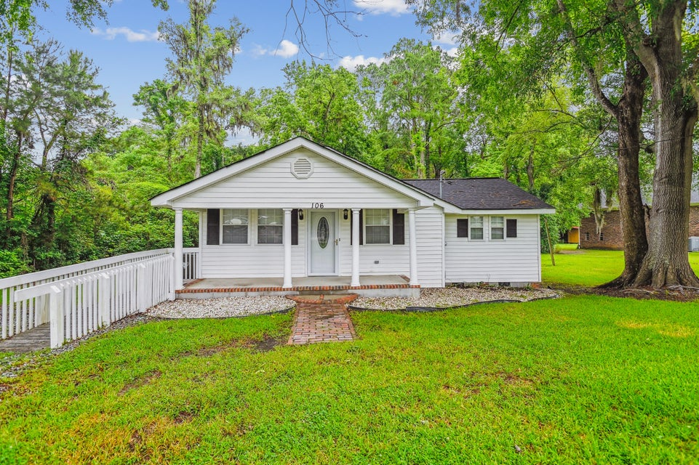
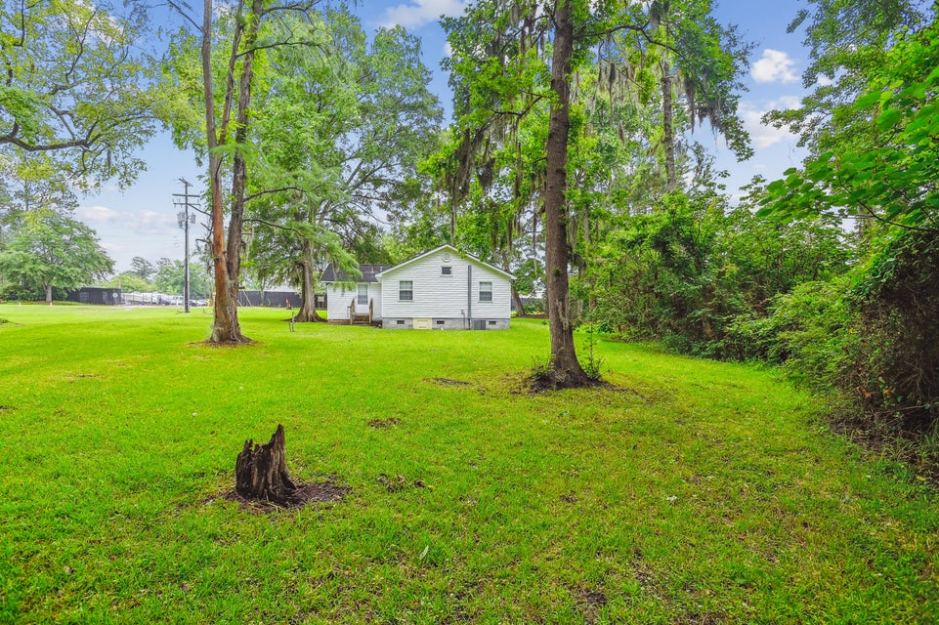
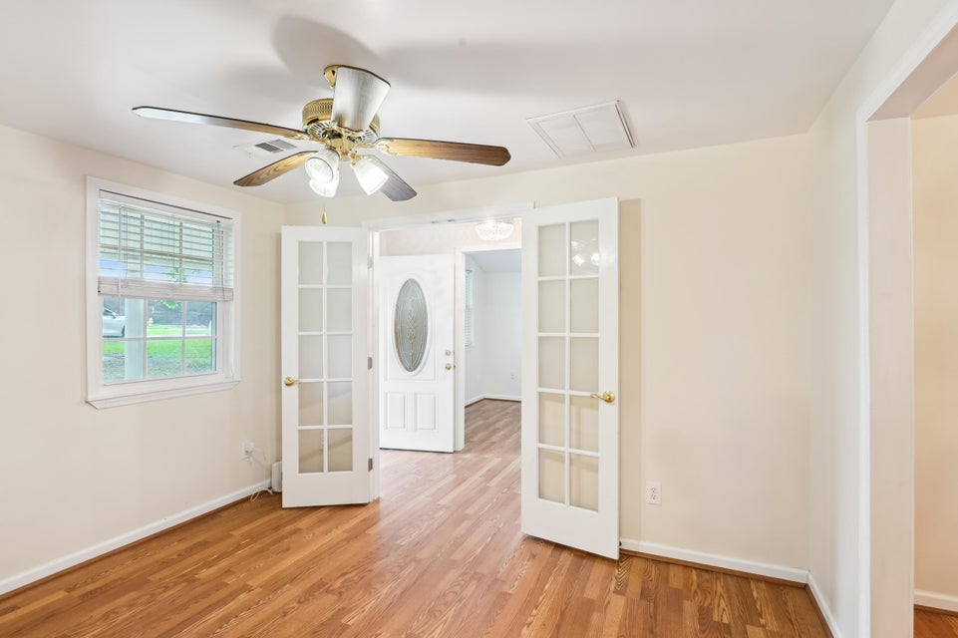
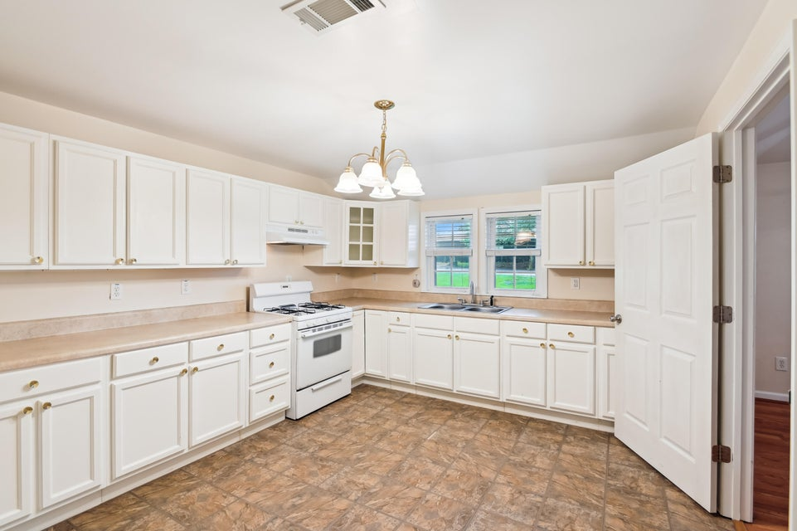
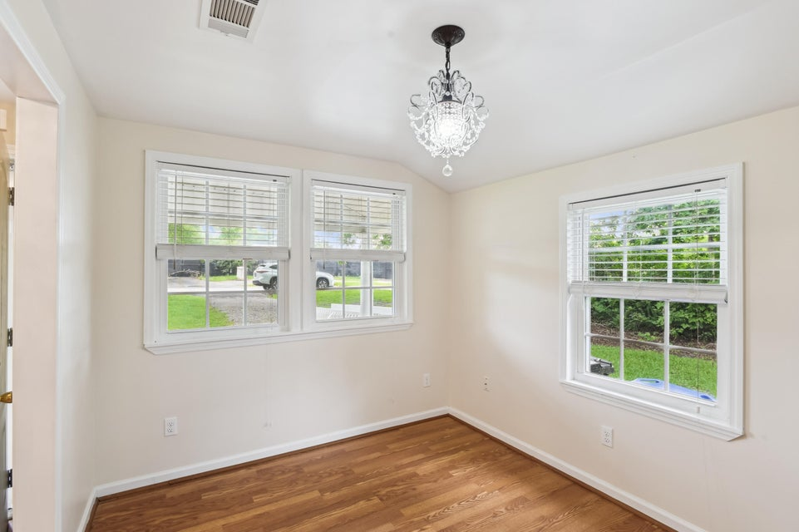
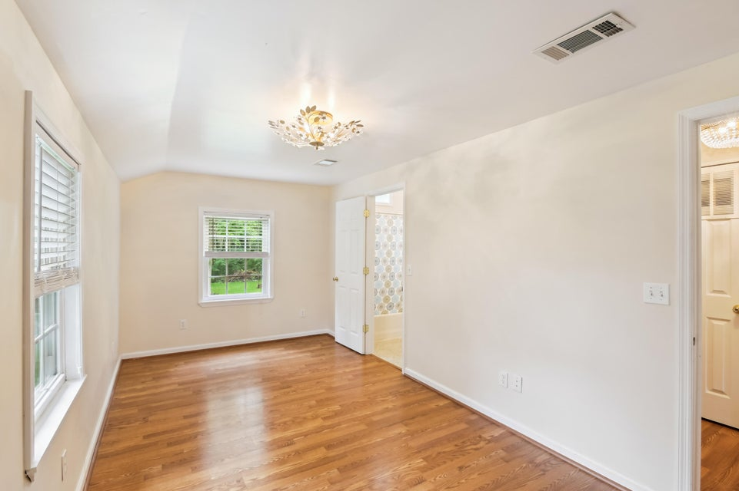


PRICE IMPROVEMENT-MOVE IN READY
PRIME DOWNTOWN SUMMERVILLE LOCATION - IDEAL FOR HOME OR OFFICE!
106 N PINE STREET
SUMMERVILLE, SC 29483 | MLS# 25014814 | $669,000
Don't miss this rare opportunity to own a beautifully updated property in the heart of downtown Summerville—perfectly suited as a charming residence or professional office space. Located just a short walk from popular restaurants, boutique shopping, and vibrant community events in Hutchinson Square, this location offers the ultimate blend of convenience and lifestyle. Remodeled in 2013, this home features durable LVP flooring, a spacious kitchen, and a fully encapsulated crawl space for added efficiency and peace of mind. Situated on a generous half-acre lot, the backyard offers privacy and tranquility with a natural border of mature trees—a rare find in the downtown area.
One of the spacious living rooms can be easily converted into a third bedroom with the simple addition of a wall closet unit-offering flexible living options to suit your needs.
Best of all, there's no HOA, giving you the freedom to truly make this property your own whether you're envisioning a cozy home or a unique office setup, this versatile space is ready to meet your needs.
Schedule your showing today and discover the possibilities this fantastic location has to offer!
David Hotchkiss
843-695-7015
davidhotchkissrealtor@gmail.com
davidhotchkiss.erawilderrealty.com
ERA Wilder Realty | 1282 State Rd | Summerville, SC 29486

