Slide 1
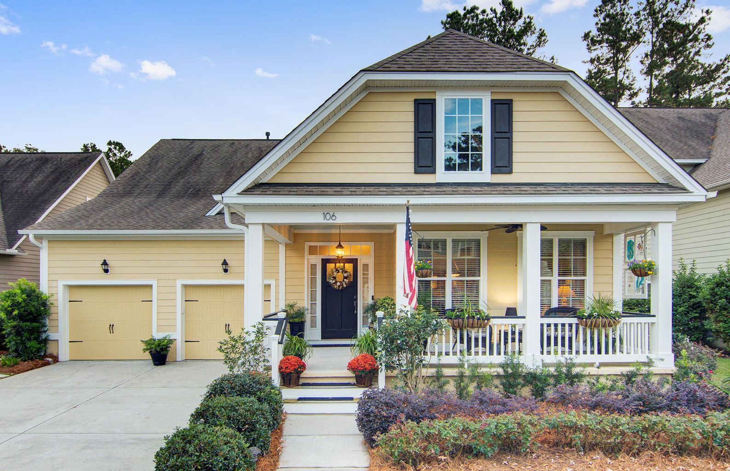
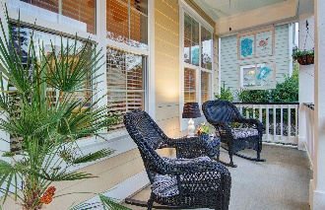
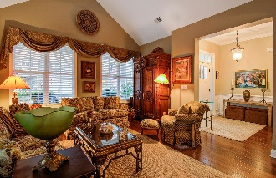
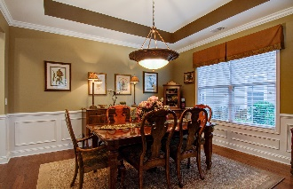
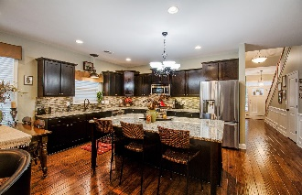
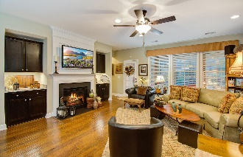
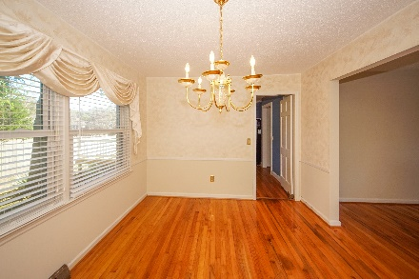

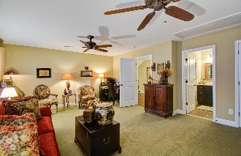
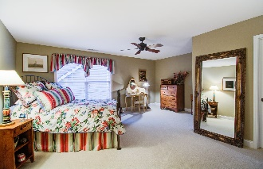
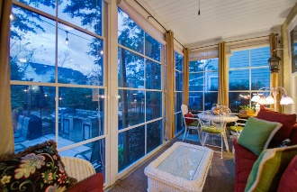
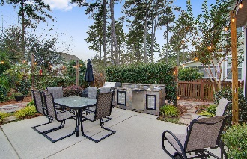


106 Ribbon Road The Ponds :: Summerville :: MLS# 21015099 :: $525,000
Can Accommodate A Quick Close
Master Up & Down
Just Listed!
Located on a quiet street within The Ponds, this picturesque home offers 4 bedrooms, 4 full baths, and an open layout with plenty of space for entertaining, both inside and out. A charming full front porch welcomes guests into the foyer, adjacent to the formal living and dining rooms. In the rear of the home is a spacious family room with a gas fireplace surrounded by beautiful built-in shelving with cabinets and granite countertops. Chat with family and guests as you prepare a meal in the gourmet kitchen, complete with a gorgeous custom backsplash, upgraded counters, stainless steel appliances, granite countertops, and a huge island with additional seating for entertaining. Beautiful hand-scraped hickory floors are featured throughout all the main living spaces, with tile in all 4 baths and the convenient downstairs laundry room.
Tucked away to the left is the owner's suite, boasting a large walk-in closet and a private bathroom with dual vanities, a garden tub, and a separate walk-in shower. Completing the 1st floor is another bedroom and a full bath, the perfect location for a home office or playroom. Wood stairs lead to the 2nd floor, where you will find two spacious bedrooms off a second-floor landing/loft area featuring upgraded hand-scraped hickory floors. Each room has its own full bath.
Last, but not least, is the very private backyard with a professionally designed $75,000+ garden sanctuary that creates the perfect environment for relaxation. Step out into the multifunctional 3-season room and enjoy your morning coffee or an evening cocktail as the sun sets over your secluded backyard sanctuary. The fully fenced yard includes a huge patio with an impressive outdoor kitchen and a custom-built bluestone walkway that winds throughout a plethora of year-round professional landscaping and flowers. Other noteworthy features of this amazing home include generous amounts of indoor storage space, a 2-car attached garage with shelved storage and epoxy floors, yard irrigation, and a recently painted neutral interior.
The Ponds offers residents a neighborhood pool, fishing pond, play parks, clubhouse, and a YMCA. Plus, it is in the award-winning Dorchester II school district and you will be just minutes away from historic downtown Summerville shopping and dining as well as Downtown Charleston and its beautiful beaches.
Seller is a licensed SC real estate agent.
Items included: Kitchen refrigerator, double oven, garbage disposal, lighting, ceiling fans, blinds on windows, Maytag energy efficient washer and dryer, laundry room cabinets, outdoor stone kitchen with refrigerator and sink, wire shelving in all closets and surrounding three sides of the garage.
https://my.matterport.com/show-mds?brand=1&m=bM1gTiB9NxC
Belita Shapiro
843-830-8105
belitashapiro@gmail.com · www.belitashapiro.com
Brand Name Real Estate · 4 Carriage Lane · Suite 106 · Charleston, SC 29407

