Slide 1
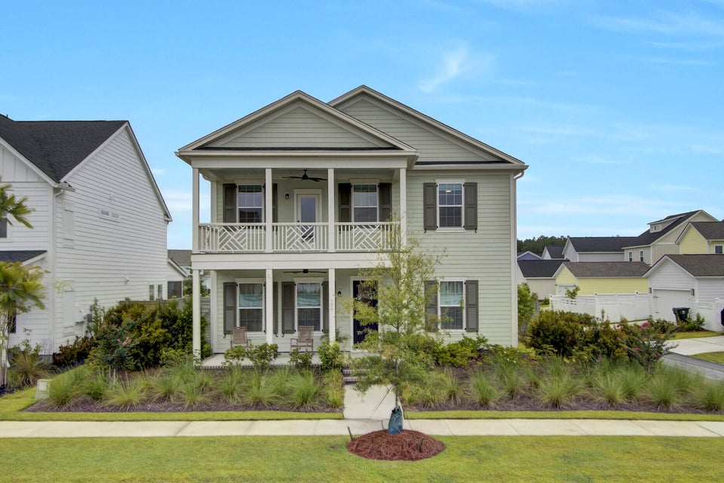
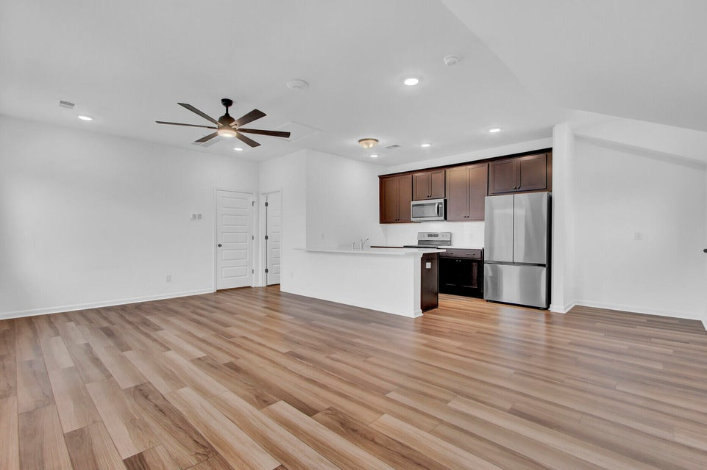
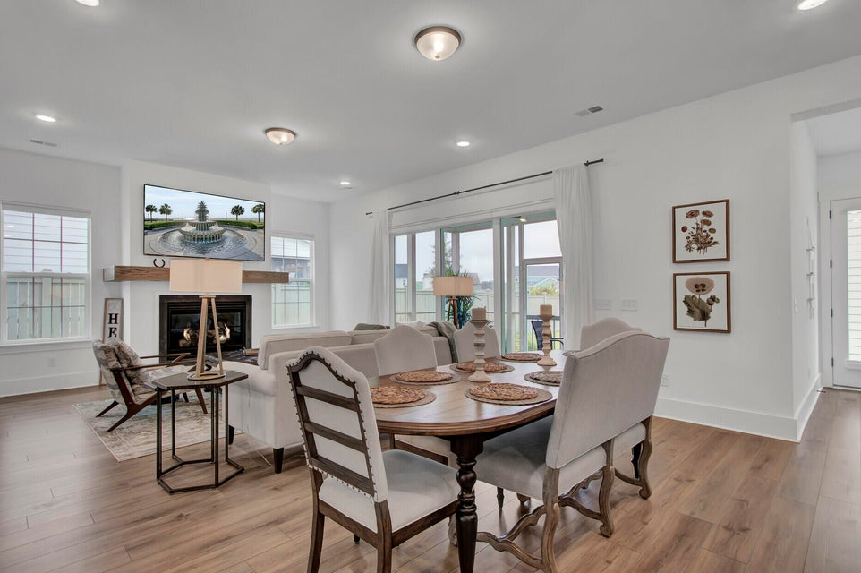
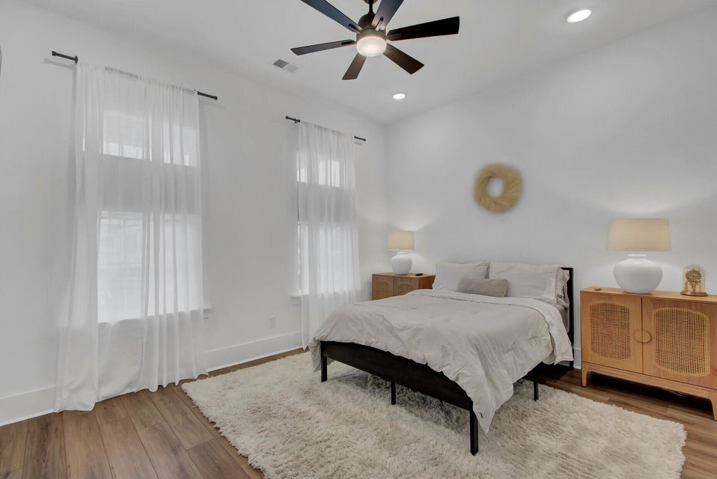
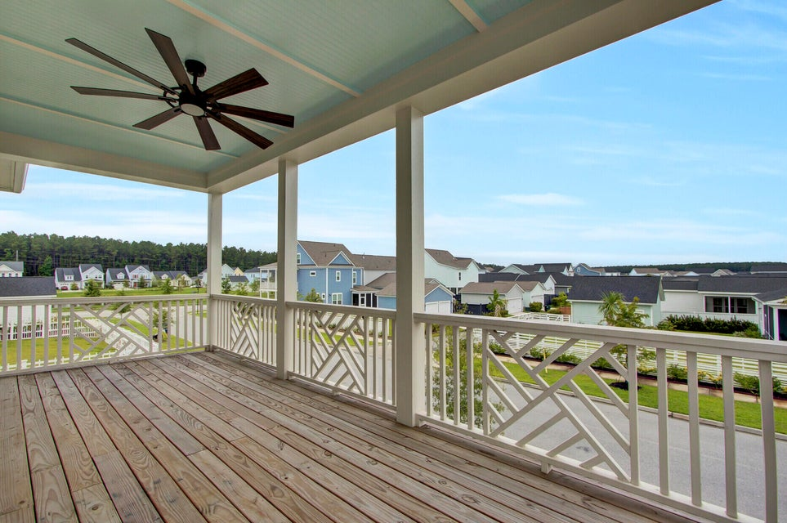
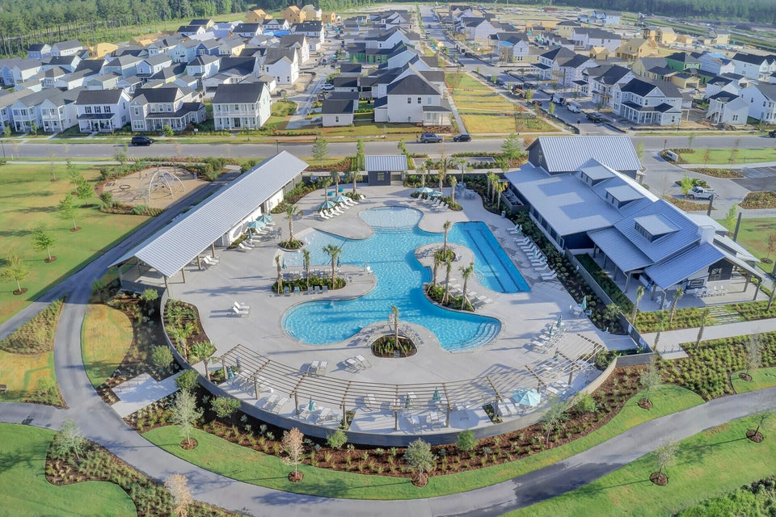

SELLER OFFERING 3% BAC
106 Sandy Bend Lane
Nexton | Summerville, SC 29486 | MLS# 24019937 | $849,500
Welcome to this exceptional residence, perfectly situated on a larger corner lot with dual pond views in a vibrant golf cart community. This home offers an exquisite blend of modern convenience and timeless elegance, ensuring a lifestyle of comfort and sophistication. The first floor includes a versatile guest room next to a full bathroom, making it ideal for visitors. The valet room features a built-in drop zone for added convenience. The home is thoughtfully designed with high-end finishes, including updated lighting, ceiling fans, and under-cabinet lighting throughout. Step outside from the spacious living area through a trio of sliding glass doors into an expansive screened-in back porch, which allows for indoor/outdoor living. The gourmet chef's kitchen is a culinary dream, boasting a pot filler with a backsplash that reaches the ceiling, top-of-the-line cabinets, a farm sink, and a butler's pantry with glass-front cabinets. The adjacent dining room and open living spaces are perfect for both everyday living and entertaining. Ascend to the second floor to discover a cozy loft with a window seat for extra storage and a second porch with views of a second pond. The primary suite is a retreat in itself, with an updated wood closet offering ample storage. The additional bedrooms and bathrooms on this level ensure plenty of space for family and guests.
Outside, the property shines with a fenced yard, irrigation system, and a detached 2.5-car garage with an apartment situated above featuring a full kitchen, laundry room, and a spacious closet. The garage is also equipped with a workbench and built-in storage shelves on both sides. This home is perfectly positioned within a thriving community that offers access to the Midtown Club amenity center, complete with a resort-style pool, multiple common areas, pickleball and tennis courts, a full gym, and a newly constructed track around a pond. Enjoy the nearby Brighton Park with its lap pool, expansive walking and biking trails, and disc golf. The under-construction middle school is within walking distance, and the newly built Harris Teeter is a convenient golf cart ride away.
For dining and entertainment, Nexton Square and the upcoming Nexton Downtown offer a wealth of options. Embrace the vibrant lifestyle and unmatched convenience of this stunning property...schedule your tour today and experience it for yourself!
Enjoy a Virtual Tour
Mike Galgano
631-871-3398
magest1969@gmail.com
ERA Wilder Realty Inc | 1282 State Rd | Summerville, SC 29486

