Slide 1
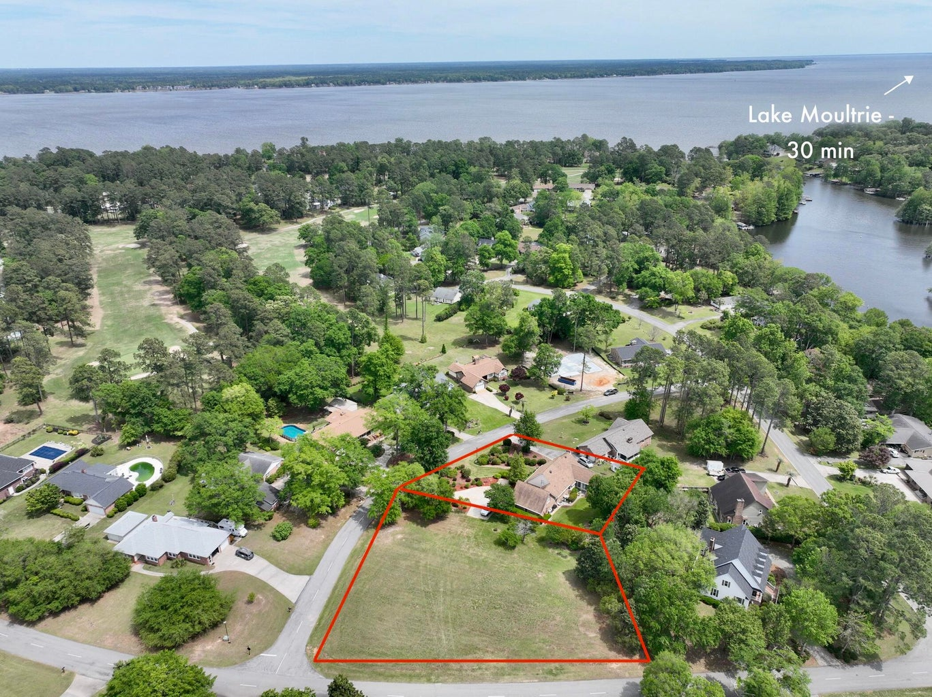
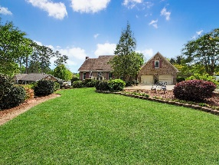
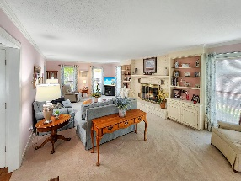
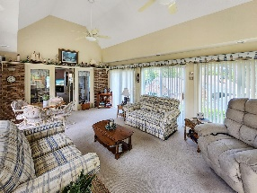
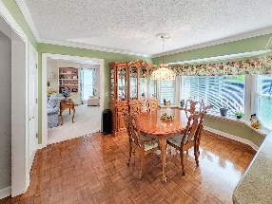
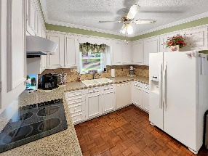
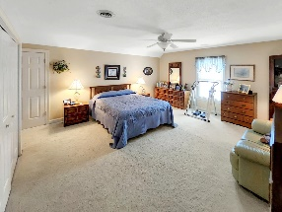
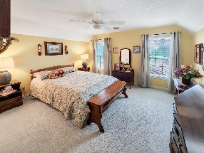
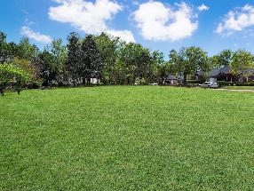
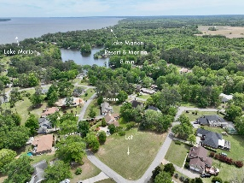

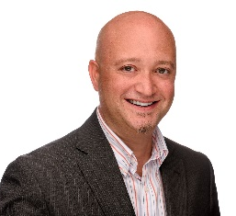
106 Santee Cooper Annex
Santee Cooper Resort | Santee, SC 29142
MLS# 23006980 | $425,000
Gorgeous Brick Home
In the Santee Cooper Resort!
Open House
Wednesday, 7/20
3-5PM
A wonderful brick ranch home with 3 bedrooms, and 3 full bathrooms in Santee Cooper Resort! 1.02 total acreage includes the lot the home sits on, and the lot next to it. This home is located just mins from Lake Marion with access to the boat docks. Approaching the home, you will immediately notice the manicured lawn and well cared for landscaping. Irrigation is installed to help care for this wonderful curb appeal. The home features a spacious foyer that leads to a light and bright kitchen which is sure to inspire any chef with its efficient layout. For casual meals, the eat-in kitchen offers a relaxed atmosphere. The gas fireplace in the family room sets the tone for coxy gatherings on chilly evenings. The large family room space lends to several options for furniture arrangement and great entertainment. If you love to bask in natural light, you'll definitely appreciate the high ceiling living room/sunroom with large windows and a sliding glass door that offers a gorgeous view of the back yard. The large master bedroom has its own private en-suite with a sink vanity and a walk in shower. Two additional generously sized bedrooms that share another full-sized bathroom is also included in this 2701 sq ft home. When you need some quiet time, the upstairs flex room is an excellent space for focusing on reading a book or indulging in your favorite hobbies. Overall, this is a fantastic property that is sure to impress. The Santee Cooper Resort, a gated residential golf community, is just outside the town of Santee, South Carolina. The Resort consists of almost 300 beautifully landscaped homes and quiet, low traffic streets. It not only includes one of the area's finest golf courses but is adjacent to another quality golf course as well. The Resort borders on Lake Marion and offers numerous amenities, including a swimming pool, clubhouse and marina. Schedule your showing today to see everything this home has to offer!
Brandon Ray
(843) 499-1928
brandon.ray@carolinaone.com
www.therightrayhome.com
Carolina One Real Estate
900 N Main St
Summerville, SC 29483

