Slide 1
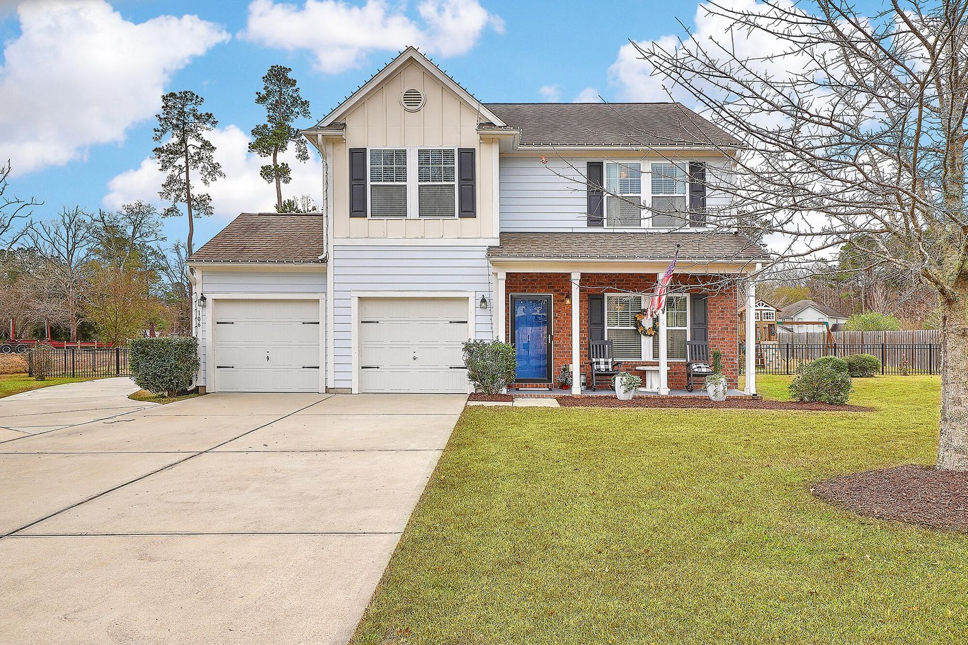
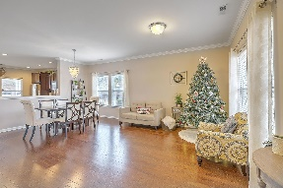
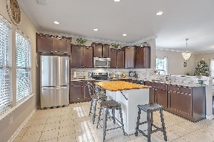
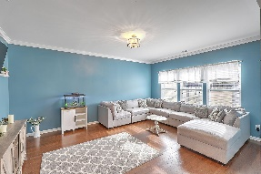
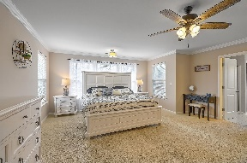
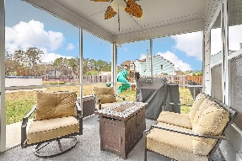
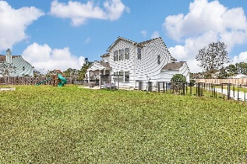
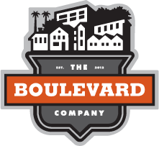

Custom Built Home With Plenty of Space
106 Scotland Drive
East Highland Acres ~ Summerville, SC 29483
MLS# 21032870 ~ $545,000
This 2013 custom built home, comes with nothing but the BEST!. Highland Estates is a unique development. There are only 15 homes all on a minimum of .60 up to 1.25 acre lots! Lots of space & only one road in that ends in a cul-de-sac. Located in the popular Dorchester District 2 (DD2) Schools. This This a great family friendly neighborhood! This home is the Proper Combination of Modern Style and Spacious Land... Cement Hardi-Pland Siding, and A overwhelmingly large lot .72 Acres. This lot is Fenced with a beautiful Black Aluminum, Also has Two Car Garage, Covered Front Porch and Screened in Back Porch for those Beautiful Summer Evenings. Above Ground Pool and Workshop.
Take a video tour: https://vimeo.com/659029434
Laura McLain
843-509-7647
laura@lauramclainrealty.com | www.theblvdcompany.com
The Boulevard Company, LLC | 806 Johnnie Dodds Blvd Ste 100 | Mt Pleasant, SC 29464

