Slide 1
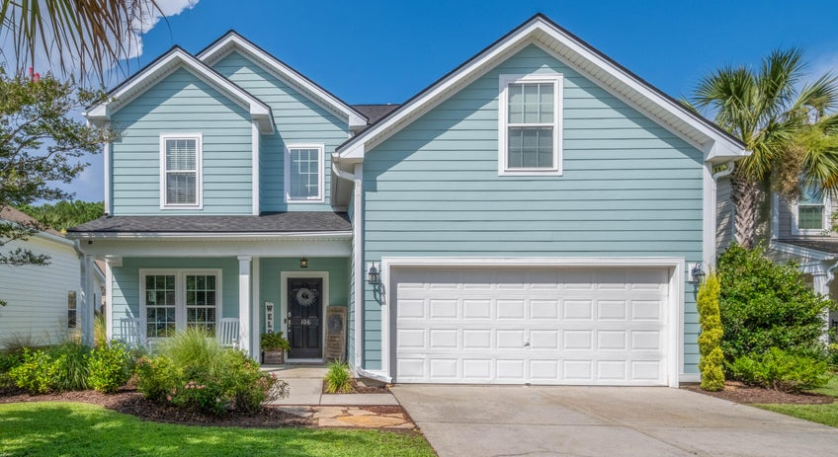
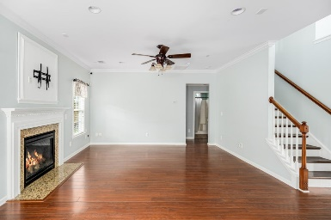
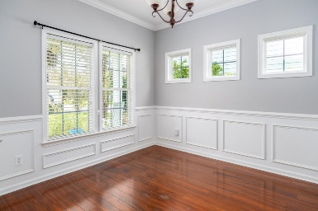
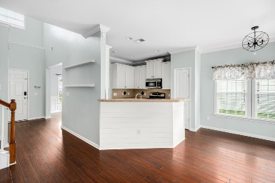
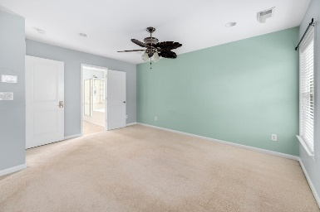
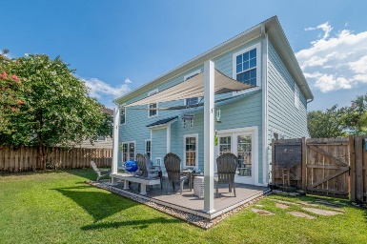


Open House Saturday 11-1 & Sunday 12-2
106 TEA FARM WAY
Nelliefield Plantation | Charleston, SC 29492 | MLS# 24016902 | $598,000
Welcome home to 106 Tea Farm Way. This meticulously maintained home is a must see. Located in the highly sought after neighborhood of Nelliefield Plantation! Situated on a beautiful cul-de-sac, this home features 4 bedrooms, and 3 bathrooms. There is a 5th room that could be used as a bedroom, office/play area.
New roof installed earlier this year. Exterior was freshly painted in 2022. The private back patio is perfect place for entertaining. Walk, bike, or golf cart to all that the new Point Hope Community has to offer including the renowned Phillip Simmons schools, Publix, restaurants, and more. Located in X flood zone and a quick drive to both Downtown Charleston and IOP/Sullivans Island beaches.
Listed by
Harrison Phibbs
803-617-9056
realtor.hwp@gmail.com
Hosted by
Elke Pizzo
843-991-5304
elke.pizzo@carolinaone.com
Carolina One Real Estate | 1101 St. Thomas Island Dr | Charleston, SC 29492

