Slide 1
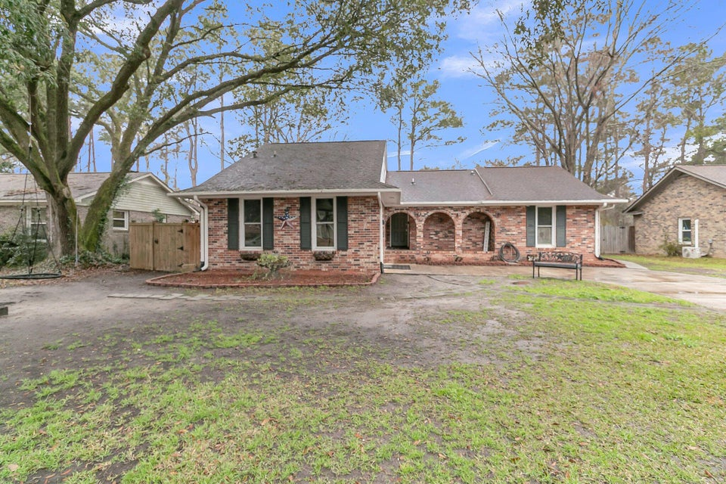
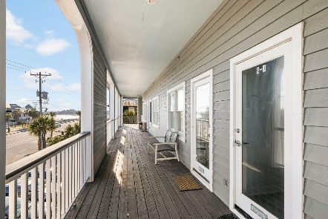
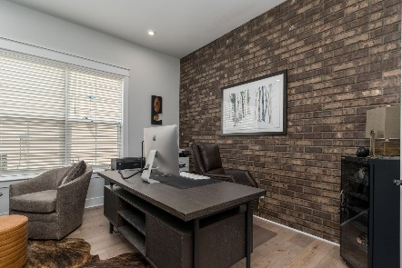
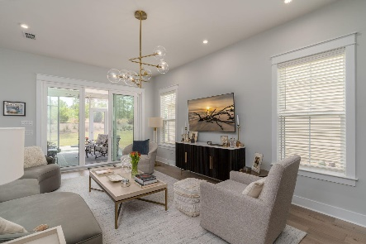

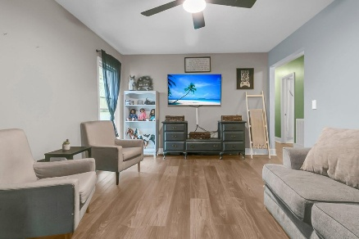
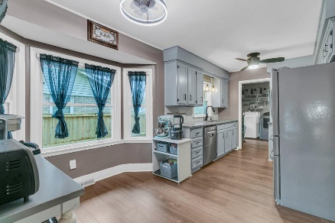
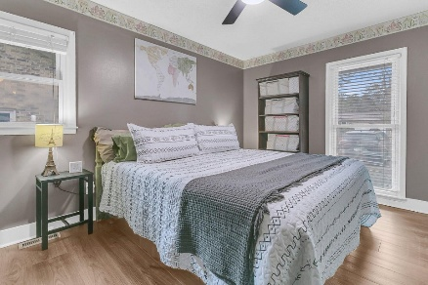
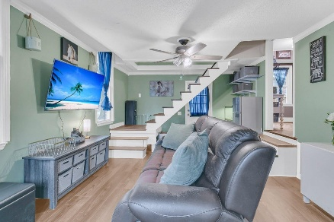
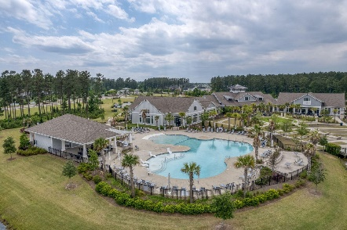
106 Two Wood Court
Corey Woods | Summerville, SC 29483 | MLS# 25005808 | $382,999
Darrell Creek Elevated Home With Elevator & Salt Pool
Big Corey Woods Cul De Sac Home
Co-sponsored by
Offering $3000
Lender Credit
This lovely Corey Woods home offers the perfect combination of established neighborhood charm, no HOA fees, and generous living space. Step onto the inviting front porch, highlighted by distinctive brick arches, and imagine relaxing in this peaceful setting. Inside, a versatile three-way living area awaits, connecting the living room, dining area, and updated kitchen. The converted garage provides a substantial family room, perfect for gatherings. Upstairs, you'll find two additional bedrooms and a full bath, a thoughtful addition completed in 2019. The spacious laundry room, conveniently located off the kitchen, adds to the home's practicality. Enjoy three full baths and well-proportioned rooms throughout. The expansive, fenced backyard, complete with a dog run, offers so many possibilities for outdoor enjoyment. Recent updates include new LVP flooring, a 2019 attic and porch conversion (creating the upstairs bedrooms and bath), and extensive 2024 updates: new floors and subfloor with joist replacement, crawl space encapsulation, dehumidifier, French drains, and a pump, Bosch dishwasher, microwave and exterior doors. New windows (2001) and a new fence (2018) further enhance this home's value. Sellers are generously offering $10,000 towards buyer concessions! Don't miss this opportunity - schedule your showing today!
Rochelle Rennert
843-847-9694 | rochellesellscharleston@gmail.com | www.RochelleSellsCharleston.com
AgentOwned Premiere Group, Inc. | 219 N Highway 52 Ste A | Moncks Corner, SC 29461-3926

