Slide 1
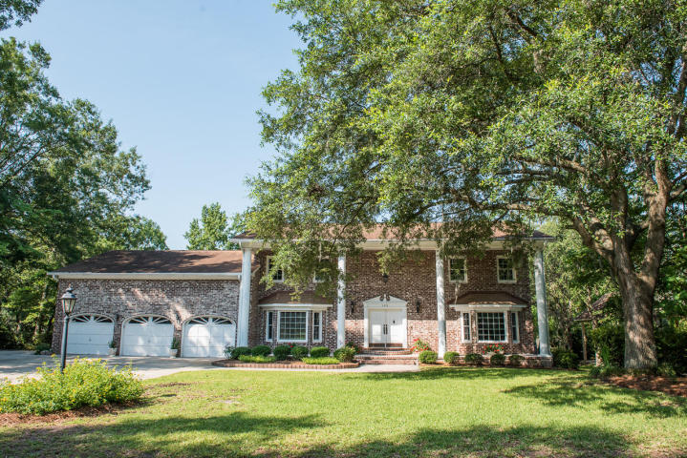
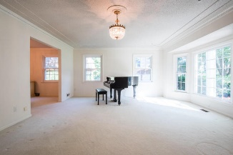
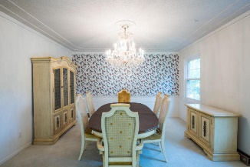
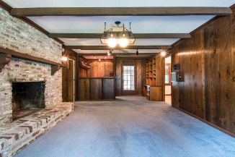
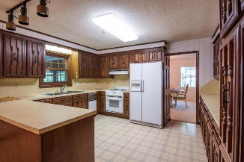
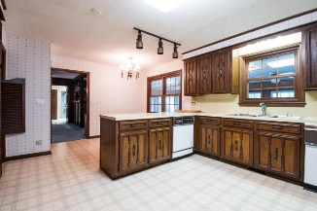
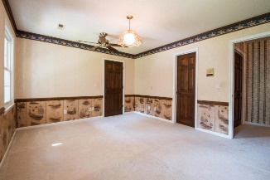
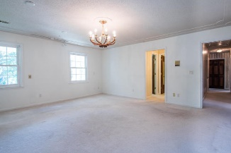
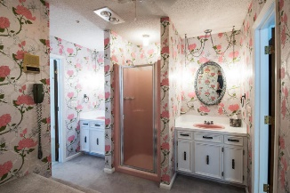
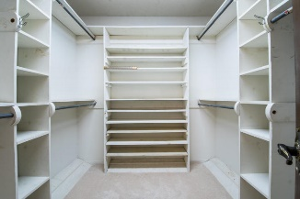
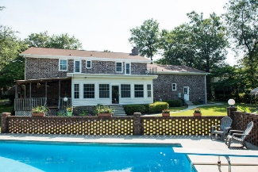
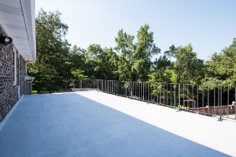
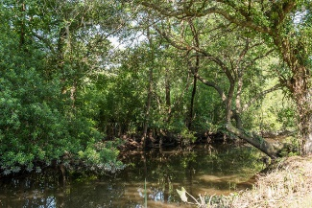


1072 Dominion Drive Dominion Hills Hanahan MLS# 16016982 $425,000 4 Bedrooms | 4½ Bathrooms | 4,050 Sq Ft
The Wait Is Over… The House You Wanted Is Here
The wait is over, the home that people have talked about for years in Hanahan and the surrounding area, is available! The Chubb family brought smiles to many lives with their incredible Christmas displays for the community to drive by and enjoy each year. After 40 years, it's time to turn the page. This home has been very well cared for and loved and is ready for the next amazing family to enjoy. Featuring over 4000 SF, plus a large sun room (not in ASF but it does have it's own AC/heat unit.) The 2nd story deck overlooks the beautiful in-ground pool and the lot backs to a tidal creek which is perfect for kayaking! The 3 car garage is humongous and can accommodate a long boat trailer. The home has many unique features but the pictures will do it more justice than my words can...enjoy!
Gregg Fesler GRI, CRS, REALTOR
Office (843) 856-3983 | Mobile (843) 797-0000
gregg@greggfesler.com
Carolina One Real Estate | 628 Long Point Rd. | Mt Pleasant, SC 29464-3032

