Slide 1
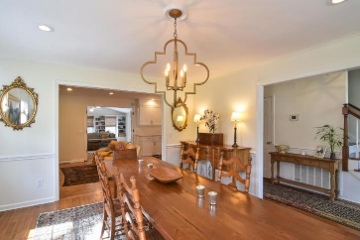
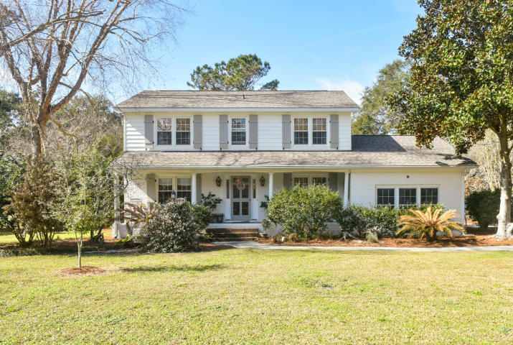
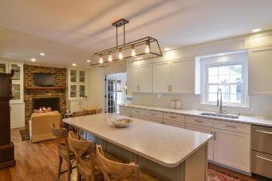
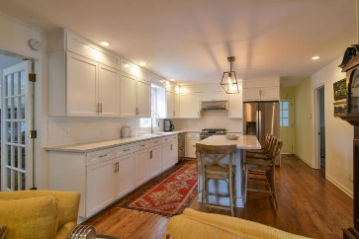
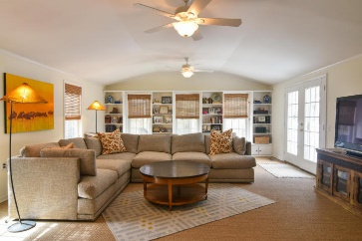
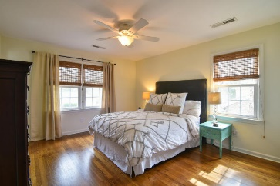
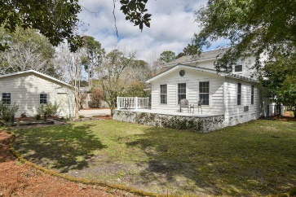
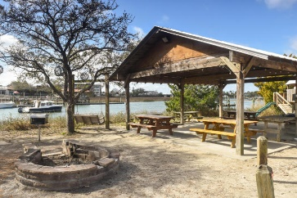
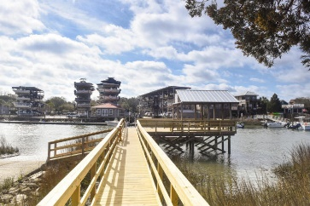


1075 Cottingham Drive
Cooper Estates | Mount Pleasant
MLS# 18004265 | $750,000
New on the market!
Highly desirable Cooper Estates beautiful home which has been extensively renovated sits on a third of an acre. Enjoy today's modern open floor plan in the established sought after Mt Pleasant neighborhood. Close to Shem Creek, and minutes to downtown Charleston. Walk to the neighborhood Shem Creek dock where you can go crabbing, launch your boat or host a dock side party. Grand lanterns compliment the front entry. Enter the foyer with a large dining room on one side and a home office on the other side. The foyer leads into the totally renovated kitchen complete with a new oversized island for family dinners. Silestone quartz countertops, white shaker ceiling height cabinets, new stainless steel appliances and tons of storage.The kitchen includes a cozy den with a fireplace and built in bookshelves. Off of the kitchen and den is a very large family room which overlooks the expansive backyard, custom bookshelves line the wall. The bonus/5th bedroom could be a playroom, a mother in law suite, an au pair bedroom, or for a post college young adult as there is a separate entrance. A full bath with carrera marble vanity and white cabinetry is down the hall from the office. Red oak hardwoods throughout the entire home except family room and bonus/5th bedroom. Tile in all the baths. Upstairs is 4 bedrooms and 2 baths. All of the closets have custom wood shelving designed for optimal storage. There's a 2 car detached garage with a new metal roof. The home also has a new roof. The vinyl siding has been removed and replaced with artisan hardi board. The brick has been painted the same as the hardi plank. All new exterior shutters. Large fenced in yard and deck off of family room.
Homeowners in Cooper Estates have the option to join Madere's Boat Landing located on Shem Creek off of Cottingham, complete with a dock, a picnic shelter, a grill and playground.
$2,700 credit available toward buyer's closing costs and pre-paids with acceptable offer and use of preferred lender.
Darlene Tanenbaum
(843) 817-9700
darlene.tanenbaum@carolinaoneplus.com
www.darlenetanenbaum.com
Carolina One Real Estate | 2713 Highway 17 North | Mt. Pleasant, SC 29466

