Slide 1
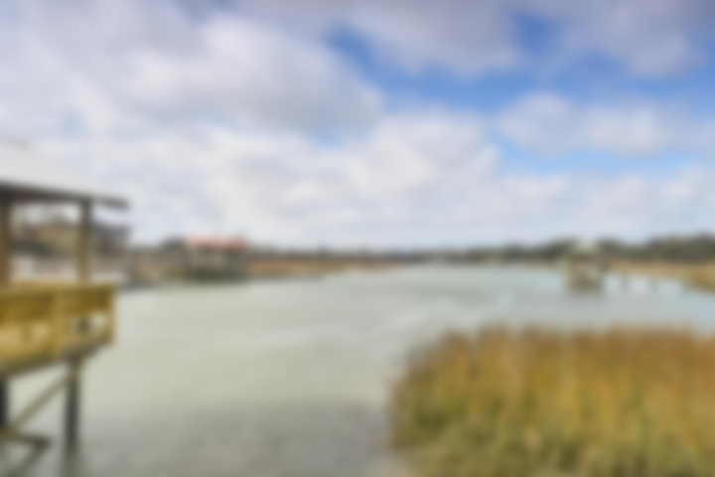
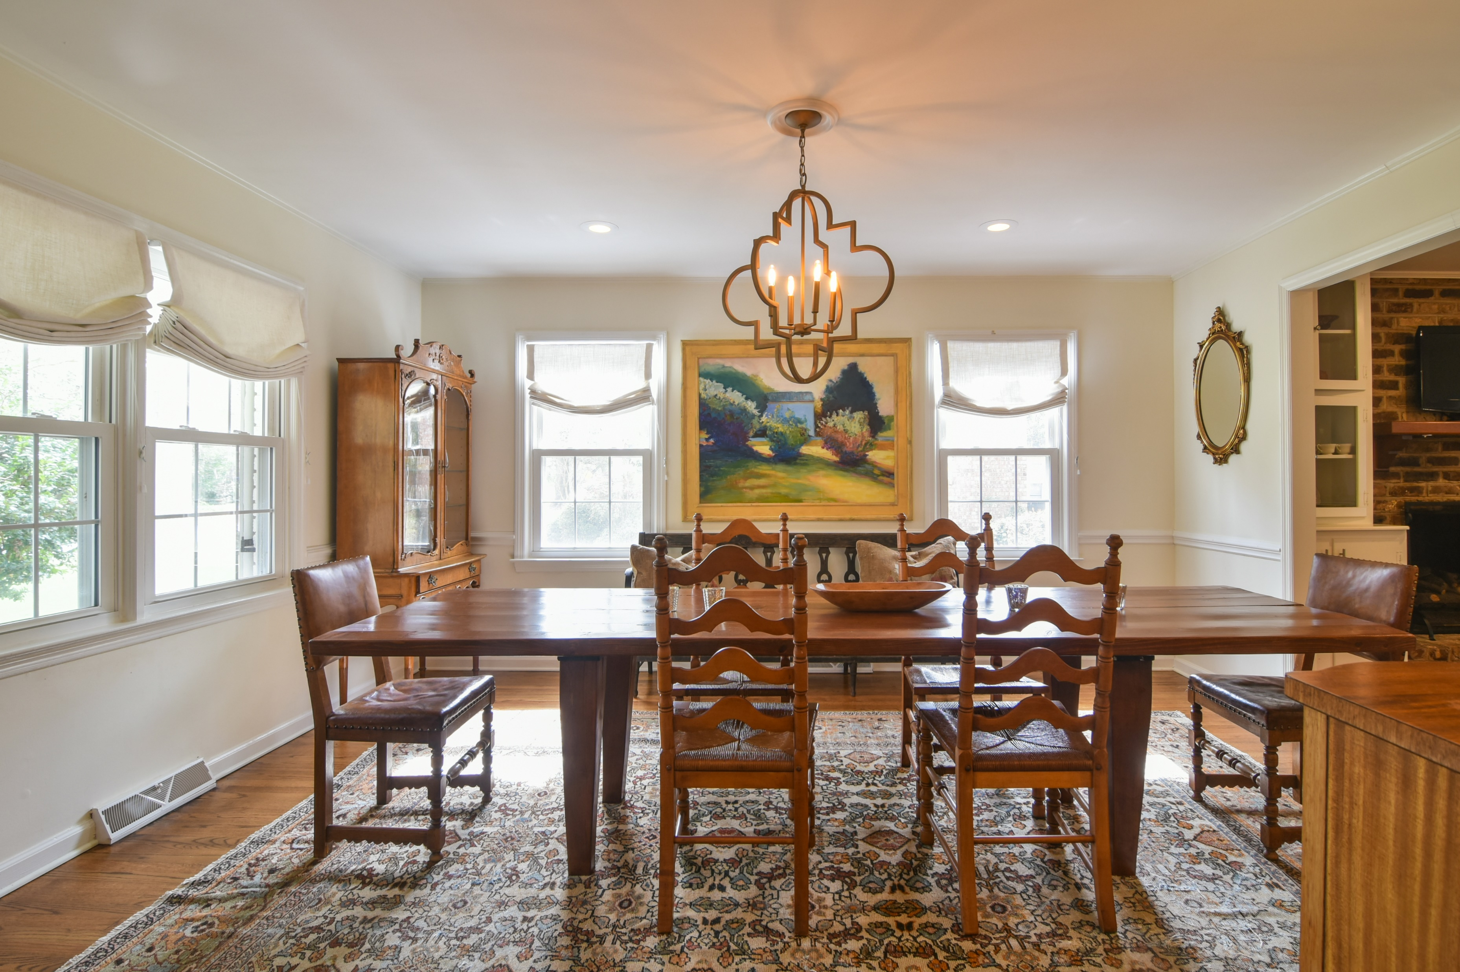
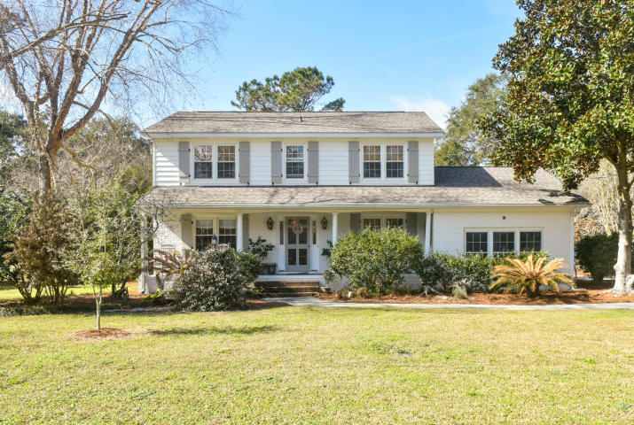
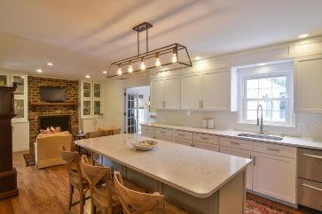
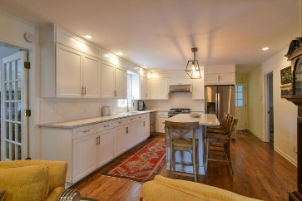
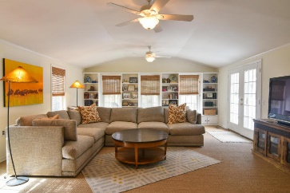
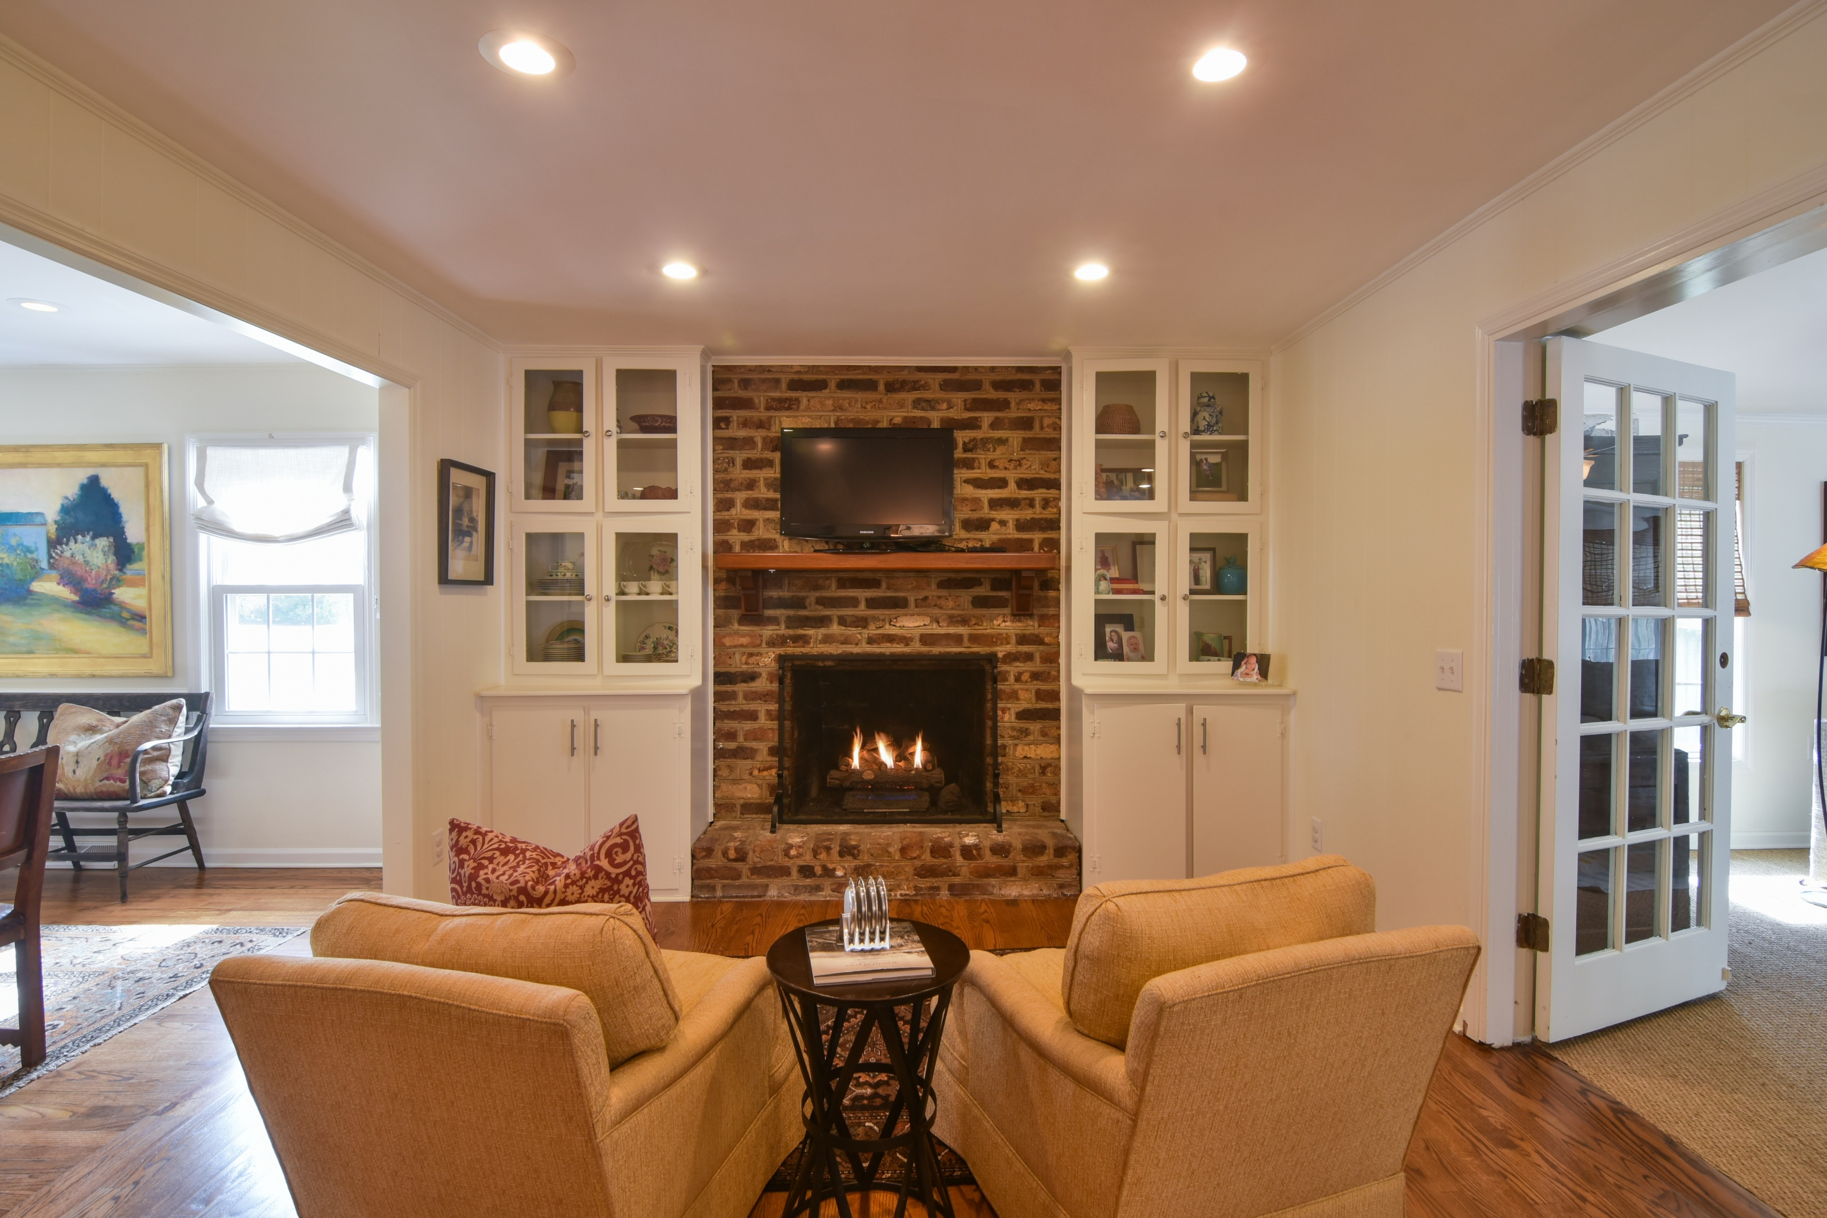
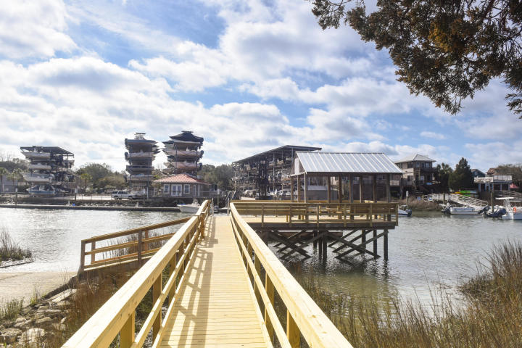
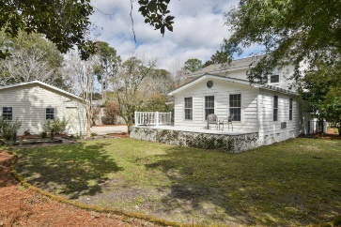
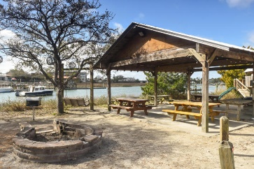
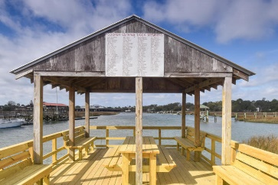


1075 Cottingham Drive Mt Pleasant | MLS# 18004265 | $735,000
Cooper Estates
The best location in Mt Pleasant, located in between Coleman Blvd and Johnnie Doods. Get anywhere in 10 minutes! And enjoy the lifestyle that Shem Creek has to offer with the neighborhood boat landing, dock, picnic area, complete with grills and a playground. This charming 2892 sf home has been extensively updated and renovated over the past 3 years from the outside to the interior. Sitting on 1/3 of an acre in an established neighborhood.
Darlene Tanenbaum (843) 817-9700
darlene.tanenbaum@carolinaoneplus.com
www.darlenetanenbaum.com
Carolina One Real Estate | 2713 Highway 17 North | Mt. Pleasant, SC 29466

