Slide 1
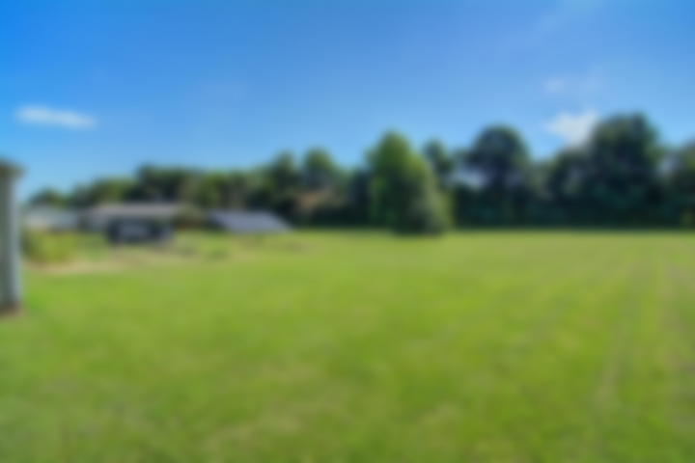
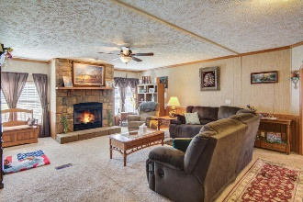
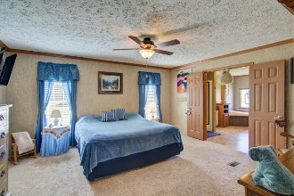
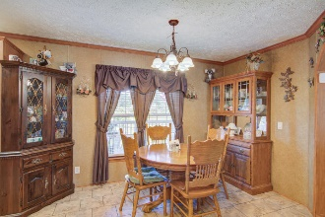
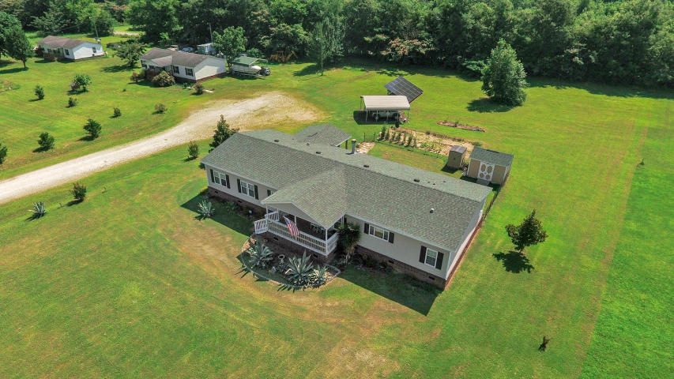
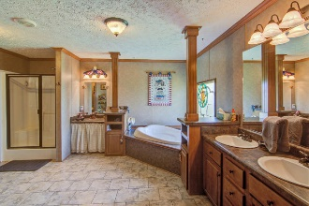
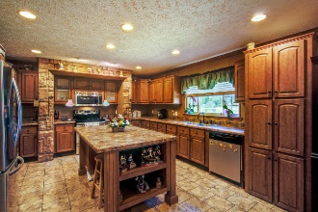

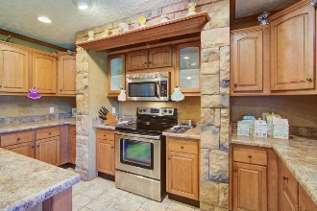

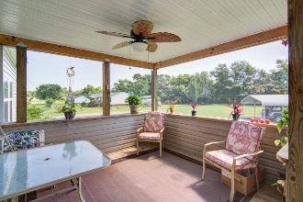
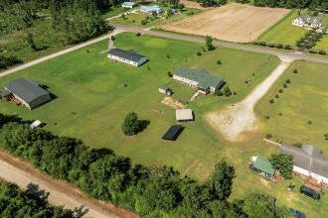

1076 Spiers Landing Rd
Casada ~ Cross, SC 29436
MLS# 18018723 ~ $175,000
Back on Market.
Financing fell through!
Back On Market.
Financing Fell Through!
One truly has to see this property to understand how beautiful and unique it is! As you drive up the driveway the impressive expanse of the grounds will certainly catch your attention. The backyard is just as beautiful and that solar panel will save you hundreds of dollars a year. As you enter the front door, the huge great room with its gas fireplace will greet you. Then the mighty kitchen!! Words cannot describe this mammoth gourmet eat-in kitchen with its upgraded cabinets, stone accents, stainless steel appliances, acres of counter space, and a pantry. No space issue here! Off the kitchen is another fabulous area - the master. It too is huge but the master bath is an elegant spa-like retreat! On the other side are the three other bedrooms, bath, office and laundry room. Again, all big!
The property itself is wonderful and having a solar system for the electricity, a new HVAC unit and new shingles on the roof is an added bonus; however, being two miles from Lake Marion where there is a recreational area with a boat ramp and fishing dock makes this property highly desirable! And if you are going to work at the new Volvo plant, it is only 20 miles away!
Liz & Bob Simonds
843-261-7138 O | 843-437-9696 M
lizandbob@agentownedrealty.com
AgentOwned Realty Co. Premier Group, Inc. | 141 A N. Main St | Summerville, SC 29483

