Slide 1
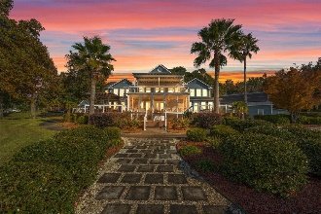
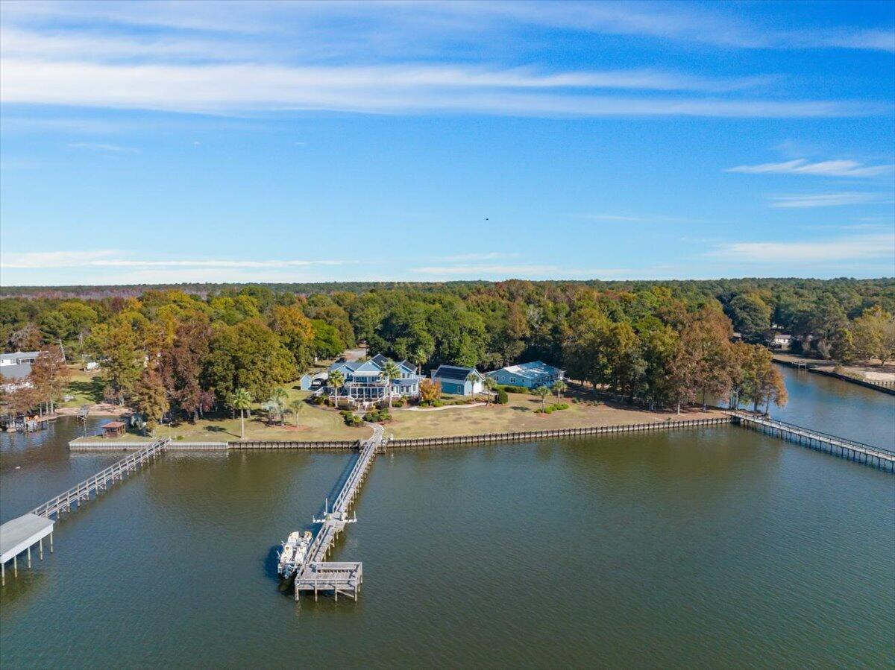
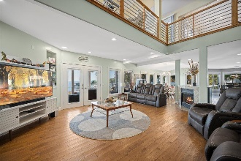
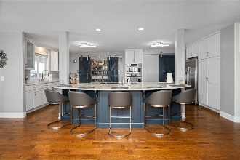
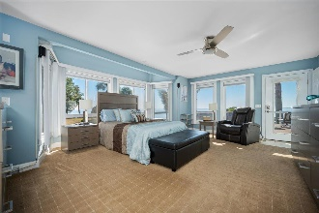
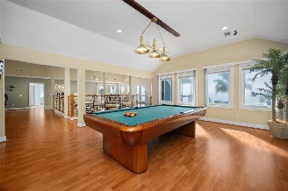
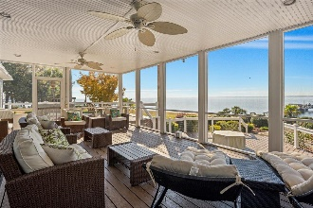
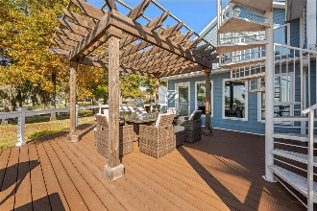
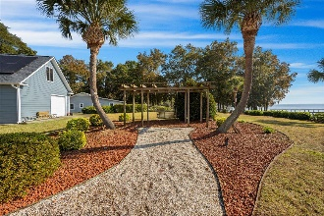
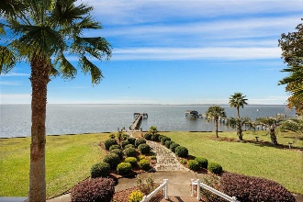


1076 Davis Drive Francis Marion Summerton, SC 29148 MLS# 23026574 | $1,950,000
Welcome to your dream home on Lake Marion!
Open House
Wednesday, 7/20
3-5PM
This luxurious property is your personal paradise which offers the perfect water views that are sure to impress. Discover the allure of living on Lake Marion, South Carolina's largest lake. Enjoy the convenience of being centrally located to a multitude of amenities; including golf courses, and easy access to both Charleston and Columbia. As you approach the home, a grand entrance awaits with a long, expansive driveway, bordered by lush tropical and mature landscaping. The 5,300 sq ft, 4-bedroom, 3.5-bathroom large home, complete with charming wrap-around porch, beckons relaxation. A 2-car detached garage adds convenience, while water views embrace the essence of tranquility.
Step inside and admire the new hardwood floors throughout the first floor. Continue through the spacious foyer, and you'll find yourself in the perfect open-concept living space that includes a family room, eat-in kitchen dining area, and updated kitchen. The abundance of windows allows natural light to flood in while offering breathtaking views of the lake. A cozy fireplace sits between the family room, eat-in kitchen dining area, and kitchen space.
The updated kitchen is a chef's dream with new stainless-steel appliances, including a wall oven, microwave and stove top on the island. Ample white cabinets provide plenty of storage space, while navy cabinets on the island add a stylish touch. The faucet is conveniently positioned under a window for added charm. A large walk-in pantry ensures that all your culinary needs are met. Conveniently positioned off the kitchen is a formal dining room with a wonderful bay window and plenty of space for a holiday dinner or entertaining a dinner party.
On the main level, you'll find one of two master suites - light-filled and spacious with its own bay window and patio door leading out to a large, covered deck overlooking the lake. The en-suite bathroom features two vanities, a separate large soaking tub with lake views, and a large walk-in tiled shower.
Upstairs awaits another master suite also with stunning lake views from its windows. The upgraded en-suite bathroom offers a large dual sink vanity and an impressive glass door tiled shower. Additionally, there's an expansive loft area with a kitchenette overlooking both floors - perfect for entertaining guests or simply enjoying more breathtaking water vistas.
Two more generously sized bedrooms, along with an upgraded Jack and Jill full bathroom, and a half bath complete this magnificent home's interior layout. A large laundry room with sink provides convenience along with ample counter space for folding clothes.
Now let's talk about outdoor living! The huge back patio/deck complete with Trex decking and cable railings, a large screened-in porch, a covered patio area, and precision landscaping is truly an entertainer's paradise. A pathway leads to the existing dock where you can enjoy all that Lake Marion has to offer. A shed for storage, a pergola with an outdoor kitchen, a fire pit with patio furniture, and spiral stairs on the outside patio leading to the upstairs loft area add even more charm and amazing options for outdoor living and entertaining.
Rest assured that only the best materials have been used throughout this home, ensuring low maintenance and long-lasting quality. Embrace sustainability with solar panels, a new HVAC system, and new ductwork in crawl space. Experience seamless functionality with a new pump house, and well pump with water softener, both elevating your lifestyle to the next level. With its .75-acre lot and unparalleled views of Lake Marion, this property offers a piece of the lake life in South Carolina that cannot be replicated.
Indulge in the captivating beauty of this lakefront retreat, where every glance offers a serene panorama. Immerse yourself in the tranquil views and embrace the sheer peacefulness that defines both the surroundings and the home itself. Don't miss out on this incredible opportunity to own your very own slice of paradise! Schedule your private showing today!
Enjoy a video tour!
Brandon Ray
(843) 499-1928
brandon.ray@carolinaone.com
www.therightrayhome.com
Carolina One Real Estate
900 N Main St
Summerville, SC 29483

