Slide 1
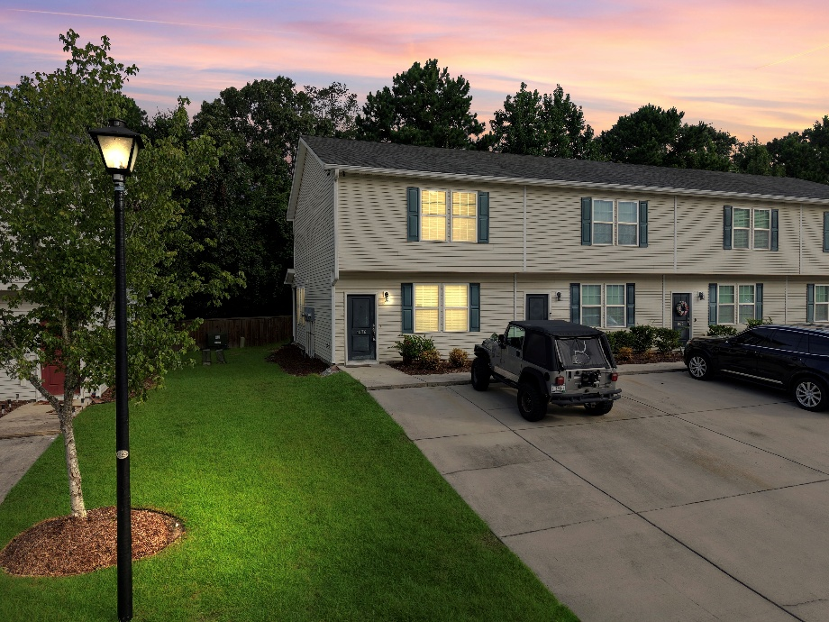
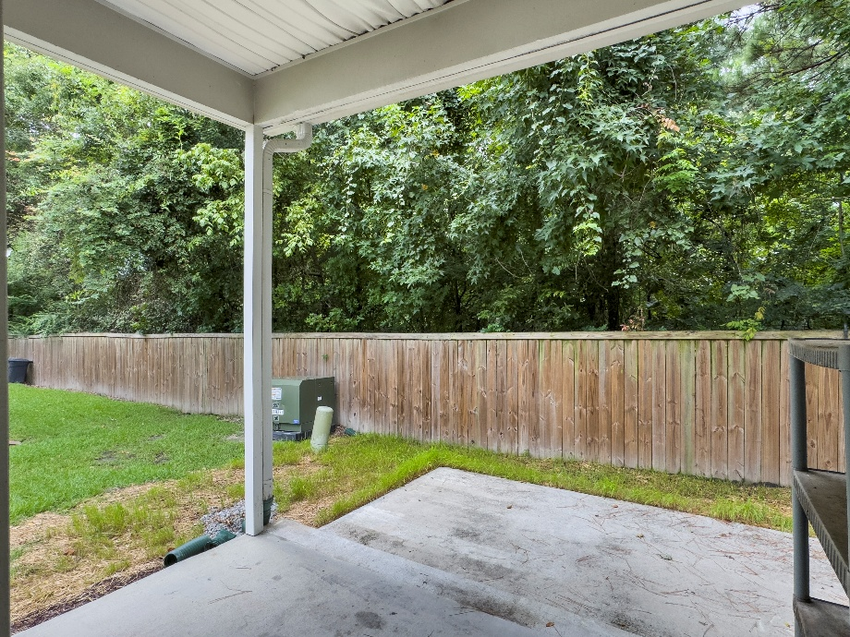
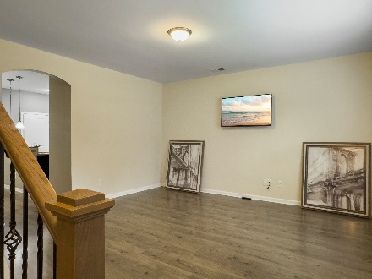
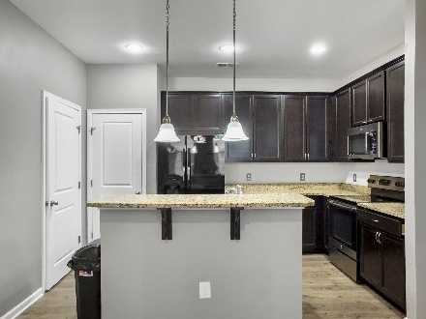
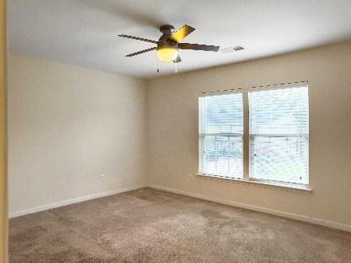
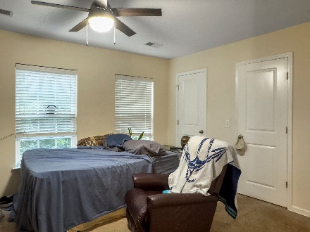


1076 Lexi Court Oakbrook Park | Ladson, SC 29456 | MLS# 25020749 | $240,000
LARGE DUAL MASTER BEDROOMS
END UNIT DUAL MASTER BEDROOM separated by small hallway. Open interior - first floor boasts 9' ceilings, elegant arches, large living room. Upscaled kitchen - granite countertops, raised breakfast bar, 42'' cabinetry topped with distinctive crown molding and upgraded pulls/knobs, pendant and recessed lighting, pantry for essential storage, refrigerator, range, built in microwave, dishwasher, washer and dryer all included. Both master bedrooms are spacious with walk-in closets. Each master bath offers granite vanities and tub/shower. Enjoy your morning coffee on your private covered patio and grilling in the evening on the open patio. An exterior camera you can connect to your computer. Located close to I-26, Bosch, Boeing, Volvo, Summerville Medical Center, Dorchester school district 2.
The HOA covers: Roof replacement, Siding repairs, Power washing, Gutter cleaning, landscaping.
Julie Wells
843-714-1237
juliew12001@gmail.com
Brand Name Real Estate
4 Carriage Lane Suite 106
Charleston, SC 29407

