Slide 1
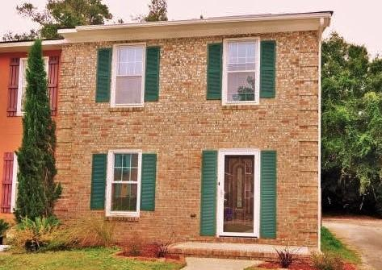
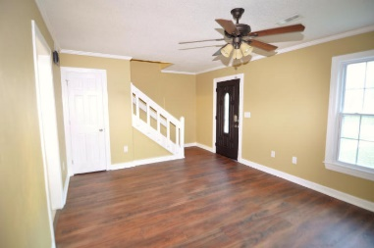
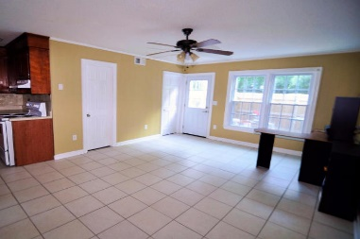
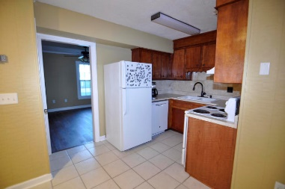
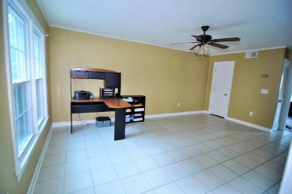
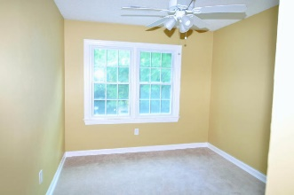
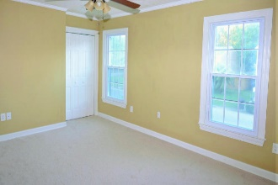
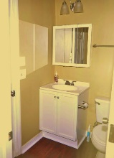
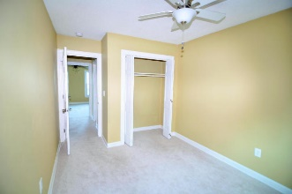
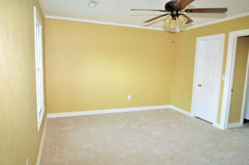



1079 S Shadow Drive
Hickory Shadows
Mount Pleasant, SC 29464
MLS# 15028843
$200,000
3 Bedrooms
1½ Bathrooms
1,360 Sq Ft
Charming Townhouse near The Old Village in Mount Pleasant.
This bright, airy house has been renovated and is move in ready. Enter the home and notice the new laminate wood floor in the spacious living room, freshly painted walls and new ceiling fan. Move on through to the kitchen with dining and casual seating area, half bath and laundry room. Exit to a private, low maintenance outdoor living space, perfect for enjoying a morning coffee or evening grilling.
Upstairs you will find the master bedroom w/ 2 built in closets and access to the fully renovated main bathroom. Two bedrooms w/built in closets also. New carpet, ceiling fans, heating system and much more. Appliances convey with the house. Minutes from downtown Charleston and beaches. Parking spaces at rear. Come see for yourself!
Bobby Shealy
Office (843) 900-4000
Direct (843) 442-7373
bobby@redefy.com
Lindsay Pennell
Office (843) 900-4000
Direct (843) 830-6004
Lindsay@redefy.com
Redefy Real Estate | 12 Carriage Ln | Charleston, SC 29407 | redefy.com/Charleston

