Slide 1
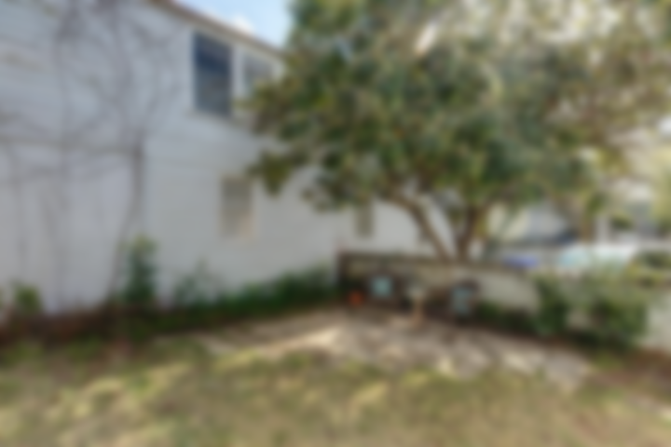
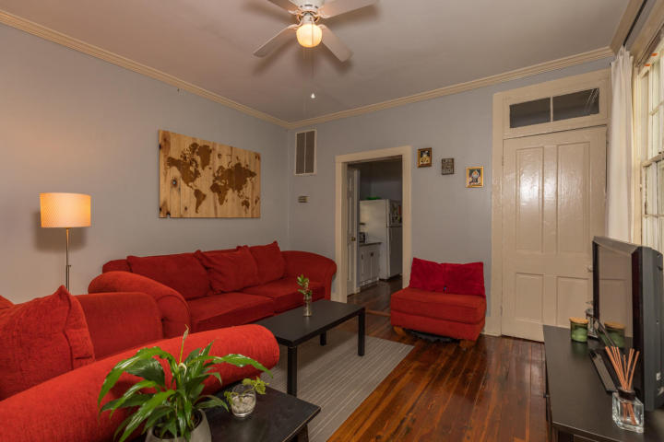
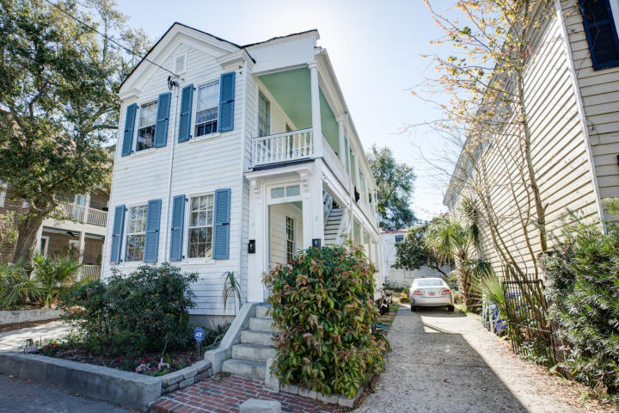
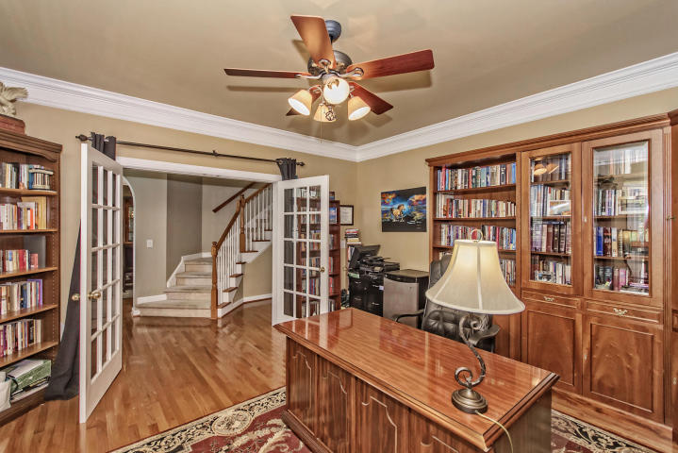
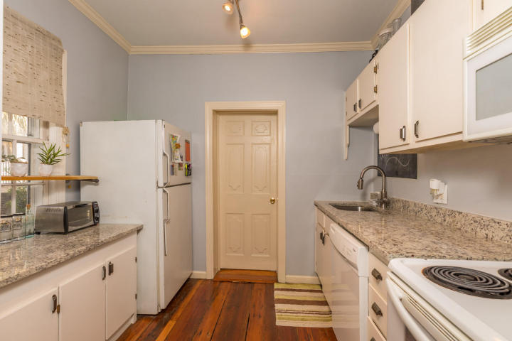
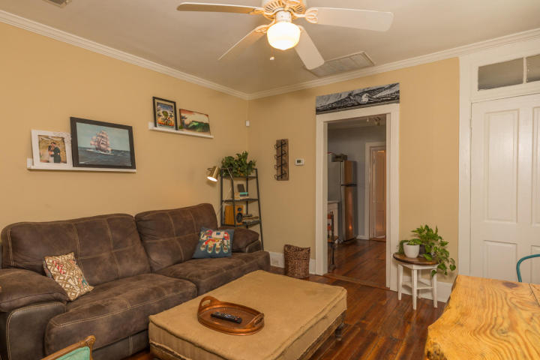
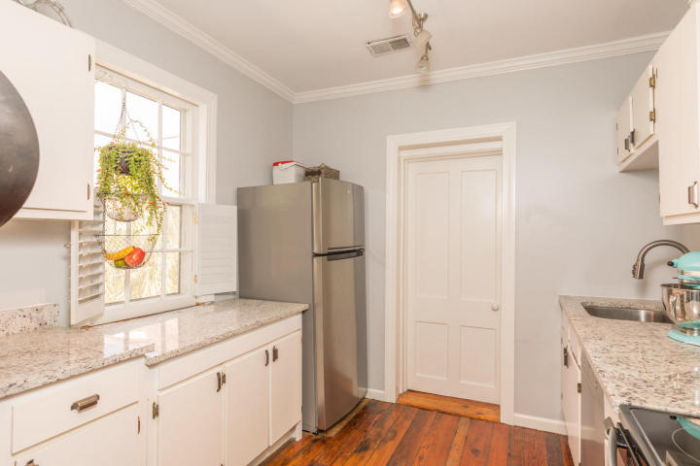
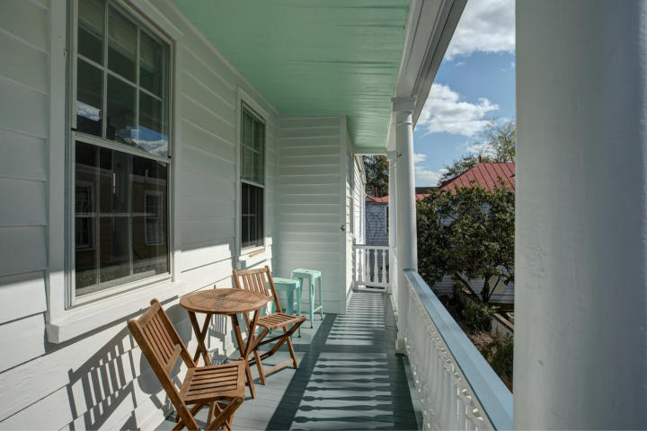
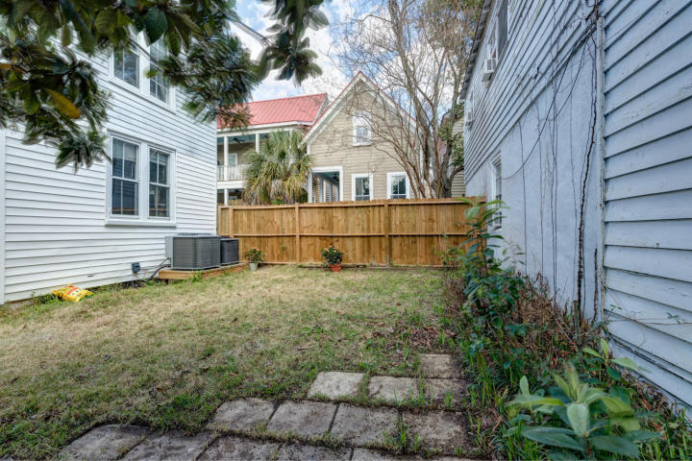
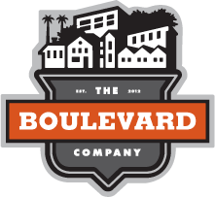
UPDATED DOWNTOWN DUPLEX
REDUCED $40,000!!!
107 Bogard Street Cannonborough-Elliottborough
Charleston ~ MLS# 18006395 ~ $649,000
2 Bedrooms and 2 FULL Baths per unit
Many updates and upgrades, including electrical, plumbing, and HVAC
Walk to MUSC and CofC
Off-street parking for 3 cars
Annual gross rent of $42,000 (undermarket, not raised in 4 years)
Jeff Irvine
(843) 619-9930
irvine.jeff1@gmail.com
The Boulevard Company, LLC 35 Broad Street Charleston, SC 29401
www.theblvdcompany.com

