Slide 1

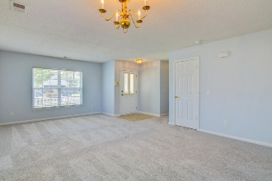
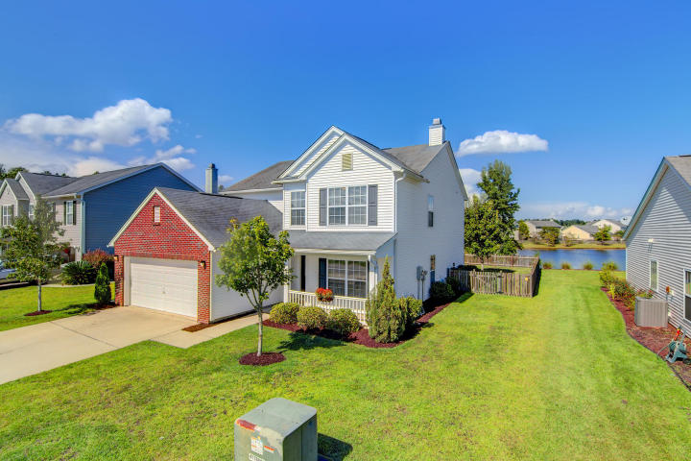
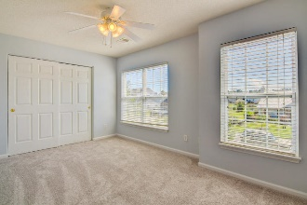
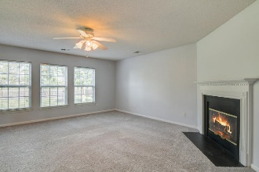
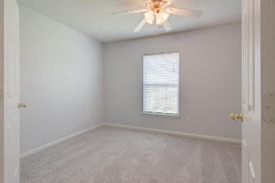
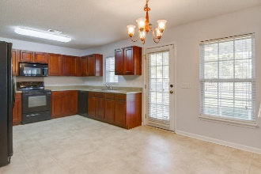
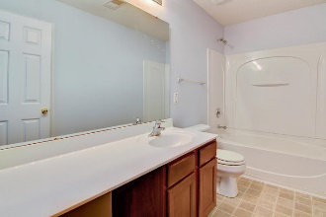
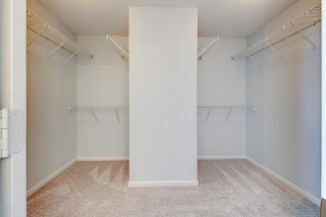
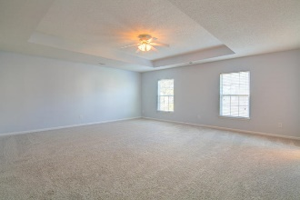
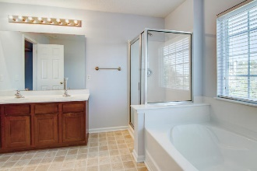
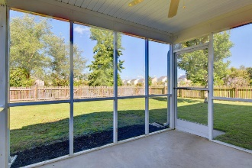
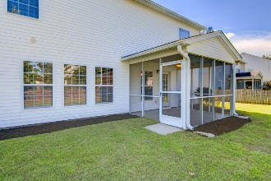
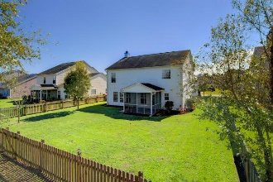

107 Buckfield Lane Weatherstone ~ Summerville MLS# 17024888 ~ $238,000
Move-In Ready and Priced to Sell Quickly!
Move-In Ready and Priced to Sell Quickly!
BIG BOLD BEAUTIFUL best describes this Weatherstone Gem! Freshly painted & new rugs throughout the whole house give it a "wow" factor. The open floor plan boasts of a living/dining room connected to a large family which has 3 large windows for extra light and a fireplace. Eat-in kitchen is huge/tons of counterspace/cabinets and a walk-in pantry. Lastly, downstairs is a full bath, flexroom, laundry room and many closets for a comfortable living space. Upstairs are 4 bedrooms and 2 full baths. Master with its tray ceiling is immense! Master bath has dual sinks and separate tub/shower. Master closet is huge too! Being on a pond and having a screened-in porch makes those outdoor activities so enjoyable yet the having it fenced-in makes it safe for children and pets. Weatherstone is not only family friendly with sidewalks, play area, and community pool, but it is so convenient to shopping and highways that it makes this community one of the sought after ones!
Liz & Bob Simonds
843-261-7138 O | 843-437-9696 M lizandbob@agentownedrealty.com
AgentOwned Realty Co. Premier Group, Inc. | 141 A N. Main St | Summerville, SC 29483

