Slide 1
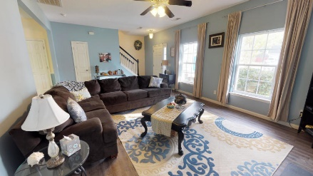
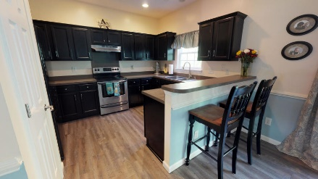
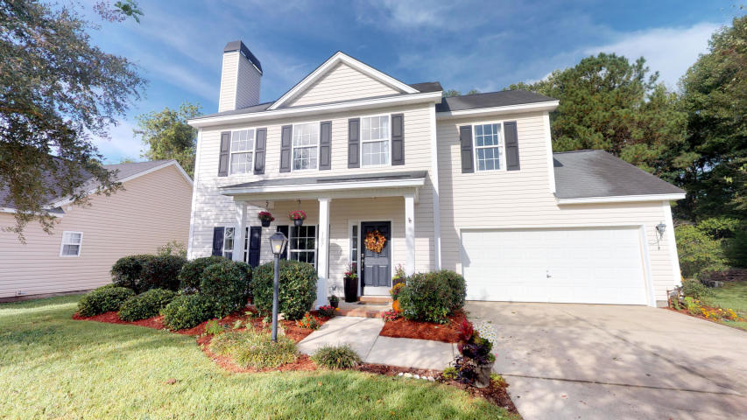
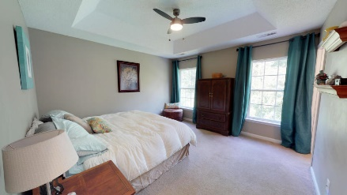
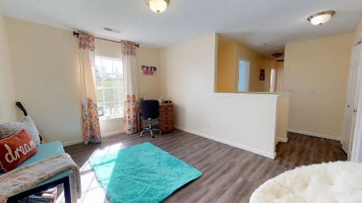
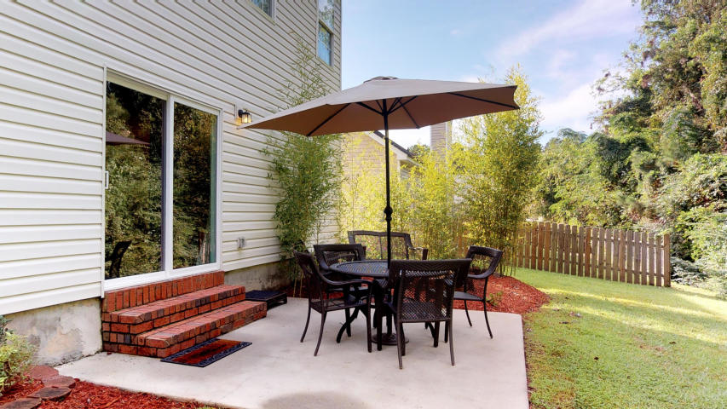
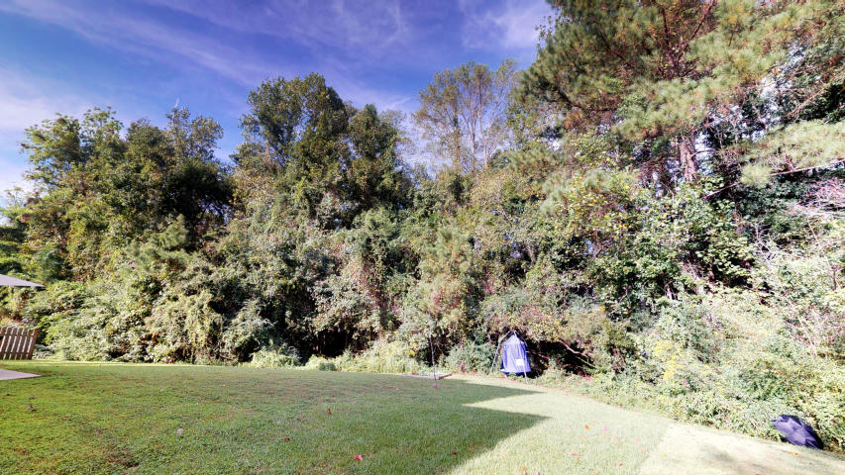
Price Reduced! USDA Eligible Area!
107 Cassels Lane
Highwoods Plantation
Summerville, SC 29485
MLS# 18027712
$215,000
3 Bedroom ~ 2½ Baths
1,698 Square Feet
Owners Pride shows throughout this home. Enter the home to breathtaking luxury vinyl plank floors and cool relaxing wall colors. The vinyl plank flooring is super durable and water resistant. Enjoy the wood burning fireplace during our up and coming winter nights. Large Eat in kitchen offers a beautiful view of your very private backyard through the large sliding door. Kitchen has tons of cabinets and lots of counter space. Upgraded stainless steel appliances and oversized stainless steel kitchen sink. Newly finished hardwood stairs leads you to a very open loft area with tons of natural light. Laundry room is conveniently located upstairs. Hall bathroom offers lots of space and newly installed vinyl tile floors. The two secondary rooms offer lots of natural light and plenty of space.
Master bedroom has vaulted ceilings and a large walk in closet. The master bathroom has dual sinks and large garden tub. All faucets were updated to a brush nickel finish. The backyard is so peaceful and backs up to HOA protected area. Enjoy the sound of birds chirping and your morning coffee of the outside patio. Fall evenings will be a success enjoying the fire pit and making delicious smores. Don't miss out on this amazing home!!
Jennifer Laffey-Foster, MRP
Real Estate Agent
Miler Properties
Office: 843-821-1111
Cell: 843-708-1582
jlfoster86@gmail.com
www.milerproperties.com

