Slide 1
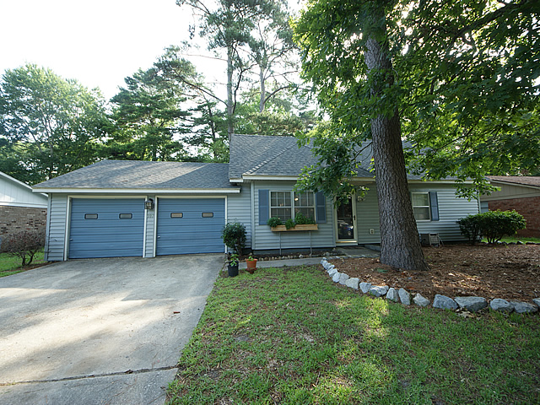
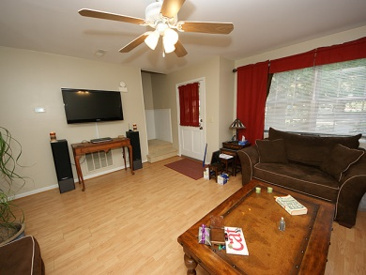
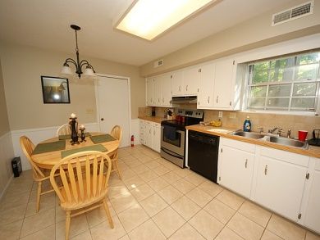
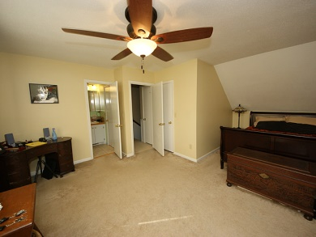
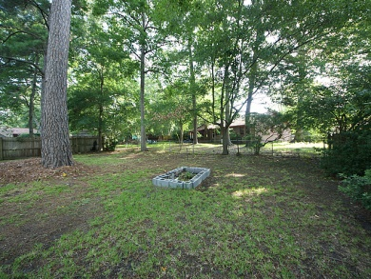

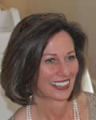
$500 BUYER'S AGENT BONUS!!! With Ratified contract by December 15th...that goes on to closing!
107 Finch St
Tranquil Estates ~ Ladson ~ MLS# 1416468 ~ $139,500
BRAND NEW ROOF!!!! Great house for a great price! Located conveniently off Ladson Rd near the Oakbrook area. Close to Downtown Summerville. NEW Roof April 2014 with 30 Year transferable warranty. NEW A/C system Jan 2014! LR is wired for Home Theater/surround sound - speaker jacks to remain. Even the Garage has a built-in stereo system that STAYS! ...speaking of the Garage it's an oversized 2-car and has work space cleverly hinged on one wall of the garage. Other work areas too...this is great for the handy person. Back to the house....downstairs are two bedroom and a full bathroom and upstairs are two HUGE bedrooms and another bath. Walk-in closets in both of these bedrooms with extra storage. Living Room is large with plenty of room for the whole family. LARGE Eat-In Kitchen with tons of cabinet space. Large back yard that has fencing all the way around it. Tons of room for your toys in this yard! No HOA and no fees! Just a few minutes to Charleston, beaches and Boeing! Non-smoking home and no pets....Come see this great house today!
Susan Weeks
(843) 813-0495
susanweeksdesign@gmail.com
www.agentownedrealty.com
AgentOwned Charleston Group
902 Savannah Hwy
Charleston, SC 29407-7802

