Slide 1
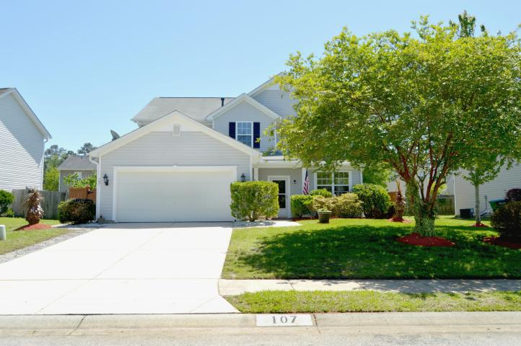
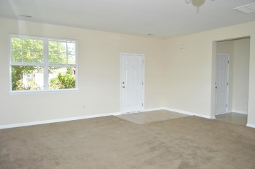
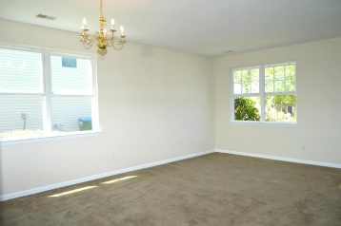
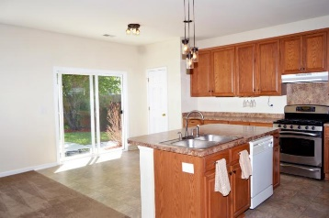
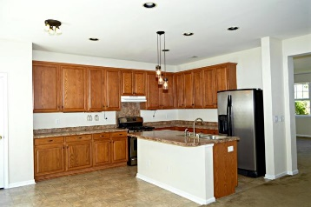
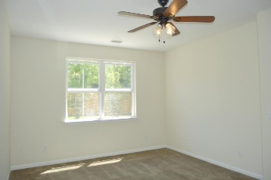
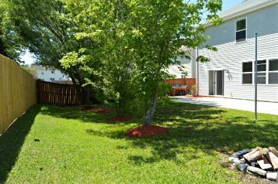
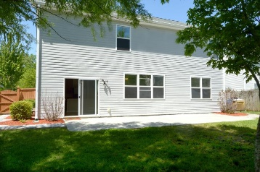
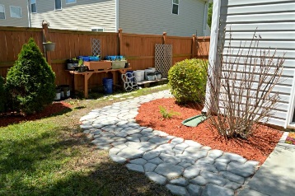


107 Graduate Lane Eagle Run ~ Ladson, SC 29456 MLS# 18010884 ~ $260,000
Open House Lunch ~ Friday, Oct 3 from 11 - 1
Handyman Special… Bring your hard hats!
Bright & Airy Interior
Manicured Exterior
Starting with the breathtaking landscaping, you will absolutely fall in love with this home! Freshly painted with bright and airy rooms this home offers a large family/dining room in addition to an eat in kitchen open to another gathering space. The sunny kitchen is equipped with a gas range and a large island with pendant light. The fully fenced backyard features a fire pit, custom walkways, beautiful landscaping, pull up bar and tether ball pole. The large master bedroom is downstairs with a huge on suite bathroom and giant walk in closet. Upstairs features 5, yes 5 additional bedrooms. This home has enough space for a large family, anyone needing an office, media room, workout space etc. The home also has a whole house water filtration system.
Hillary Jones
(843) 709-4666 hillaryjones@sc.rr.com | www.rogcoastal.com
Realty ONE Group Coastal | 1510 Trolley Rd | Summerville, SC 29485

