Slide 1
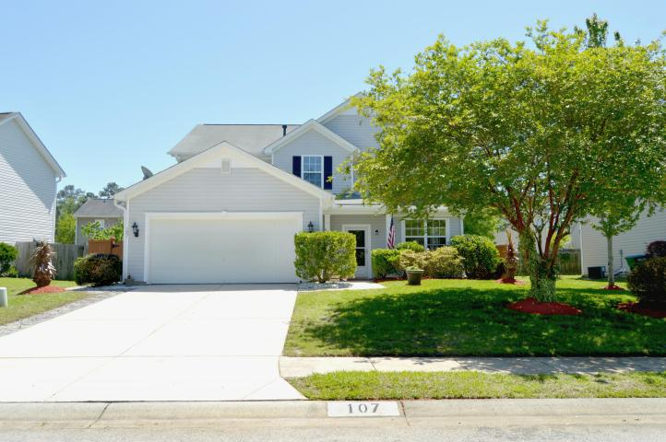
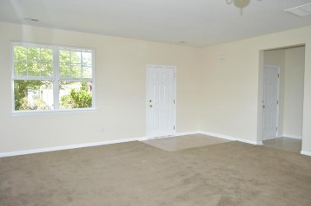
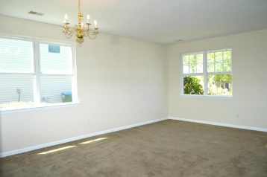
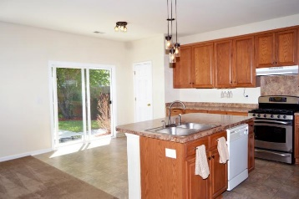
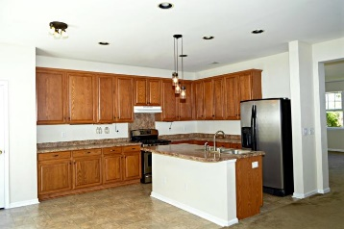
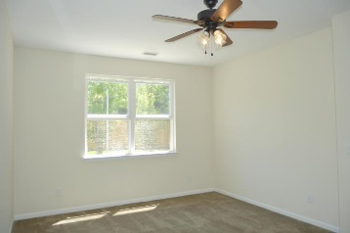
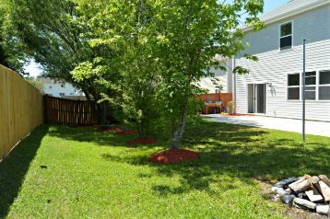
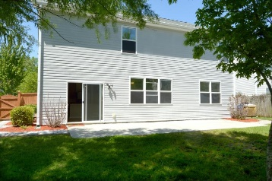
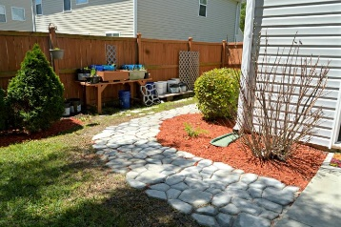
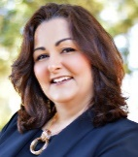

107 Graduate Lane
Eagle Run ~ Ladson, SC 29456
MLS# 18010884 ~ $250,000
Open House Lunch ~ Friday, Oct 3 from 11 - 1
Handyman Special… Bring your hard hats!
Bright & Airy Interior
Manicured Exterior
Great New Price!
New Price!
Starting with the breathtaking landscaping, you will absolutely fall in love with this home! Freshly painted with bright and airy rooms this home offers a large family/dining room in addition to an eat in kitchen open to another gathering space. The sunny kitchen is equipped with a gas range and a large island with pendant light. The fully fenced backyard features a fire pit, custom walkways, beautiful landscaping, pull up bar and tether ball pole. The large master bedroom is downstairs with a huge on suite bathroom and giant walk in closet. Upstairs features 5, yes 5 additional bedrooms. This home has enough space for a large family, anyone needing an office, media room, workout space etc. The home also has a whole house water filtration system.
Hillary Jones
(843) 709-4666
hillaryjones@sc.rr.com | www.ahomeinsummerville.com
Realty ONE Group Coastal | 1510 Trolley Rd | Summerville, SC 29485

