Slide 1
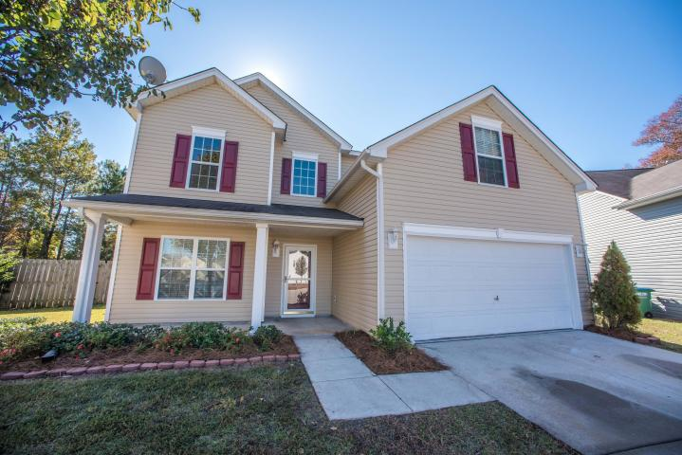
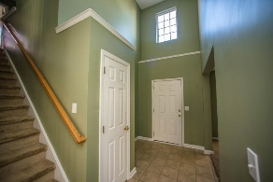
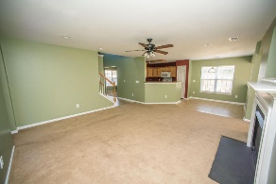
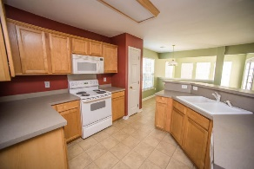
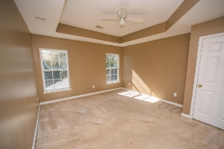
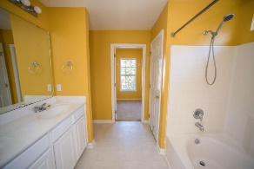
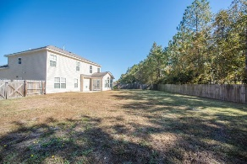
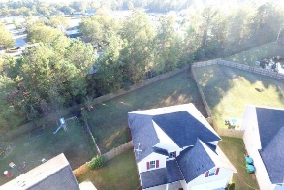
Price Just Reduced!
107 Plume Poppy Court
Summerhaven
Ladson, SC 29456
MLS# 16029995
$219,900
Come see this amazing 4 bedroom floor plan that immediately opens up all the way to the 2nd floor hallway as you enter! The frog is huge and could be used as a 5th bedroom. New paint and blinds throughout the home. The master has a tray ceiling and over sized walk in closet with window. The spacious kitchen overlooks the family room and sun room making this the perfect setup for entertaining! Recessed canned lighting and a gas fireplace in the family room as well! Formal dining room. Laundry room upstairs! A big backyard with a privacy fence that backs up to a wood buffer. This is the home that you have been looking for!
David Hickman | 843.505.0456 | davidisyouragent@gmail.com | www.omnicarolinarealestate.com
Omni Carolina Real Estate | 126 Eston Dr | Goose Creek, SC 29445

