Slide 1
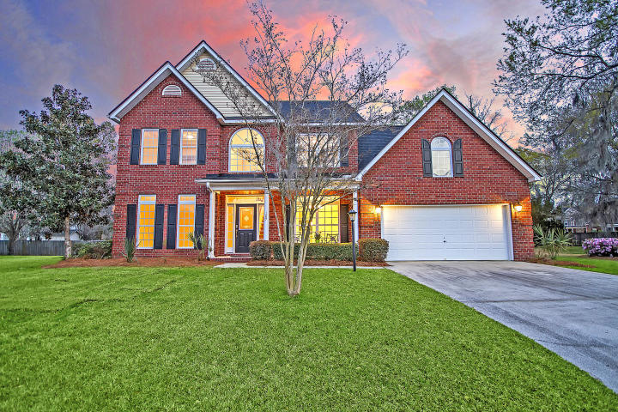



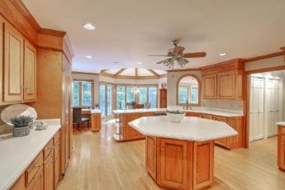
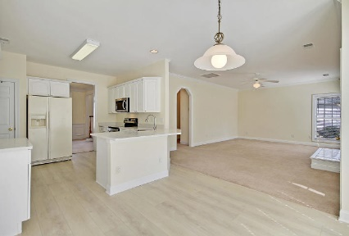



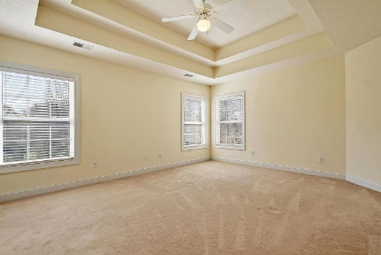

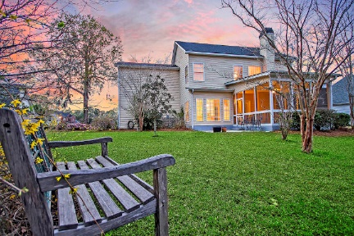
Parkshore Marshfront
Move-in Ready Shadowmoss
107 Ryton Drive
Shadowmoss ~ Charleston, SC 29414 ~ MLS# 20007033 ~ $399,000
Set on a cul-de-sac in Shadowmoss Plantation, this move-in ready two story home is a must see! This sun-drenched open floor plan boasts a two story foyer, crown molding, columns in the living room, wainscoting in the dining room, a fireplace in the family room and floor to ceiling windows in the remodeled eat-in kitchen that let the sun pour onto the light-colored hardwood floors. The gorgeous kitchen features quartz coutertops & includes a new stainless steel stove, dishwasher, & microwave. From the family room, you can access the spacious screened-in porch & patio that overlook the backyard. The owner's retreat features a tray ceiling, walk-in closet and en-suite bath with dual vanity, garden tub & walk-in shower. The FROG is a large-sized room great for a bonus area or 4th bedroom.
Additional features include:
Quartz counters in the bathrooms
New roof installed in 2019
Enjoy the wonderful location in this sought after golf course community!
Book your showing today!
Christopher Smith christopher@mattoneillteam.com 843-267-0735

