Slide 1
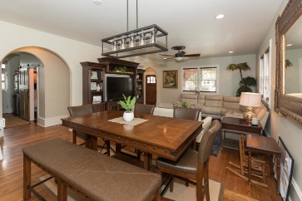
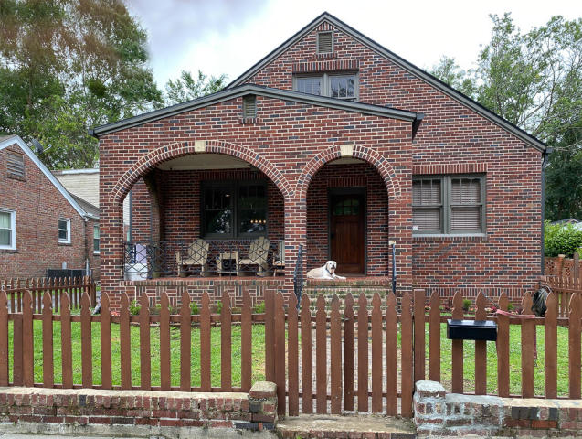
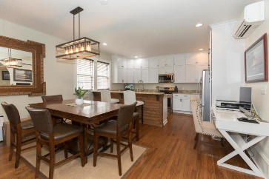
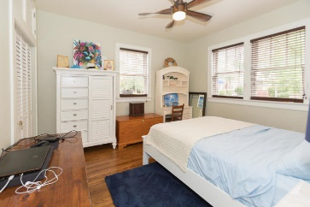
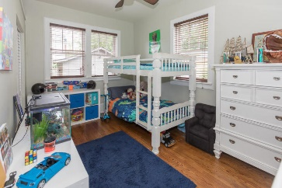
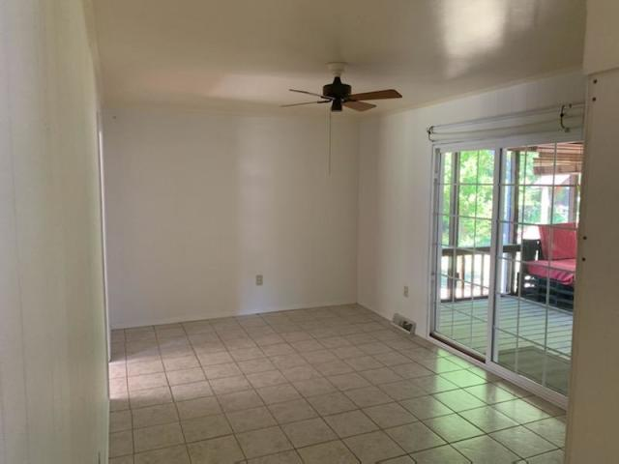
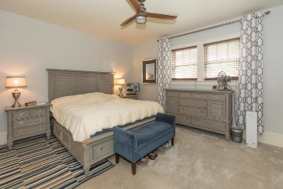
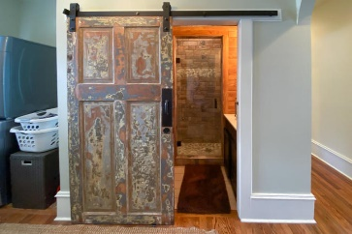
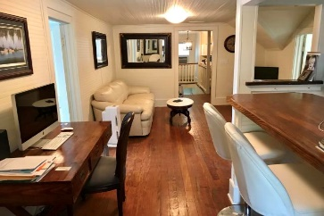
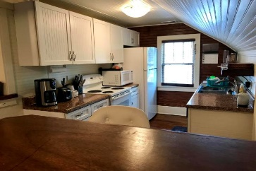
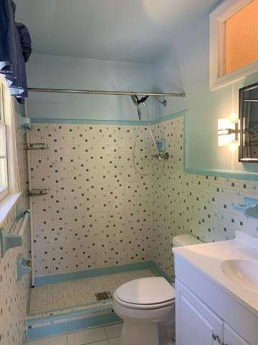
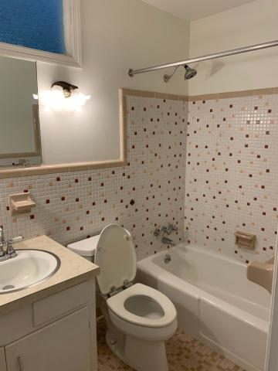


HUGE Price Reduction
107 Saint Margaret Street
Wagener Terrace · Charleston, SC 29403
MLS# 20014417 · $799,000
Michael Dew
O 843-769-5100
M 843-870-7000
michaeledew@gmail.com
www.michaeldewrealestate.com
Completely renovated large 1930's home in Wagner Terrace. 3 bed 2 bath downstairs and 3 bed 1 bath mother in law apartment upstairs. Completely gutted to the studs in 2017 and meticulously renovated. Extremely solid and well constructed home with true brick & masonry 14" thick walls. Personal home of a well known seventh generation local builder/developer. Original hard wood floors, doors, hardware and windows. 10 inch base boards with tons of custom handcrafted woodwork through out the home. Beautiful archways add to the original charm. Remodeled kitchen with white cabinetry, lots of counter space, breakfast bar, and new appliances overlooking living/dining room. Fabulous large front porch and fenced in yard. Sound proof walls and tons of storage. Recessed lighting on dimmers. Fully completed extra room ready for custom master bath or large walk in closet. Upstairs has separate entrance, kitchen, living area, and laundry. Garage with over hang for golf cart storage. All new electrical and plumbing. Spray foam insulation. Only two blocks to Hampton Park and gorgeous sunset views over looking Ashley River at the end of the street.
AgentOwned Charleston Group
902 Savannah Hwy
Charleston, SC 29407
Real Estate ● Mortgage
Insurance ● Business Brokerage

