Slide 1
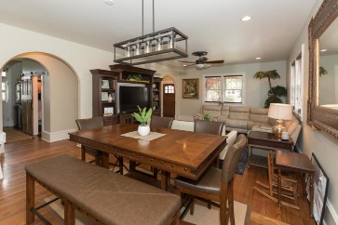
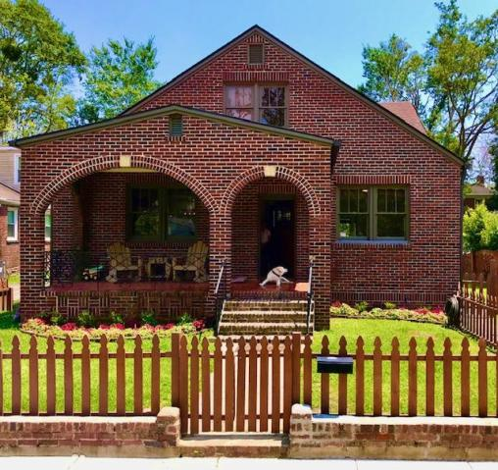
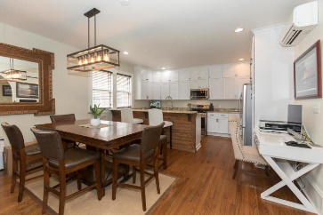
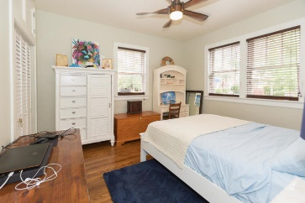
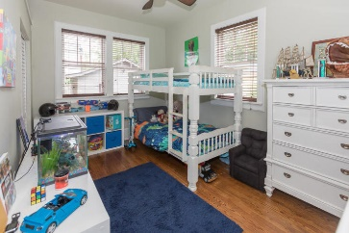
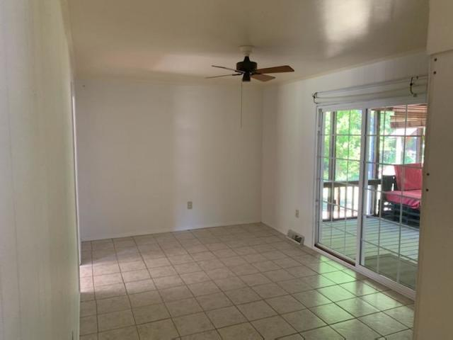
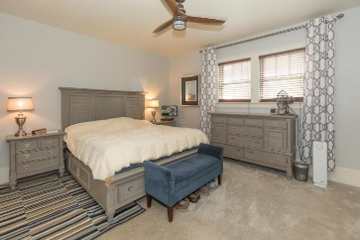
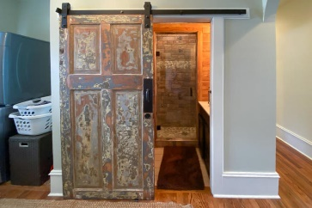
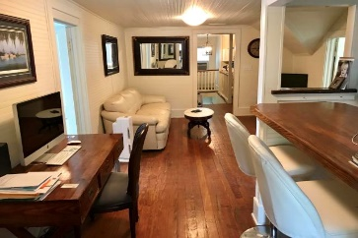
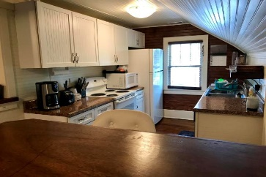
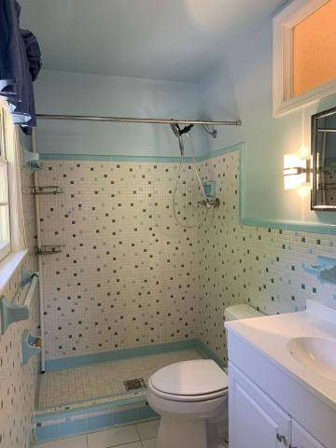
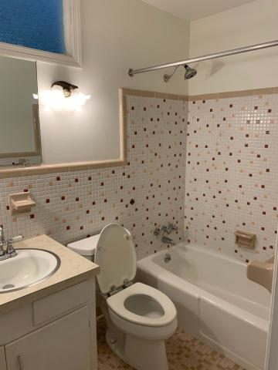


REDUCED! Beautiful Home!
107 Saint Margaret Street
Wagener Terrace · Charleston, SC 29403
MLS# 20014417 · $749,000
Michael Dew
O 843-769-5100
M 843-870-7000
michaeledew@gmail.com
www.michaeldewrealestate.com
Completely renovated large 1930's home in Wagener Terrace on a high lot . Only two blocks to Hampton Park with gorgeous sunset views overlooking Ashley River at the end of the street. This is a Grandfathered duplex zoned and used as a single family (SFR) with 3/2 down and 3/1 upstairs with separate entrances & meters. Owner is willing to flip the hallway staircase to use the entire house as SFR or continue to use upstairs as mother in law apartment. Completely gutted to the studs in 2017 and meticulously renovated with completely new EVERYTHING. Beautiful interior & exterior archways add to its original charm. Modern large & open kitchen with lots of cabinet & counter space, breakfast bar, and new appliances overlooking the living / dining room. Fabulous large front porch and fenced yard. Many original 1930s era interior components were woven into the new renovation including hardwood floors, a nostalgic bathroom, hardware, and 10 inch baseboards with custom handcrafted woodwork throughout. All new electrical and plumbing, spray foam insulation, high efficiency HVAC, sound proofed walls, tons of storage upstairs and downstairs, copper embedded architect shingles with water shield underlayment and a custom designed underground rainwater drainage system to street. Extremely solid and well constructed home with true brick & masonry 14'' thick walls. Personal home of a well known seventh generation local builder/developer. Fully completed extra room ready for custom master bath or large walk in closet. Upstairs has separate entrance, kitchen, living area, and laundry. Nice garage with an overhang for golf cart storage. Great Deal!!!
AgentOwned Charleston Group
902 Savannah Hwy
Charleston, SC 29407
Real Estate ● Mortgage
Insurance ● Business Brokerage

