Slide 1
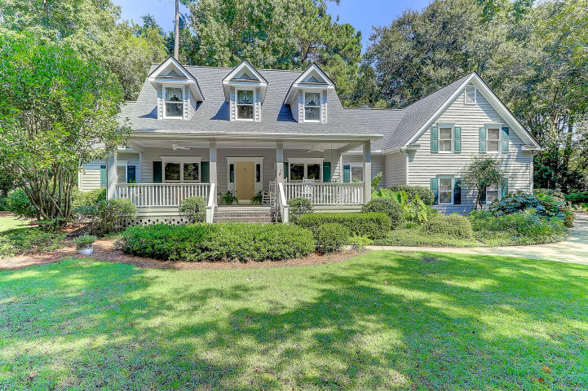
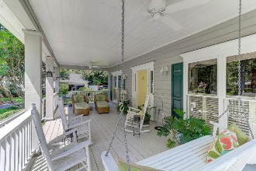
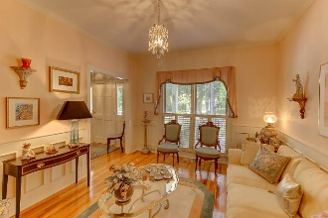
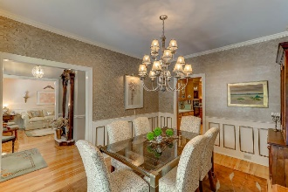
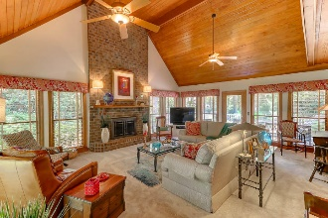
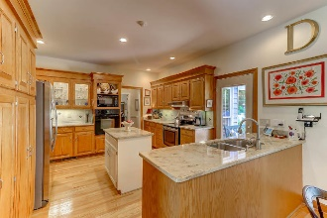
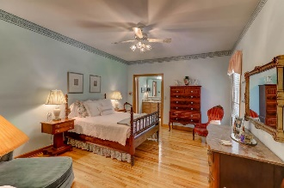
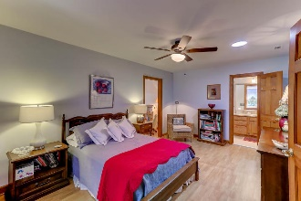
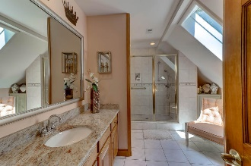
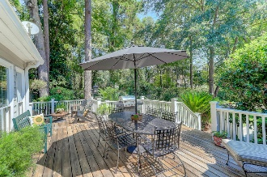
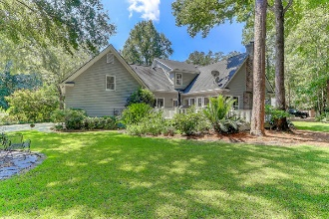

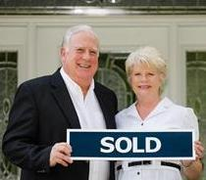
107 Scott Court
Gadsden Manor · Summerville · MLS# 17023355 · $448,900
Dual Masters in Historic Summerville
$550,000
This wonderfully cared for custom built home is located on a quiet cul de sac in Summerville’s highly desired Gadsden Manor neighborhood. Spend time on the inviting full size front porch with ceiling fans or take a short walk/bike ride downtown to enjoy dining, shopping, and recreation. Other features include 5 bedrooms and 3.5 baths, study/living room, formal dining, gourmet kitchen, family-dining area, and laundry room. The over sized family room is enhanced with a gas log fireplace, vaulted ceilings, and was recently carpeted with high-end designer carpeting. The spacious gourmet kitchen with granite counter tops and oak cabinets opens to charming breakfast room along with access to the spacious deck overlooking the garden and lawn. Two master suites add flexibility.
Dual masters each offer walk in closets, tiled baths/showers, and one is complimented by it's own separate office space. The large upstairs bedrooms include ceiling fans, hardwood floors, and window seats for cozy reading nooks. Storage areas abound, including attic storage. Oversized double garage has built in work bench and epoxy finished floor.
American Home Shield warranty is available with the purchase of this home along with a transferable termite bond with quarterly pest management by Ledford's Termite and Pest Control. No flood insurance required for the neighborhood. There are no annual home owner association fees as this property is considered to be an in town family residence. Garbage collection is paid for in your city property taxes.
Tommy Lovett
Tommy - (843) 442-1276
tlovett@carolinaone.com
www.tommylovettrealestate.com
Carolina One Real Estate
628 Long Point Rd.
Mt Pleasant, SC 29464-3032

