Slide 1
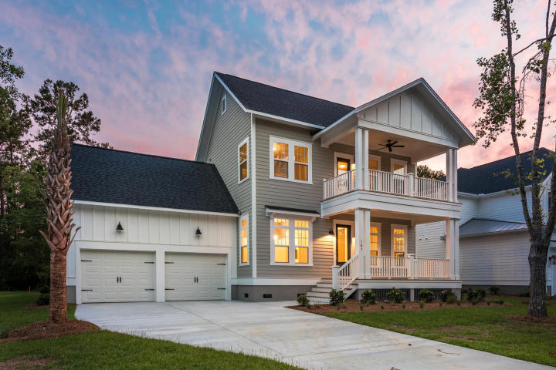
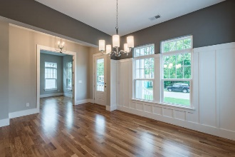
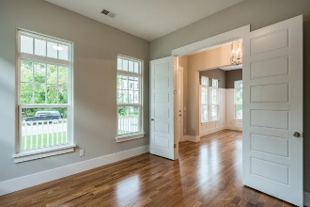
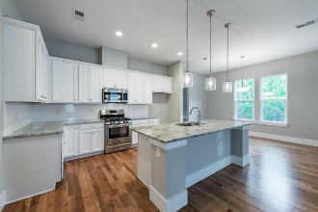
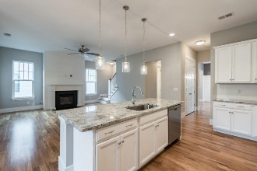
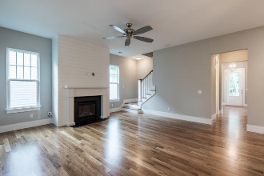
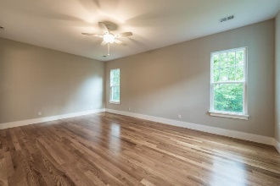
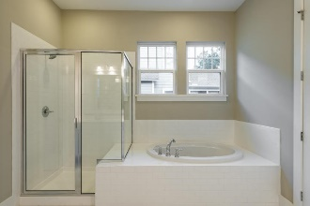
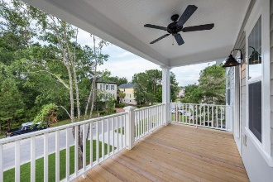
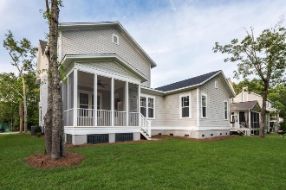


107 Wando Reach Drive
Wando Point | Charleston, SC 29492
MLS# 17017729 | $549,900
The Only Deep Water Home On Daniel Island
Open House Friday ~ 10a-2p
Fantastic new construction in convenient Wando Point. This lovely home offers gleaming hardwood floors, an open floor plan, a gourmet kitchen with a huge island and a gas fireplace. There is a downstairs master suite with all the upgrades and an extra downstairs study attached to a full bath that can serve as the 6th bedroom. Upstairs there are 4 other large bedrooms and 2 more full baths.
The screened porch is perfect for enjoying Charleston summer evenings. The backyard is private! Custom moldings such as board and batten and shiplap reflect the attention to detail this builder has put into this home. Wando Point has a boat landing and is right on the Wando River. This neighborhood is districted to the new elementary and middle schools and the high school which opens in August 2017
Helen Hudson
843-991-9875
helen.hudson@carolinaone.com
Carolina One Real Estate
2713 Highway 17 North
Mt. Pleasant, SC 29466

