Slide 1
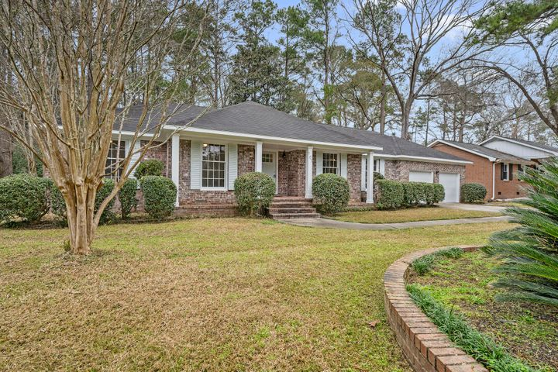
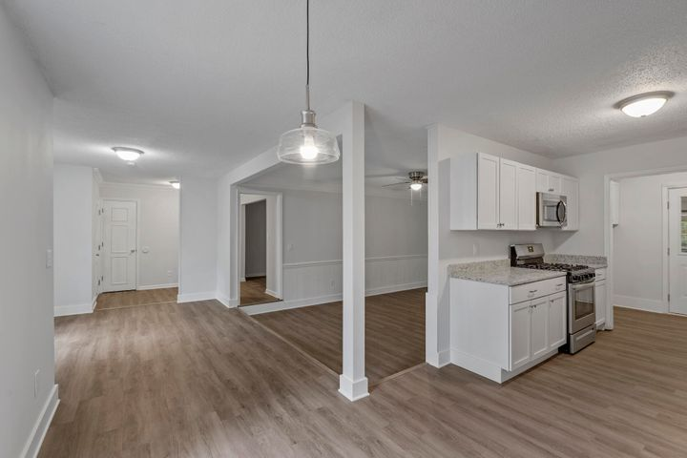
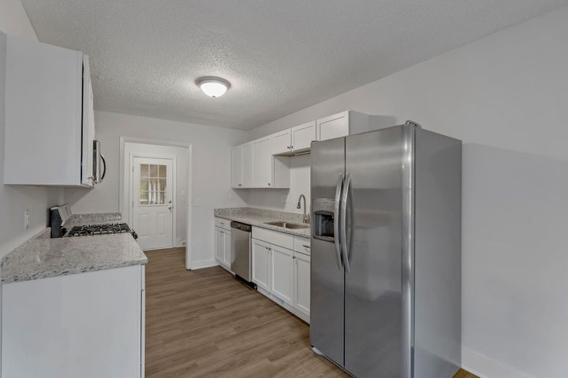
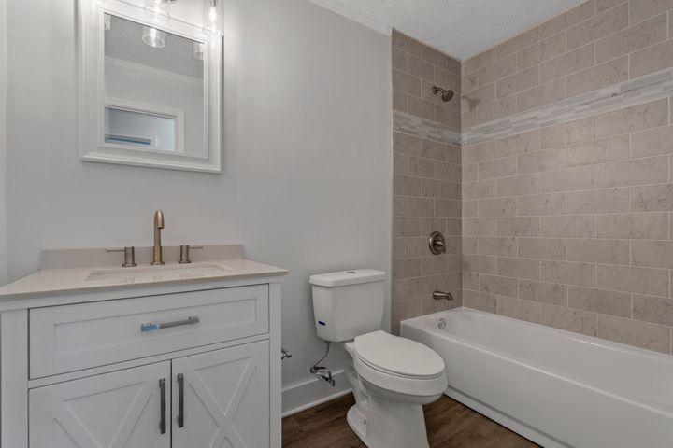
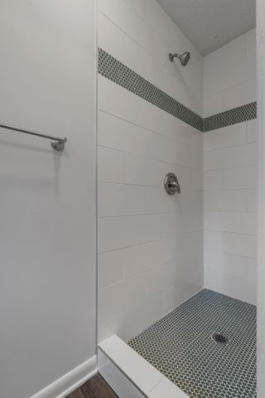


Loaded with Updates
107 Bob White Lane
Quail Arbor | Summerville, SC 29485
MLS# 21004081 | $327,450
Well over 2000 sq ft living space, plus a detached apartment out back with even more! Very unique property in a great neighborhood, with lots of updates. New kitchen and baths, new HVAC system, new flooring and paint throughout home, and the list goes on! DD2 school zoning with Summerville Elementary. Established neighborhood in Summerville with pool and tennis club a quick bike or golf cart ride away. Competitively priced under $330,000.
Justin Natale
843-437-9739 | jnatale1982@gmail.com
www.theblvdcompany.com
The Boulevard Company, LLC | 806 Johnnie Dodds Blvd Ste 100 | Mt Pleasant, SC 29464

