Slide 1
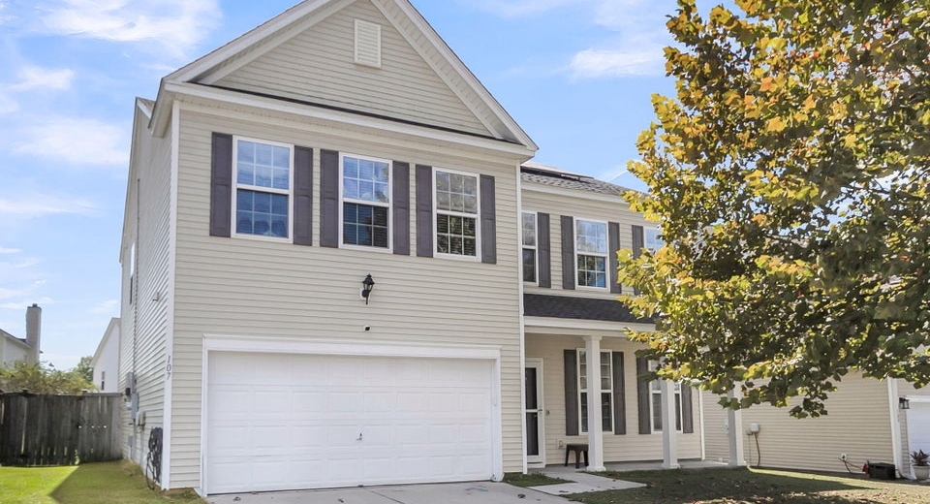
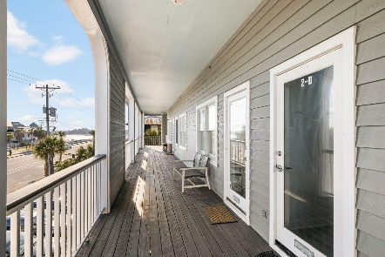
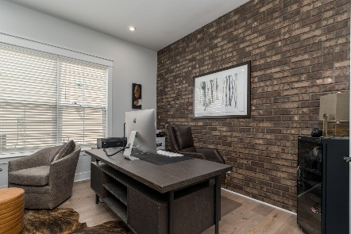
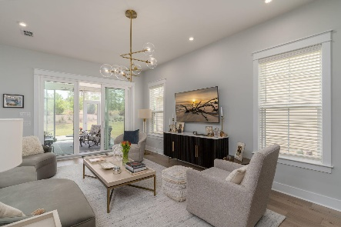

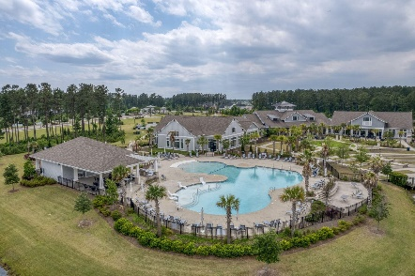
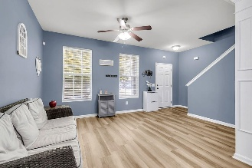
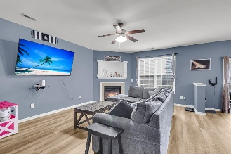
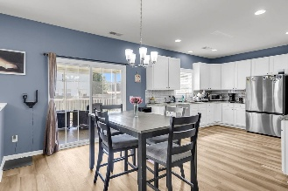
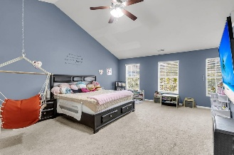
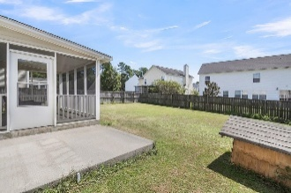
107 Brick Park Lane Brickhope Greens | Goose Creek, SC 29445 | MLS# 25026356 | $394,999
Darrell Creek Elevated Home With Elevator & Salt Pool
Brickhope Greens Beauty
Co-sponsored by
Welcome home to this impressive four-bedroom, 2.5-bath residence, perfectly blending space and comfort in a desirable two-story layout. Built in 2009, this well-maintained house features a convenient two-car garage and an inviting atmosphere from the moment you step inside. The bright foyer leads you into the expansive living room, providing plenty of space for relaxation and gathering. The main floor continues with a large, functional kitchen complete with a separate eating area, ideal for daily meals and entertaining. Journey upstairs to find the heart of the home's living quarters. You'll love the spacious central loft, a versatile area perfect for a media room, home office, or play space. All four bedrooms are located on this level, each thoughtfully equipped with its own ceiling fan for year-round comfort. The oversized master suite is a true retreat - it must be seen to be appreciated! For ultimate convenience, the laundry room is also perfectly situated upstairs.
Step outside to discover your private outdoor oasis. The fully fenced backyard offers tranquility and security, highlighted by a generous screened porch that transitions seamlessly to an extended patio. This setup is perfect for hosting summer barbecues, enjoying morning coffee, or simply relaxing in the fresh air. This is the perfect setting for making lasting memories! Paid off solar panels to help reduce cost and increase your savings on utility bills.
Seller motivated and offering concessions.
Offering $3000
Lender Credit
Rochelle Rennert
843-847-9694 | rochellesellscharleston@gmail.com | www.theunlockingdreamsteam.com
AgentOwned Premiere Group, Inc. | 219 N Highway 52 Ste A | Moncks Corner, SC 29461-3926

