Slide 1
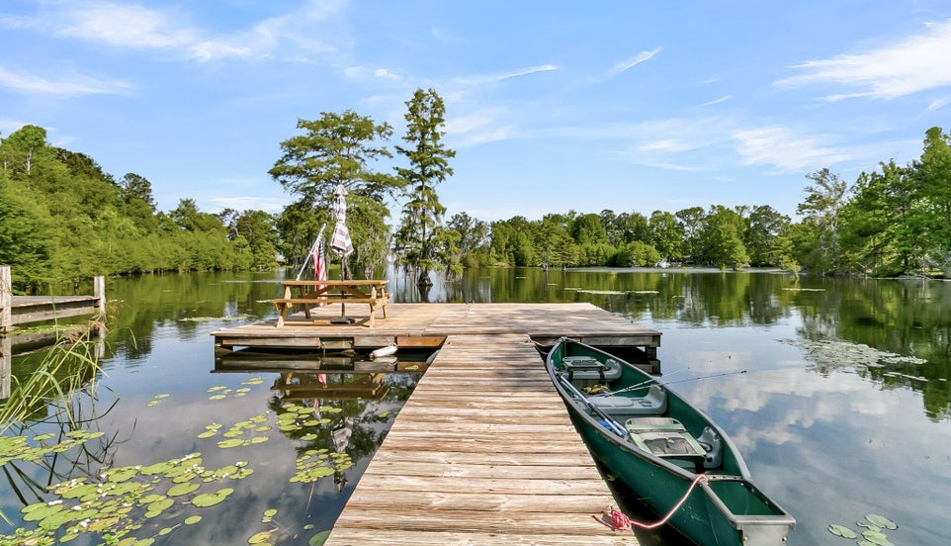

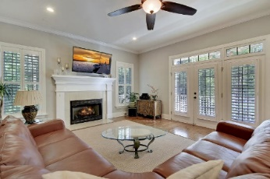
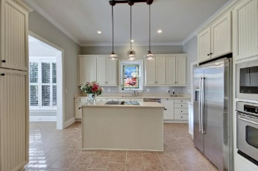
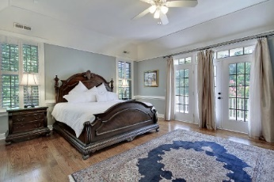
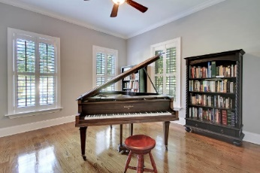
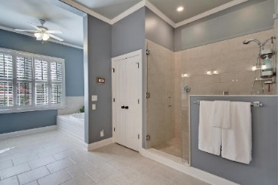
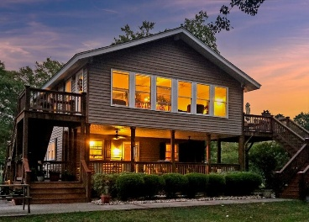
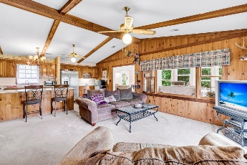
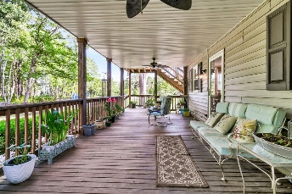
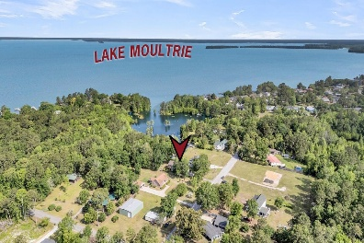
Price Improvement
Price Reduced!
Happy Hour Broker Open House Friday, Nov 22 from 3-5
$100 Gift Card Giveaway
107 Jacks Lane
General Moultrie | Bonneau, SC 29431 | MLS# 25012682 | $855,600
A Million Dollar View for Under a Million! LAKE MOULTRIE LAKEFRONT! Experience the timeless beauty of this intimate cove tucked serenely within majestic Lake Moultrie in Berkeley County. This rustic lakefront home offers the epitome of lake living with seasonal water lilies, irises, and more lining the private dock walkway to your secluded fishing and kayaking outings any time of day. Three neighborhood launches conveniently accommodate your boat trips on the 60,000-acre Lake Moultrie — with both Waterfront - shallow and Waterfront - deep access, opening the door to a wider range of lake enthusiasts and buyers seeking diverse waterfront experiences. Whether you're watching the sunrise over the lake or enjoying a peaceful evening paddle, this waterfront property delivers the dream of serene lake life. As you approach the home, a wood rail fence, mature trees and flowers, expansive yard, and thoughtful landscaping set a tone of tranquility.
Designed with a reverse floor plan to take full advantage of the breathtaking views, the upper level features an open-concept living area and kitchen. The kitchen is a warm and inviting space with knotted pine cabinets, granite countertops, a breakfast bar, dual sinks (including a separate vegetable sink), and stainless steel appliances, including a new GE refrigerator and a ZLINE convection gas range. Vaulted, beamed ceilings enhance the openness and natural light, while the adjacent family room offers ample space to relax and unwind.
Just off the main living space is the sunroom, one of the home's most cherished spots. With soaring ceilings and panoramic windows, it's the perfect place to enjoy incredible views of the backyard, lake, and surrounding wildlife. You'll love watching ducks, geese, egrets, bald eagles, deer, white squirrels, and all sorts of local wildlife from the comfort of your home. Step onto the deck from the sunroom to enjoy even more outdoor living whether it's coffee at sunrise or a glass of wine at sunset. The lower level houses the primary bedroom, a peaceful retreat with access to a large, covered porch overlooking the lake. The en-suite bathroom features a Jacuzzi 10-jet tub, a large step-in shower finished with natural stone and colored glass block, a marble vanity, and travertine tile flooring. Two additional bedrooms, another full bath with equally fine finishes, and a generous recreation room complete the interior layout.
Outside, the magic continues. The backyard, with its mature trees and open space, is ideal for entertaining or simply enjoying the peace and beauty of the lake. From here, stroll out to your private dock, where lake adventures await. A 12x26 carport provides plenty of storage for your boat, camper, jet ski, or other vehicles, making it easy to enjoy every aspect of life on the water. This home is conveniently located just over 30 miles from the Volvo Car US Operations in Ridgeville and the Naval Weapons Station in Goose Creek. This is more than just a home; it's a lifestyle! Come experience what makes Lake Moultrie living truly special.
***Ask about the possibility of receiving 1% reduction in interest rate and free refi.***
Nancy Hawkins nancy@charlestonishome.com 843-324-2850

