Slide 1
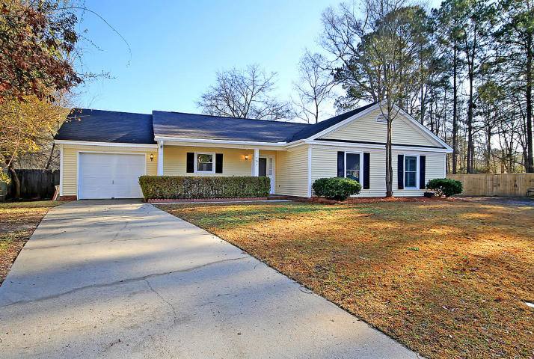
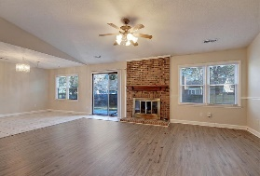
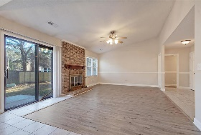
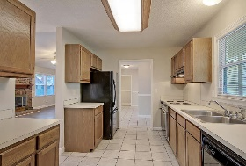
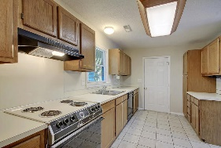
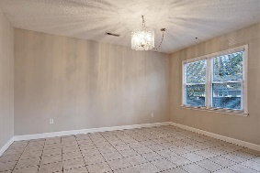
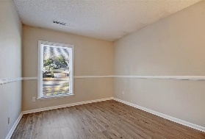
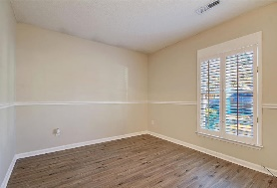
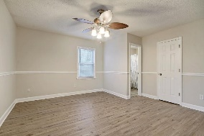
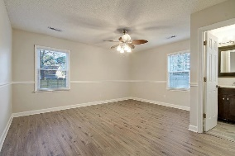
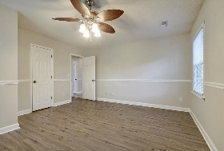
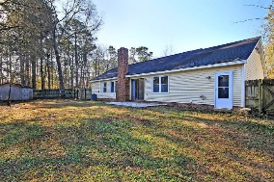
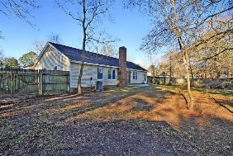
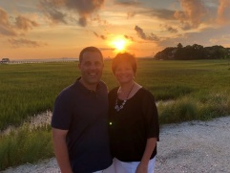

One Story in Cul De Sac! $219,000!!
107 Kings Court
Crowfield Plantation
Goose Creek, SC 29445
MLS# 21001382
$219,000
3 Bedrooms | 2 Baths | 1450 sf
This 3BR, 2BA one story home is 1,450 Sq. Ft. and features new flooring, new windows and a newer HVAC unit as well as some freshly painted rooms inside. Buyers will enter into the front foyer and straight ahead see the family room with fireplace and new flooring. To the left is the kitchen which opens to a dining room and family room. The kitchen has ample counter space and cabinetry. On the right hand side of the home buyers will find all 3 bedrooms and 2 full bathrooms. The master bedroom overlooks the backyard and has a walk-in closet as well as it's own master bathroom. The backyard is fenced in and has plenty of room for children or animals to play. The neighborhood offers a community pool, walking trails and the Crowfield Golf course is nearby! This home is a must see!
Larry & Kathy Mazalatis
Larry Cell 843-693-0529
Kathy Cell 843-693-0159
Office 843-871-9133
AGENTOWNED PREMIERE GROUP | 1800 TROLLEY RD | SUMMERVILLE, SC 29485

