Slide 1

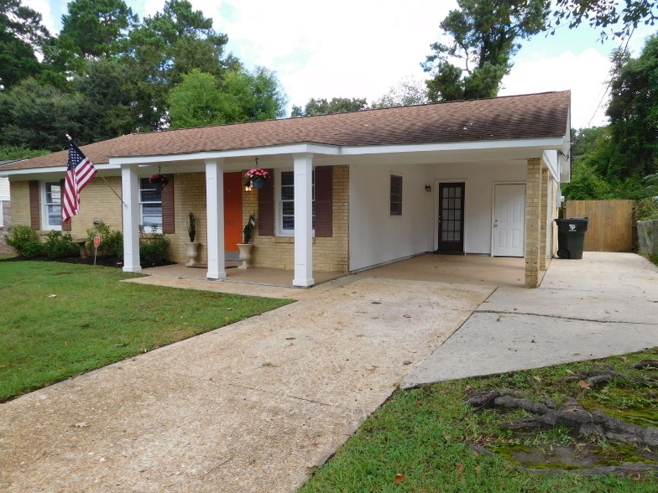
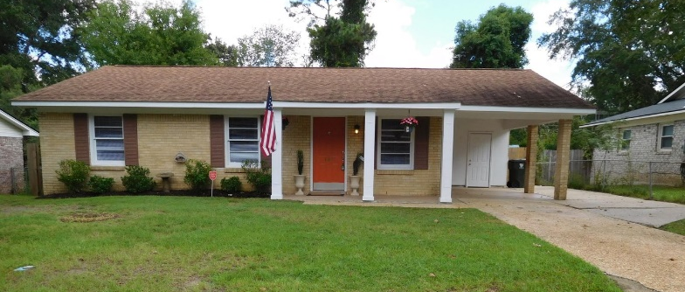
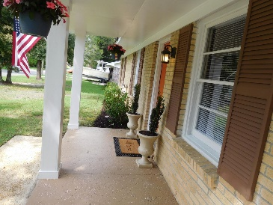
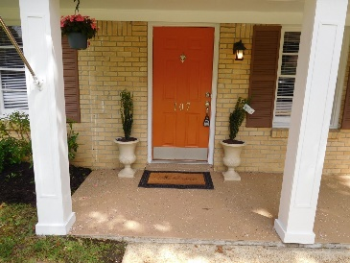
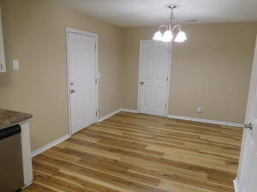
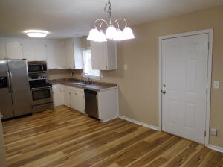
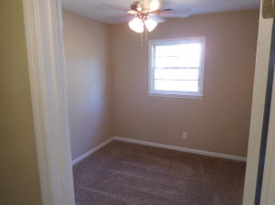
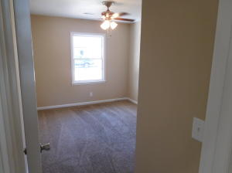
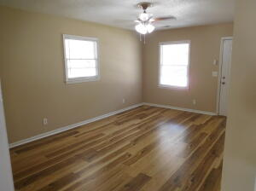
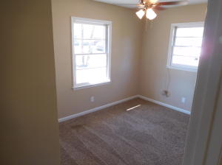
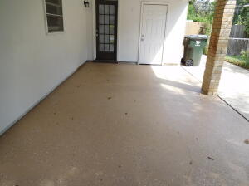
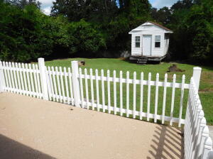
Don C. Mason, CIAS, CNE
(843) 364-9090 nibsc@aol.com
All Brick
4 Bedrooms
OPEN HOUSE SUNDAY 9/18 ~ 2-5P
107 Millburn Avenue
Sedgefield
Goose Creek, SC 29445
MLS# 22023832 ~ $300,000
Property Subtypes: Executive Suites, Office Building
Building Size (RSF): 2,400 SF
Sale Price: $379,000
Cooperation Compensation: 3%
Property Use Type: Investment/Professional Office
Usable Size (USF): 2,400
Sale Terms: Cash to Seller
Agency Type: Exclusive Right to Sell/Lease
Great curb appeal. Fresh & clean, Move in ready. True 4 bedroom all brick ranch. This home was totally renovated 5 years ago. To include new architectural shingled roof. New heat & air units. New water heater. New upgraded electrical panel to 200amp. All new stainless appliances to include smooth top range, dishwasher, built in microwave and a side-by-side fridge. All new vanities, faucets, toilets, mirrors in both bathrooms. All new doors, ceiling fans, lights etc. Huge Private fenced backyard with a storage shed. Nice patio. Close to good schools.
Real Estate Advocates LC
3356 Billings Street | Mt. Pleasant, S.C. 29466 www.realestateadvocates.com

