Slide 1
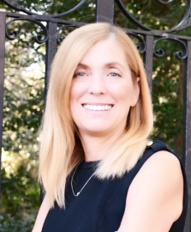
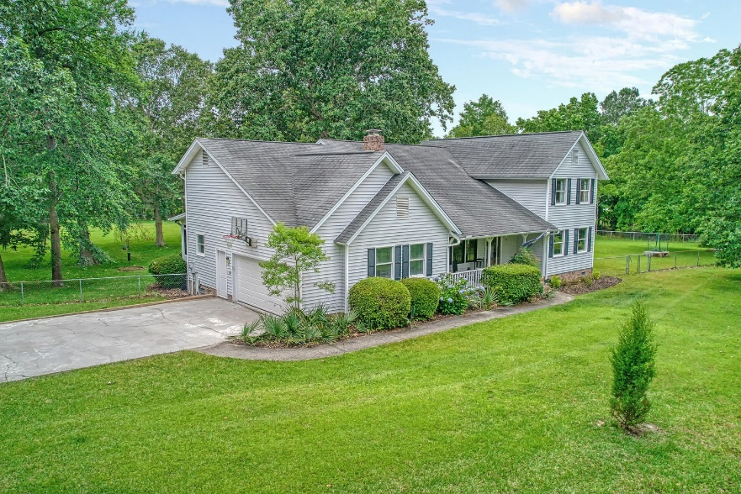
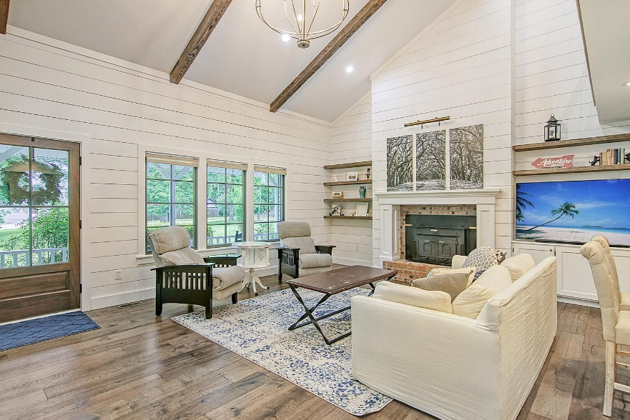
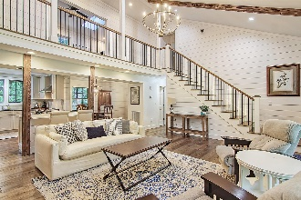
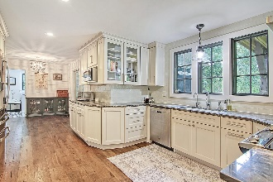
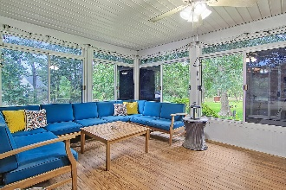
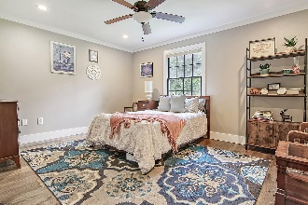
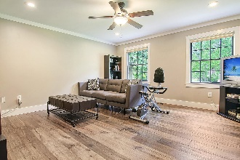

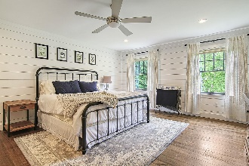
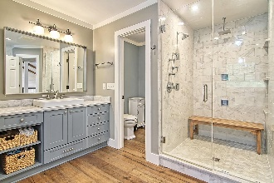
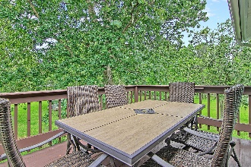
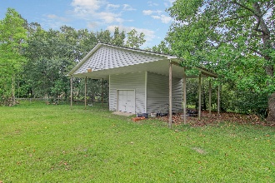
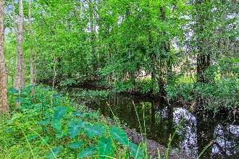
Beautiful Renovated Home On 2 Acres
In Unincorporated Dorchester County
Debbie Cromer
ABR, RSPS, REALTOR, CRS
(843) 437-6342
debbie@debbiecromer.com
www.debbiecromer.com/
107 Nightingale Manor
North Charleston, SC 29418 | MLS# 23011942 | $800,000
Escape to your own private oasis on this 2.29-acre property. This home has been fully renovated and offers a gracious lifestyle for entertaining with its spacious open floor plan flooded with natural light. When you step inside, beautiful wood floors throughout featuring vaulted ceilings and shiplap walls illuminated by recessed lighting greet you. The stunning kitchen is complete with granite and quartz countertops, stainless steel appliances, a large farm sink, and an island with breakfast bar. Upstairs features the luxurious master suite which includes two walk-in closets leading towards an amazing spa-like bathroom. An additional large bedroom is also upstairs along with a private bath as well as a media room that leads to a deck offering stunning views of the expansive backyard. Downstairs there are two more bedrooms along with another full bath. The property is fenced-in and surrounded by tranquil creeks providing ultimate privacy without sacrificing access to all that Charleston has to offer - just minutes from Boeing, CHS Int'l Airport, CHS AFB, Historic Downtown Charleston, Mt Pleasant or Summerville while being able to enjoy nature in your own backyard!
New Heat Pump HVAC 2022 | New Heat Pump Water Heater 2021 | New Plumbing under the House 2021 | REME Halo Air filtration system 2021 | New Garage Door
Video Tour: https://vimeo.com/830436902
Century 21 Properties Plus | 1090 Park West Blvd; Ste 103 | Mount Pleasant, SC 29466

