Slide 1
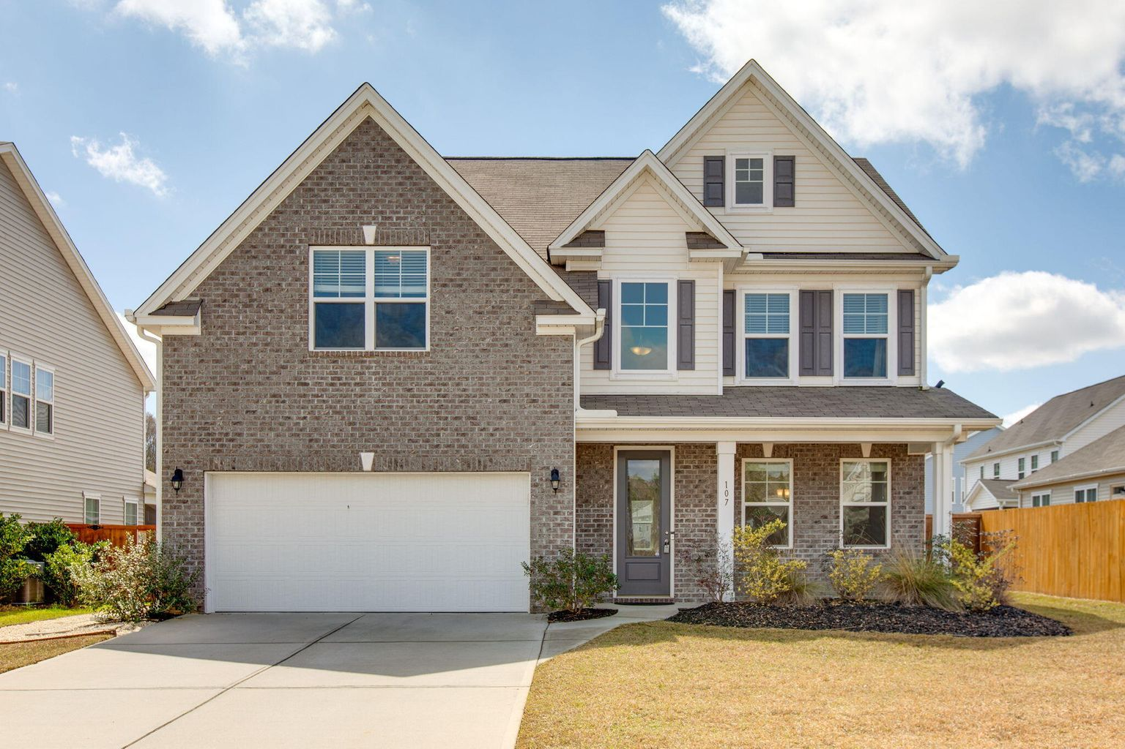
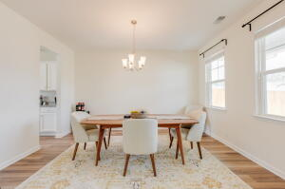
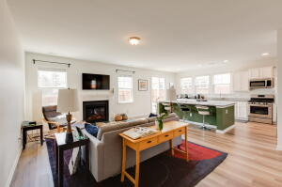
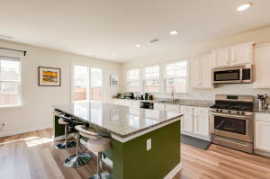
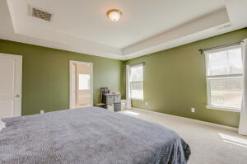
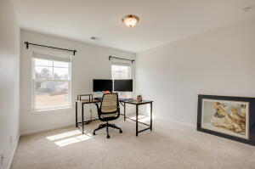
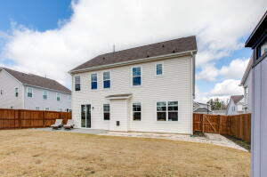
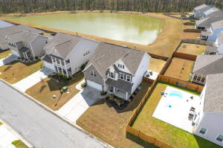


107 Nolin Road
Spring Grove Plantation | Moncks Corner | MLS# 22006683 | $415,000
Just Listed!
This beautiful home checks all of the boxes! From the moment you step inside, you will be wowed by the light-filled 2-story foyer, beautiful LVP floors, open concept first floor and the gorgeous chef's kitchen with an 8' Island. Spacious bedroom on the main level with a full bathroom just steps away is perfect for guests, a family member that doesn't like to climb steps or an office. The huge living room has a gas fireplace and is a great place to relax. Drop zone off of the 2 car garage access round out the first floor. Upstairs is a large Primary En-Suite with a spacious bathroom and walk-in closet, 3 additional bedrooms and one full bathroom. The backyard is fully fenced, has a patio perfect for grilling and dining outside and has a lovely view of the pond. Fantastic amenities included.
Take a virtual tour: https://my.matterport.com/show/?m=QgzgfyPEF6b
Beth Mandell
M 803-463-7734 | O 843-871-2121
bmandell@century21properties.com
www.bestcarolinahomedeals.com
Century 21 Properties Plus of Summerville | 118 W Richardson Ave | Summerville, SC 29483

