Slide 1
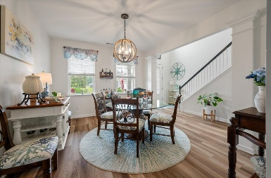
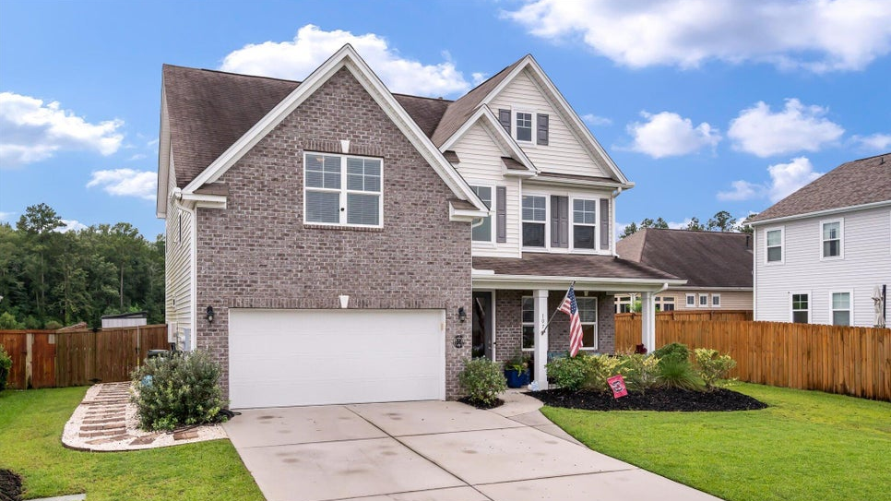
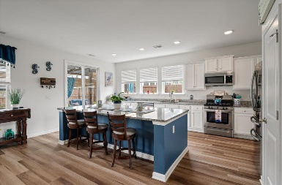
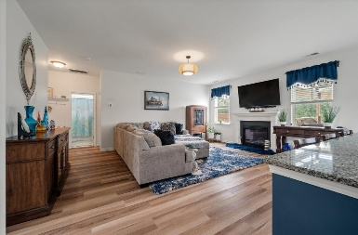
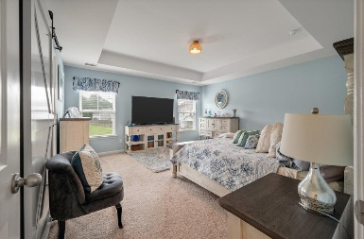
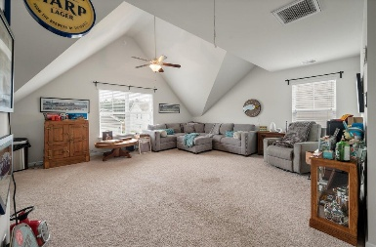
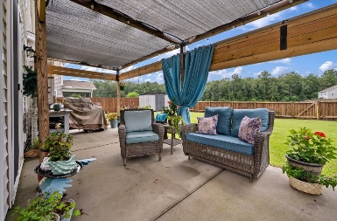
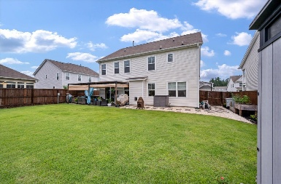


107 Nolin Road Spring Grove Plantation · Moncks Corner, SC 29461 · MLS# 25021782 · $435,000
Five Bedroom Home For Sale
This five bedroom home is located in the beautiful community of Spring Grove Plantation in Moncks Corner. The house sits on a large lot with lovely views of the pond. As you enter the home to the right is a formal dining room. Through the dining room you walk into the spacious kitchen with a gigantic amount of counter space. There is a large island with ample seating. The kitchen also has a pantry & lots of windows that bring in tons of natural light. There are stainless steel appliances including a gas range and the white cabinets with lovely crown molding. The kitchen opens up to the family room that has a gas fireplace and past the family room there is a guest bedroom with a full bath that is currently being utilized as an office space.
Upstairs you will find 3 large bedrooms including the primary suite and a large media room that could be used as a 5th bedroom. The primary suite has a large en suite bathroom with a bathtub and stand alone shower and the master closet is massive! The laundry room is conveniently located on the second floor and it is exceptionally large which is a must have!
The home also has a 2 car attached garage and as you enter into the home through the garage there is a built in drop zone. This property also has a spacious patio area in the backyard which the current homeowners have turned into a wonderful outdoor oasis. There is a pergola situated on the patio that is perfect for hanging out under! Spring Grove Plantation is a gorgeous community that boasts tons of walking trails and a lovely community pool.
Carey Nikonchuk
843-276-1701
cnikonchuk@gmail.com
www.brennamangroup.com

