Slide 1
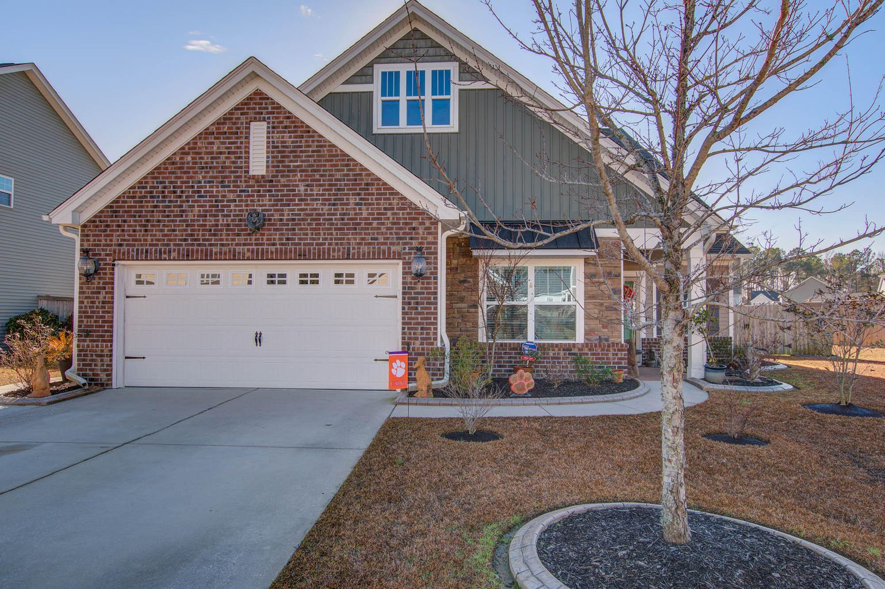
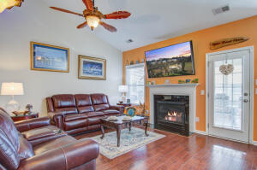
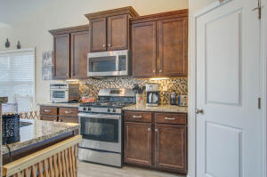
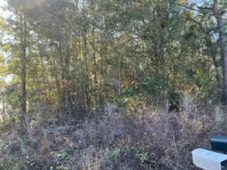
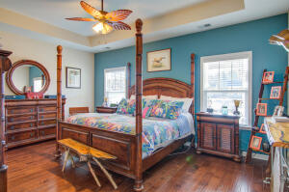
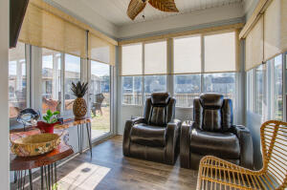
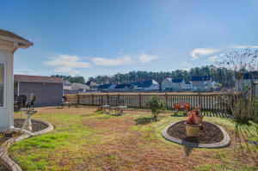
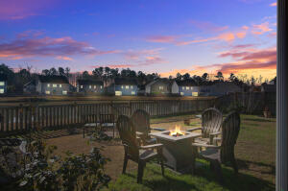


Just Listed - Must See!!
Reduced!
107 Vessey Drive
Spring Grove Plantation · Moncks Corner, SC 29461
MLS# 23000715 · $379,000
Michael Dew
O 843-769-5100
M 843-870-7000
michaeledew@gmail.com
www.michaeldewrealestate.com
Beautiful, very well kept 3 bed 2 bath home on pond in Spring Grove Plantation. Professionally landscaped. Open floor plan. Kitchen with granite counter tops, stainless steel appliances, backsplash and island. All open to the family room with vaulted ceilings and gas fire place.
Master en suite with dual sinks, separate tub and shower. Sunroom with mini split. Covered porch overlooking fenced back yard with beautiful water views. A fisherman's paradise right outside your home. Storage building with electricity. 2 car garage with porcelain tile flooring and mini split for comfort.
AgentOwned Charleston Group
902 Savannah Hwy
Charleston, SC 29407
Real Estate ● Mortgage Insurance ● Business Brokerage

