Slide 1
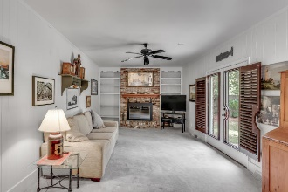
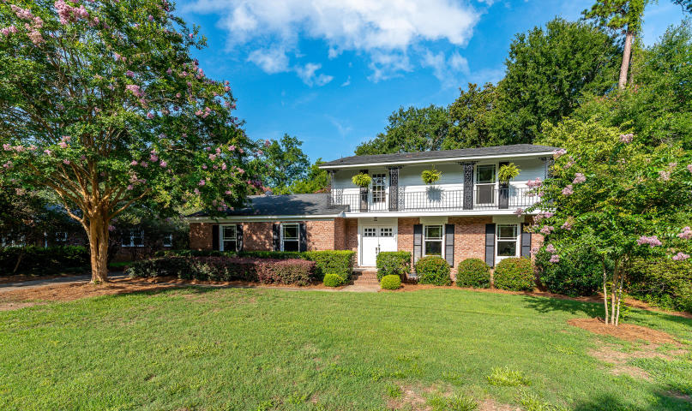
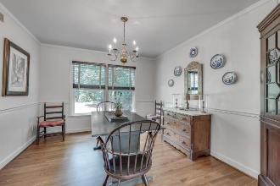
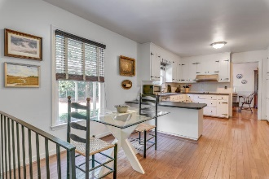
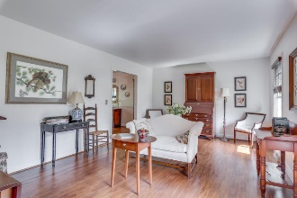
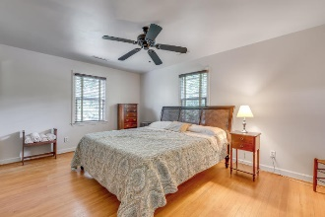
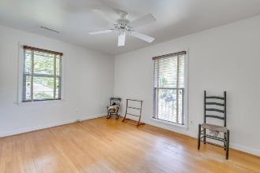
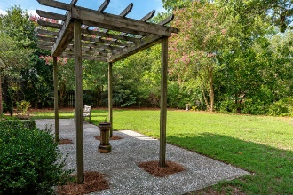
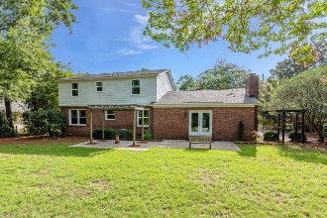
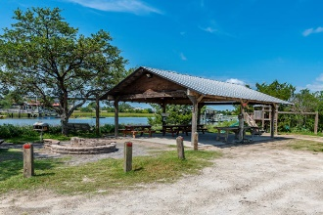
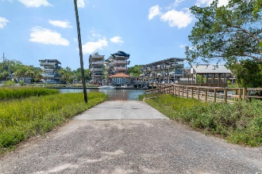


End Unit Townhome on Golf Course w/ Screened Porch
Starbucks card to first 10 agents
1081 Cottingham Drive
Cooper Estates ~ Mount Pleasant, SC 29464
MLS# 19020183 ~ $545,000
Lovely Cooper Estates 4 br, 2 story home that features a bright open & spacious floor plan. Downstairs offers a traditional floor plan with a formal living room as well as a separate dining room that opens into the kitchen w/ breakfast nook which overlooks family room and backyard areas. The back yard is extremely private with lush landscaping and mature trees.
Upstairs is the master bedroom suite as well as 3 other bedrooms & 2nd full size bath. There are 2 attic areas offering plenty of storage, and also an attached garage with washer/dryer and workbench. New HVAC units & upstairs ductwork were replaced in 2014, and new roof and Pella windows were installed in 2010. The kitchen includes stainless dishwasher and refrigerator along with double wall ovens, smooth top stove, stainless vent hood and new subway tile.
No flood insurance required, and an active termite warranty is in place. Within easy walking distance to private gated boat landing with access into Shem Creek, covered dock, fish cleaning station & party shelter! The Shem Creek Boardwalk and restaurants are so close you can walk, bike or golf cart to them! Neighborhood has easy access to Coleman Blvd or Hwy 17, and within 5 mile radius of Mt. Pleasant Waterfront Park, Downtown Charleston and of course several beaches!
Move-in ready & priced to sell!
Jerod Coulter, ABR, REALTOR
(843) 513-3741
jerod@realtor.com | www.HomesOfMountPleasant.com
The Boulevard Company, LLC | 35 Broad Street | Charleston, SC 29401

