Slide 1
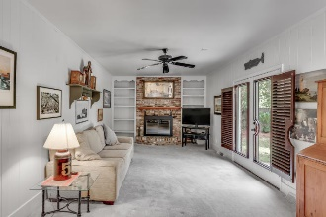
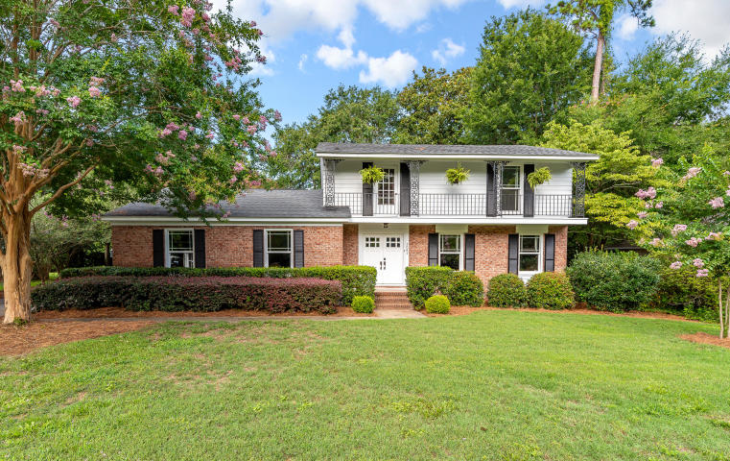
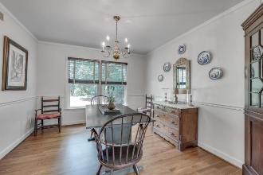
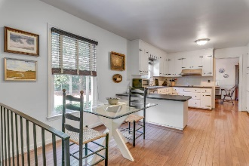
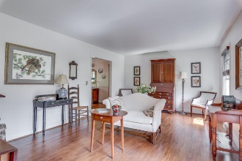
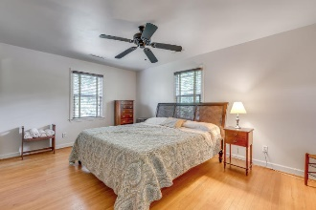
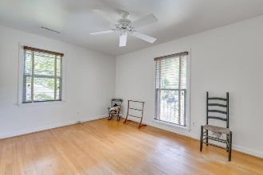
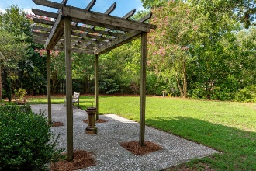
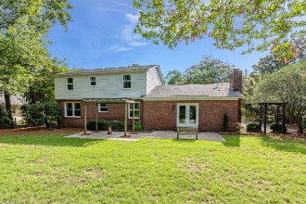
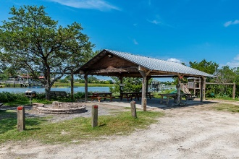
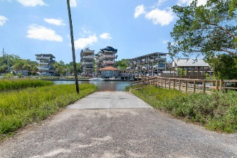


End Unit Townhome on Golf Course w/ Screened Porch
Starbucks card to first 10 agents
1081 Cottingham Drive
Cooper Estates ~ Mount Pleasant, SC 29464
MLS# 19020183 ~ $525,000
Huge Price Reduction ~ Motivated Sellers!
Cooper Estates 4 Bedroom Two Story home
Bright open & spacious floor plan.
New HVAC units & upstairs ductwork were replaced in 2014
New Roof and Pella windows were installed in 2010
No Flood Insurance
Extremely private backyard with lush landscaping and mature trees
Tons of Storage - 2 Attic areas
Attached garage
Kitchen includes stainless dishwasher and refrigerator along with double wall ovens, smooth top stove, stainless vent hood and new subway tile.
Active termite warranty is in place.
Downstairs offers a traditional floor plan with a formal living room as well as a separate dining room that opens into the kitchen w/ breakfast nook which overlooks family room and backyard areas.
Easy WALKING distance to private gated boat landing with access into Shem Creek, covered dock, fish cleaning station & party shelter
Move-in ready & priced to sell!
Jerod Coulter, ABR, REALTOR
(843) 513-3741
jerod@realtor.com | www.HomesOfMountPleasant.com
The Boulevard Company, LLC | 35 Broad Street | Charleston, SC 29401

