Slide 1
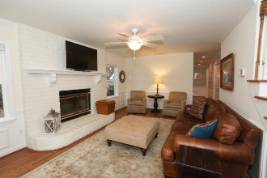
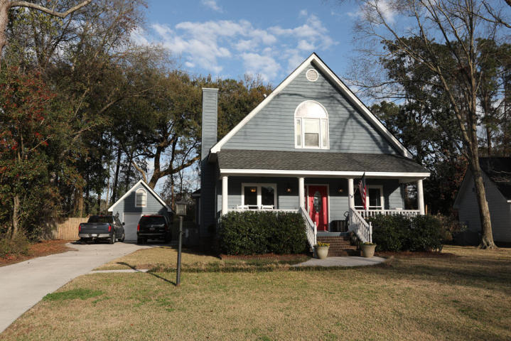
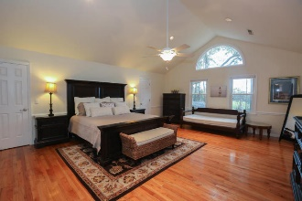
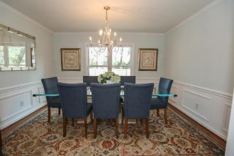
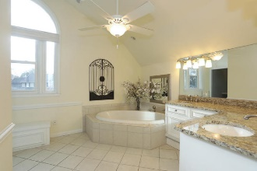
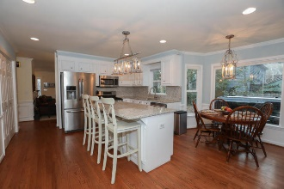
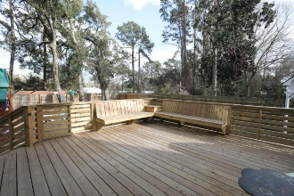
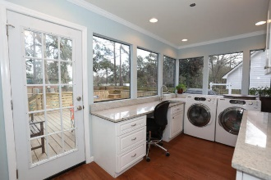
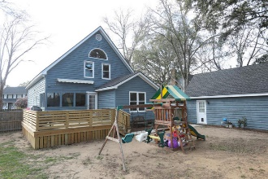


Open House ~ Saturday, December 8 ~ 11-2
1082 Blue Marlin Drive
Harbor Woods III · Charleston, SC 29412 · MLS# 18026857 · $424,000
Must see! Beautiful 3 bedroom 2 bath home on James Island. Very desirable location. Hardwood floors through out. Downstairs freshly painted with newer windows. Crown molding in living areas. Smooth ceilings. All new blinds. Separate ding area and den with wood burning fireplace and wainscoting. Large remodeled eat in kitchen with island, stainless steel appliances, gas range, granite counter tops and back splash. 2 bedrooms downstairs and renovated bath with tile flooring. Big laundry room with granite folding table, sink and storage. Upstairs you will find a huge master with attached office or nursery. Gorgeous en suite with garden tub and walk in shower. Enjoy the new deck with automated awning overlooking the backyard with privacy fence and separate boat storage. No HOA!
Michael Dew
O 843-769-5100
M 843-870-7000
michaeledew@gmail.com
www.michaeldewrealestate.com
AgentOwned Charleston Group
902 Savannah Hwy
Charleston, SC 29407
Real Estate ● Mortgage
Insurance ● Business Brokerage

