Slide 1
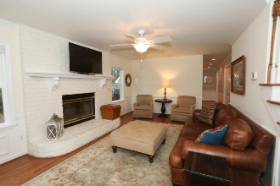
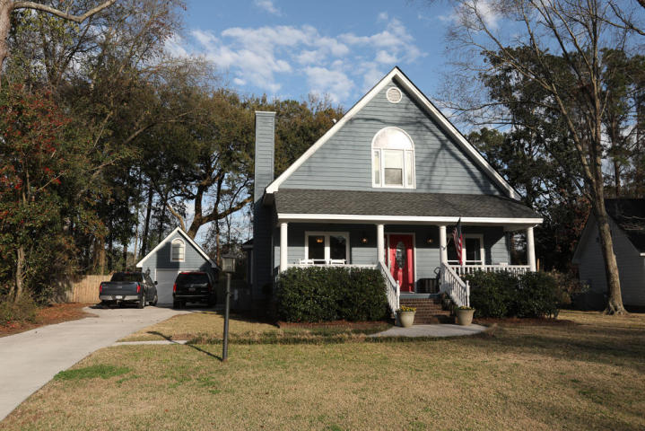
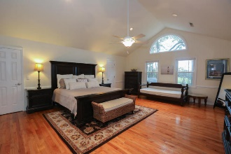
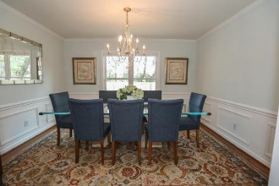
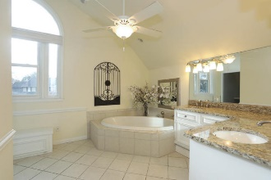
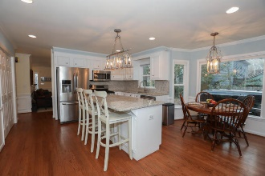
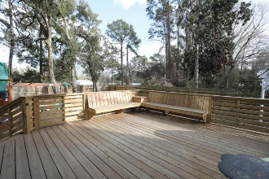
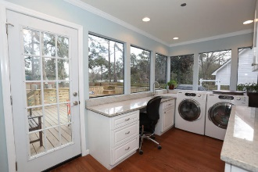
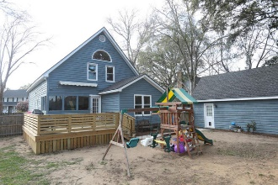


Price Reduced!
1082 Blue Marlin Drive
Harbor Woods III · Charleston, SC 29412 · MLS# 18005076 · $434,900
Gorgeous home in fabulous location on James Island. No HOA! 3 bedroom 2 bath home. Hardwood floors through out. Tiled bathrooms. Smooth ceilings. Crown molding in living areas. Large updated eat in kitchen with island, stainless steel appliances, granite counter tops, back splash, and gas range. Separate dining and den with wood burning fire place. Both with wainscoting. Big laundry room with sink, granite counter folding table and cabinets. 2 bedrooms downstairs with renovated bath. Huge master upstairs with large en suite with garden tub and walk in shower and attached office or nursery. Nice new deck with automated awning over looking backyard with privacy fence and separate boat storage. Downstairs windows were replaced in 2015 and new blinds installed on all windows. Interior and exterior was painted in 2015 as well as new roof installed. 2 light fixtures in kitchen and 1 in dining room do not convey. Seller will replace. Must see!!
Michael Dew
O 843-769-5100
M 843-870-7000
michaeledew@gmail.com
www.michaeldewrealestate.com
AgentOwned Charleston Group
902 Savannah Hwy
Charleston, SC 29407
Real Estate ● Mortgage Insurance ● Business Brokerage

