Slide 1
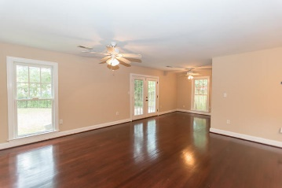
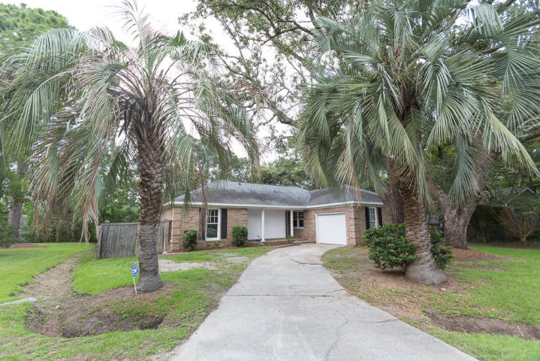
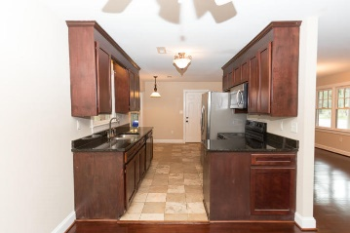
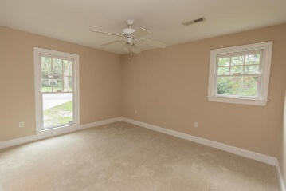
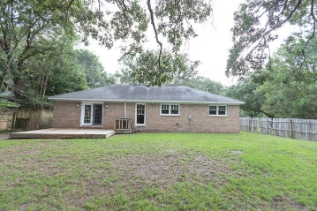
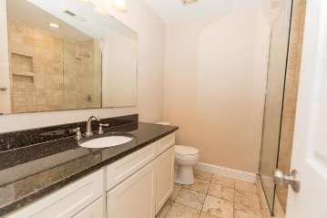
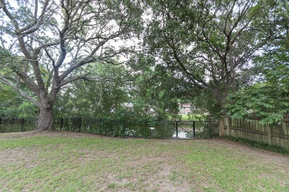


New Price! Great James Island Location!
1082 Wellington Court
Lawton Bluff · Charleston, SC 29412
MLS# 19021179 · Reduced to $334,000
Beautiful 3 bedroom, 2 bath brick home in desirable, established neighborhood. Home is situated on a quiet cul de sac on pond. Hardwood floors throughout living area. Interior freshly painted. Eat in kitchen with bay window, granite counter tops and travertine flooring. . Open concept living and dining. Perfect for entertaining. New carpet in all 3 bedrooms. Master has en suite with travertine tiled walk in shower. Deck overlooking private fenced in yard on pond. Convenient to shopping, rec center, Folly Beach and downtown. Must see!
Michael Dew
O 843-769-5100
M 843-870-7000
michaeledew@gmail.com
www.michaeldewrealestate.com
AgentOwned Charleston Group
902 Savannah Hwy
Charleston, SC 29407
Real Estate ● Mortgage
Insurance ● Business Brokerage

