Slide 1
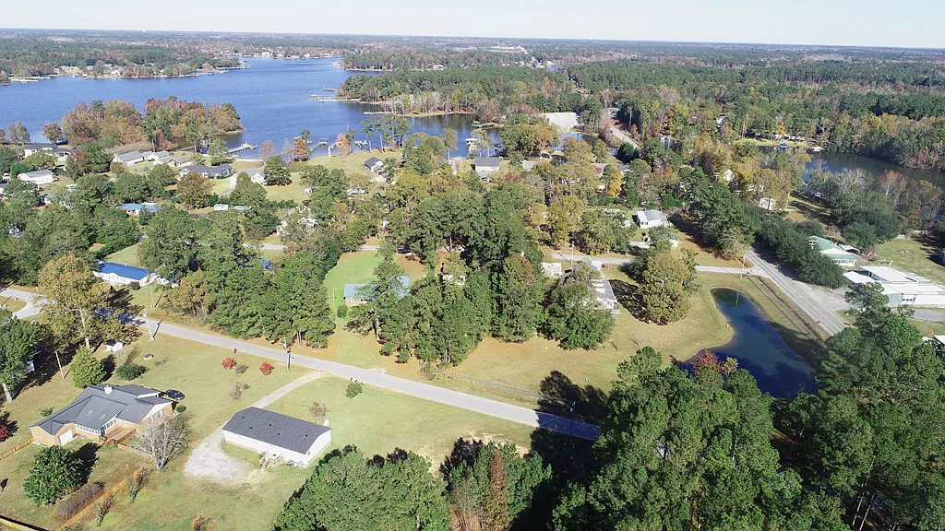
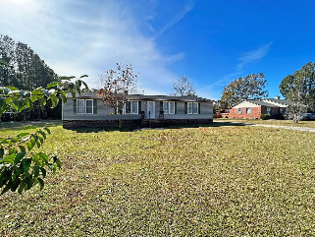
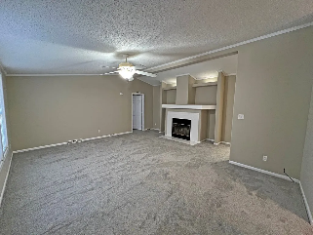
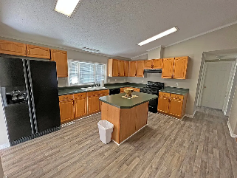
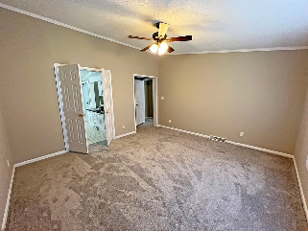
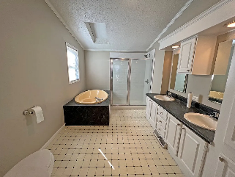

Lake Marion Area Home with Land
1085 W. A. Gamble Road
Manning, SC 29102 ~ MLS# 155640 ~ $220,000
Move to Lake! This Moblie Home sits on a large lot with its very own POND. Alex Harvin Boat Ramp (public) is 1 min around the corner - Sail to Charleston from the ramp. The lot features a large back yard with road access from front and back of the property. The pond sits fully on this lot and is not shared. The home offers a large Master with walk in closet and master bath, Hardwood in dinning room, fireplace in the large den and a kitchen big enough for the family to sit and enjoy. Apple and Pear Tree on the property. Roof and AC replaced in 2020.
Lake Homes Realty, LLC
Elloree, SC 29047
www.SCLakeLife.com
Kristie Anderson
(803) 387-9459
kristie@sclakelife.com

