Slide 1
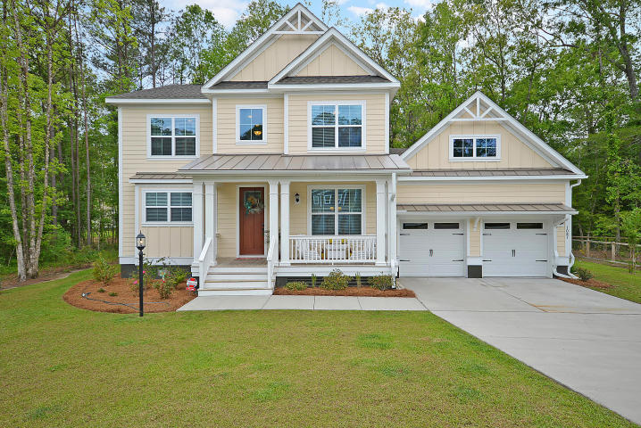
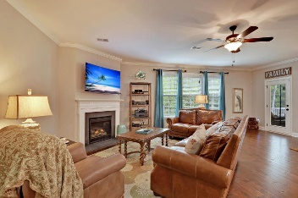
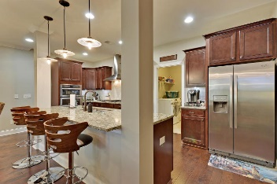
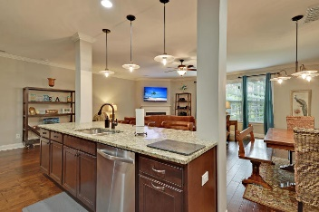
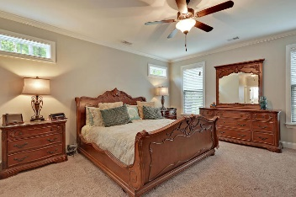
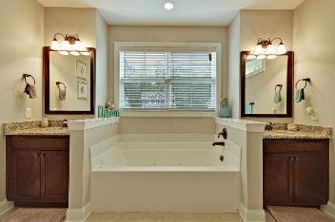
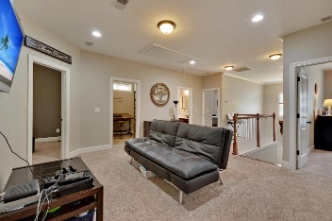
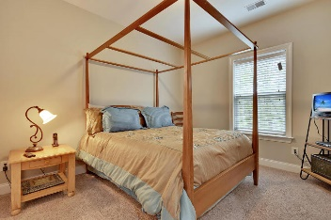
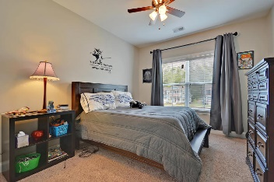
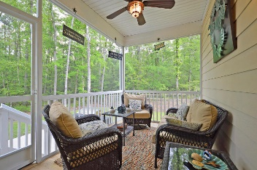
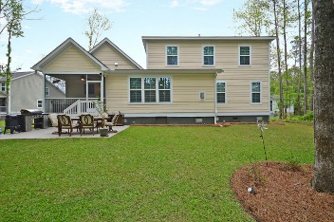

1087 Blockade Runner Parkway River Birch · Summerville, SC 29485 · MLS# 17011189 · $379,900
Loaded with Updates
Just Listed!
GORGEOUS two story 5BR/3.5BA, 3-CAR TANDEM GARAGE home nestled on a quiet cal-de-sac! Features include: great room, dining room, eat-in-kitchen, study, theater room, large covered porch, screened-in porch, oversized professionally landscaped yard, 9' smooth ceilings, handsome hardwood flooring, wainscoting, heavy moldings and abundance of natural light. Gourmet kitchen with granite counter tops, HUGE island, 42'' cabinets, and stainless steel appliances is perfect for creating a chef inspired meal and entertaining. Massive master suite with spa-like master bath including jetted soaking tub, separate vanities, separate tiled 5 zone steam shower, and walk-in closet. Home is only 2 years old and shows like NEW! This home has it all-be the first to see, CALL TODAY!
Stan Huff
843-670-2835 stan.huff@agentowned.com
Jill Marcacci
843-297-5590 jill@agentowned.com
www.agentownedrealty.com
AgentOwned Realty Co. Preferred Group, Inc. | 824 Johnnie Dodds Blvd | Mt Pleasant, SC 29464

